Slide 1
Apprenticeship Funding

Slide 2
Content
Context to apprenticeship reforms
Reforms and the apprenticeship levy
What is the apprenticeship levy?
Paying and using the levy
Latest policy announcements
Reminder of previous announcements
The DAS and Institute for Apprenticeships
What you can do now and next steps

Slide 3
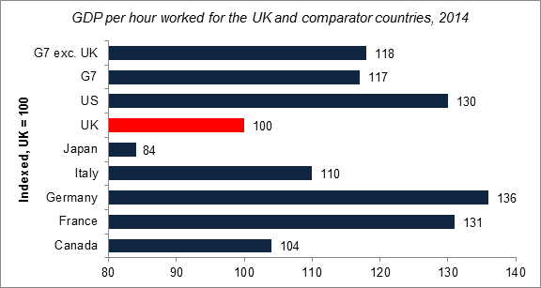
Action is needed to address current economic trends
UK productivity lags behind other developed economies…
… and employers are investing less in training
…and employers are investing less in training
Number of employees who worked fewer hours than usual because they attended a training course away from their workplace
Meanwhile… relative social mobility has stagnated or declined over recent decades
The UK has low levels of intergenerational social mobility compared to some other developed countries
3

Slide 4
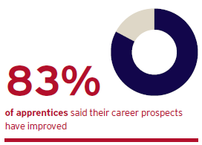
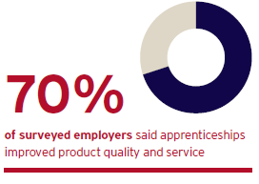
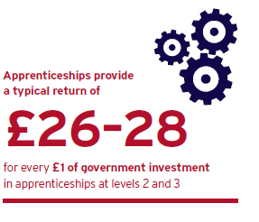
Apprenticeships contribute to addressing these challenges
That’s why the government is committed to significantly increasing the quantity and quality of apprenticeships in England and achieving 3 million starts by 2020.
Benefits
Apprentices complete their apprenticeship with highly marketable skills…
…that make it more likely for them to remain employed, including with the same employer.
Employers experience tangible improvements to their product or service as a result of apprenticeships.
Apprenticeships create real benefits for the taxpayer and the wider economy…
…and contribute to the Government’s overall goal of improving labour market outcomes.

Slide 5
But the programme could be bigger and better
Individual apprenticeships provide good returns, but there is an insufficient number of apprenticeship opportunities to meet demand from individuals, and skills gaps remain in the economy.
Whilst the vast majority of apprenticeships provide high quality training, feedback from employers shows that this is not always the case. We need to continue to drive up the quality of apprenticeship training and ensure that anyone completing an apprenticeship is fully competent in their occupation.
Ambitious Government reforms:
Employers at the heart of designing new Apprenticeships Standards to replace apprenticeship frameworks by 2020.
New Institute for Apprenticeships led by employers to oversee standards and ensure quality and rigour
Apprenticeships given equal legal protection to degrees
Apprenticeship target for public sector bodies – duty for 2.3% of workforce to be apprentices will grow opportunities
Secondary Class 1 NICs abolished for apprentices under the age of 25 since April 2016
All underpinned by changes to how apprenticeships are paid for. New apprenticeship levy paid by 1.3% of employers will fund expansion. Digital Apprenticeship Service will enable employers to directly manage their apprenticeship programmes and purchase training.

Slide 6
Apprenticeship funding in England from May 2017: How the funding changes, including the levy, work

Slide 7
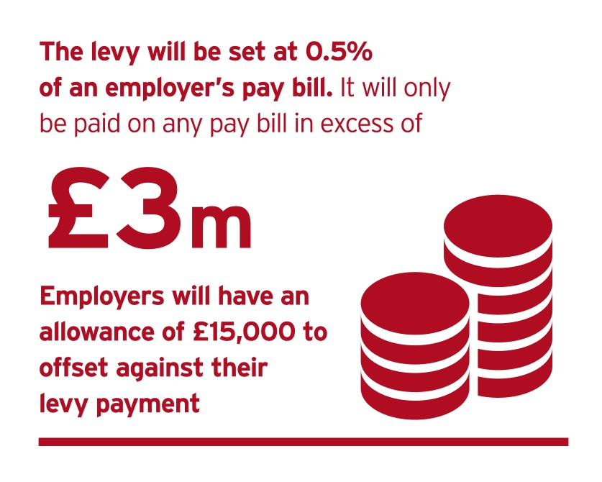
What is the apprenticeship levy and who pays it?
Starts on 6 April 2017, at a rate of 0.5% of pay bill, paid through PAYE
Applies to all UK employers in all sectors
£15,000 allowance is not a cash payment
Only 1.3% of employers will pay the levy

Slide 8
What about non levy payers? Co-Investment
There are two types of employers who will be benefit from government support towards the cost of their apprenticeships training:
Employers who haven’t paid the levy and want to purchase apprenticeship training from a provider
A levy-paying employer who with insufficient funds in their digital account to pay for the cost of training and assessment they want to purchase
The government will pay 90% of the costs of training and assessment.
The employer will be responsible for paying 10% of the costs.

Slide 9
Paying the levy
Employers pay their levy to HMRC, through the PAYE process
Single employers with multiple PAYE schemes will only have one allowance.
Connected employers share one allowance
LEVIED EMPLOYER
NON-LEVIED EMPLOYER
Employer of 250 employees, each with a gross salary of £20,000.
Pay bill: 250 x £20,000 = £5,000,000
Levy sum: 0.5% x £5,000,000 = £25,000
Allowance: £25,000 - £15,000 =
£10,000 annual levy payment
Employer of 100 employees, each with a gross salary of £20,000.
Pay bill: 100 x £20,000 = £2,000,000
Levy sum: 0.5% x £2,000,000 = £10,000
Allowance: £10,000 - £15,000 =
£0 annual levy payment

Slide 10
Accessing levy funds to spend on training
Levy funds will be available through a new digital service on gov.uk
First funds appear in account in late May 2017
How funds in the account will be calculated
If 100% of pay bill is paid to employees living in England | 100% of levy payment in digital account
If 80% of pay bill is paid to employees living in England | 80% of levy payment in digital account
10% government top up to monthly funds entering an account

Slide 11
Purchasing training – both groups
New funding system comes into effect on 1 May 2017
Apprenticeships started before 1 May will be funded through to completion according to the existing rules
Levied employers buying training from May 2017
Can commit to apprenticeship starts from the beginning of May
Funds will automatically leave the digital account on a monthly basis
The cost will be spread over the lifetime of the apprenticeship
We will hold back 20% of the total cost, to be paid on completion of the apprenticeship.
Non-levied employers buying training from May 2017
Continue to make payments direct to providers
Move onto the digital system at a later date

Slide 12
What can funds be used for?
Digital funds and government funding can be used for: |  | Digital funds and government funding can not be used for
apprenticeship training and assessment against an approved framework or standard with an approved training provider and assessment organisation up to the funding band maximum for that apprenticeship |  | wages travel and subsistence costs managerial costs traineeships work placement programmes the costs of setting up an apprenticeship programme

Slide 13
How the funding system will work
10% Top up
Levy paying employer
HMRC collect levy (PAYE)
Employer views funds in digital account to spend in England
Employs apprentice and commits to training
Receives training for apprentice
Payments to providers taken from digital account
Unused funds expire after 24 months
Employs apprentice and commits to training
Receives training for apprentice
Employer pays for proportion of cost direct to training provider
SFA pays govt proportion of costs to the training provider
Non-levIED employer
Registers with SFA
Commits to provide apprenticeship training
Provides training to apprentice
Provides info via ILR to SFA that training has taken place & that employer has made contribution
Paid by SFA and balance by employer
Training Provider
Pass data on levy payments from HMRC to DfE
Timely data on training
Check training is complete
If funding unlocked: pay provider
Government
Employer and Provider Identity Assurance

Slide 14
Apprenticeship funding in England from May 2017: Funding rules

Slide 15
Key changes since August
In August, we published our proposals for apprenticeship funding. Since then, we have been listening to employers, training providers and other stakeholders to help us develop our final position. The adjustments we have made will help ensure that the reforms benefit more employers and apprentices.
Proposals in August | Final funding policy
Expiration of digital funds after 18 months | Extended to 24 months – helping employers to prepare for the new system and to adapt training programmes
Support for 16-18 year old apprentices - £1000 payment to employers and training providers | Retaining the £1000 payments plus extra government funding to provide a transitional 20% uplift for providers training 16-18 year olds on a framework. Also applies to 19-24 year olds formerly in care or have a Education and Health Care plan
Removal of disadvantage uplift | Retain a simplified version of current system for one year to support those from disadvantaged areas whilst review best way to support disadvantaged groups

Slide 16
Funding bands
Number | Band limit
1 | £1,500
2 | £2,000
3 | £2,500
4 | £3,000
5 | £3,500
6 | £4,000
7 | £5,000
8 | £6,000
9 | £9,000
10 | £12,000
11 | £15,000
12 | £18,000
13 | £21,000
14 | £24,000
15 | £27,000
Every apprenticeship will be placed in a funding band The upper limit of each funding band will cap the maximum:
amount of digital funds an employer who pays the levy can use towards an individual apprenticeship.
that government will ‘co-invest’ towards, where an employer does not pay the levy or has insufficient digital
Employers can negotiate the best price for the training they require
If employers want to spend more than the funding band limit, using their own money, then they will be free to do that.
Funding bands do not have a lower limit.

Slide 17
Funding bands for frameworks
We will allocate each individual framework pathway to:
the nearest funding band based on the current rate of funding the government pays providers for training adult apprentices but with some extra support…
16-18 uplift
Transitional support of 20% of funding band maximum paid directly to training providers
Also applies to 19-24 year olds formerly in care or have Education and Health Care plan
STEM Support
For all STEM framework pathways we will increase the current government-funded adult rate by 40% at Level 2 and 80% at Level 3 and above, and then allocate these frameworks to the nearest funding band.
Additional support in areas of disadvantage
Training providers receive:
An additional £600 for training an apprentice from top 10% of deprived areas, £300 for next 10% range and £200 for the next 7% range

Slide 18
Funding bands for standards
Apprenticeship standards are employer-designed and offer employers and apprentices a more robust and relevant training experience.
Recognised in the funding system by allocating higher funding bands to apprenticeship standards, relative to equivalent frameworks, where appropriate.
Existing apprenticeship standards have been allocated to new funding bands according to the following principles:
Principles
Lower cost standards should be allocated to the nearest funding band
Those standards currently assigned to the widest and highest cost funding band will be allocated to a new band within this range. Taking into account:
Actual prices employers have negotiated with providers.
Evidence from Trailblazer employers on the estimated costs eligible apprenticeship training
The funding bands set for equivalent frameworks
The level and nature of the training, and consistency across similar types of apprenticeship standard.

Slide 19
WITHIN THE FUNDING BAND LIMIT
OVER THE FUNDING BAND LIMIT
Funding limits– how they work
Example funding band limit = £6,000
Price you negotiate with your training provider = £5,000
The cost is within the funding band limit
Example funding band limit = £6,000
Price you negotiate with your training provider = £7,500
The cost is above the funding band limit
With enough funding in your account
Without enough funding in your account
With enough funding in your account
Without enough funding in your account
£5,000 will be deducted from your digital account over the life of the apprenticeship.
If you have £0 in your account we will pay 90% (£4,500) and you will need to pay 10% (£500).
If you have digital funds available, these will be used first, and then we will pay 90% of the remaining costs, and you will pay 10%.
£6,000 will be deducted from your digital account over the life of the apprenticeship.
You will be responsible for paying £1,500. This payment can’t be made from your digital account
If you have £0 in your account we will pay 90% (£5,400) and you will need to pay 10% (£600). This is the maximum payable within the limit of the band.
You will also be responsible for paying the additional £1,500. This payment can’t be made from your digital account

Slide 20
Additional support
16-18 year olds
Government will pay £1,000 to employers, and a further £1,000 to training providers if they train a 16-18 year old apprentice
Disadvantaged young people
Government will pay £1,000 to employers, and a further £1,000 to training providers if they train 19-24 year olds leaving care or who have a Local Authority Education and Healthcare plan
Small Employers
Employers with fewer than 50 employees will have 100% of the training and assessment costs covered when training a 16-18 year old (or 19-24 year old formerly in care or has a Local Authority Education, Health and Care plan
Additional learning support
We will pay training providers up to £150 a month to support these learners, plus additional costs based on evidenced need
English and Maths training
To meet minimum standards of English and maths we will pay training providers £471 for each of these qualifications (Level 1 and 2)

Slide 21
Funding rules
Cross-border funding
Applying a single test for funding through the English system: based on whether the apprentice’s main place of employment is England.
‘Workplace’ is where the apprentice is expected to spend the majority of their time during their apprenticeship.
Prior qualifications
Now and in the future, you can train any individual to undertake an apprenticeship at a higher level than a qualification they already hold.
From May 2017, an individual can be funded to undertake an apprenticeship at the same or lower level to acquire substantive new skills
Transferring funding
During 2018 we will introduce means for employers to transfer up to 10% of the levy funds to another employer with a digital account, or to an ATA.
New employer steering group to design this system so that it meets their needs

Slide 22
Apprenticeship funding in England from May 2017: Supporting the reforms

Slide 23
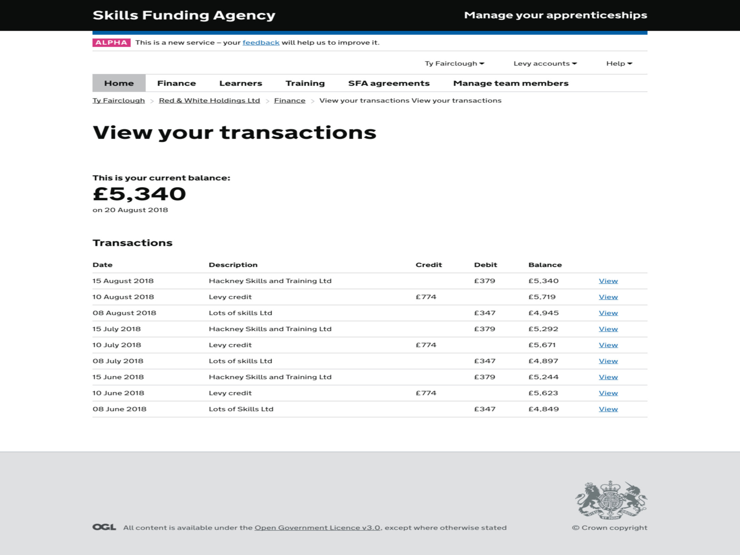
Wider reforms - DAS

Slide 24
Wider reforms - Institute for Apprenticeships
An independent employer-led body that will regulate the quality of apprenticeships, set up by April 2017 (shadow form with effect from 2016)
An independent Chair will lead a small Board comprised primarily of employers, business leaders and their representatives.
Anthony Jenkins appointed as Shadow Chair and Peter Lauener as Shadow Chief Executive
Outline role:
Approve/reject Expressions of Interest, standards and assessment plans
Provide advice and guidance during their development
Maintain a public database of apprenticeship standards and publish information illustrating potential gaps
Advise on the maximum rate of Government funding that should be assigned to each standard

Slide 25
What you can do now
Read further – go to https://www.gov.uk/government/collections/apprenticeship-changes
Plan your apprenticeship spending - https://estimate-my-apprenticeship-funding.sfa.bis.gov.uk/
Check out the draft regulations for the calculation, payment and recovery of the Apprenticeship Levy - https://www.gov.uk/government/publications/draft-legislation-regulations-for-the-calculation-payment-and-recovery-of-the-apprenticehip-levy

