Slide 1

15th January 2026
Business Rates for Charities
ANNUAL UPDATE
18 months of a Labour Government and 2026 Rating Revaluation
JOHN WEBBER – HEAD OF RATING - COLLIERS

Slide 2


Agenda
Business Rates in the UK
18 months in how is it going ?
Revaluation – Draft list headlines and budget update
Issues specific to charities – recent cases
What to expect in the next 3 years
Questions
1
COLLIERS RATING | BUSINESS RATES FOR CHARITIES |

Slide 3
Business Rates in the UK
BUSINESS RATES IN THE UK
What are Business Rates? A national levy on non-domestic property, collected by local authorities. Business Rates are calculated based upon a Rateable Value
What is a Rateable Value? The rental value of the assessment as agreed between a hypothetical landlord and tenant at the Antecedent Valuation Date (which is currently 1st April 2021 in England)
When did the current 2023 Rating List start? 1st April 2023
When is the start of the next Rating List? 1st April 2026 – AVD 1st April 2024 – 2025 in Scotland
How are rates calculated? The RV x the annual rate poundage. This is currently 55.5p or 49.9p depending on the size of the RV. The rate poundage changes in accordance with the CPI in September of each year. The new rate year begins on 1st April.
Business Rates collected in 2025/26 £33.60 Billion
Business Rates collected in 2026/27 £37.10 Billion (10.2%)
Business Rates collected in 2030/31 (OBR) £42.00 Billion (25%)

Slide 4
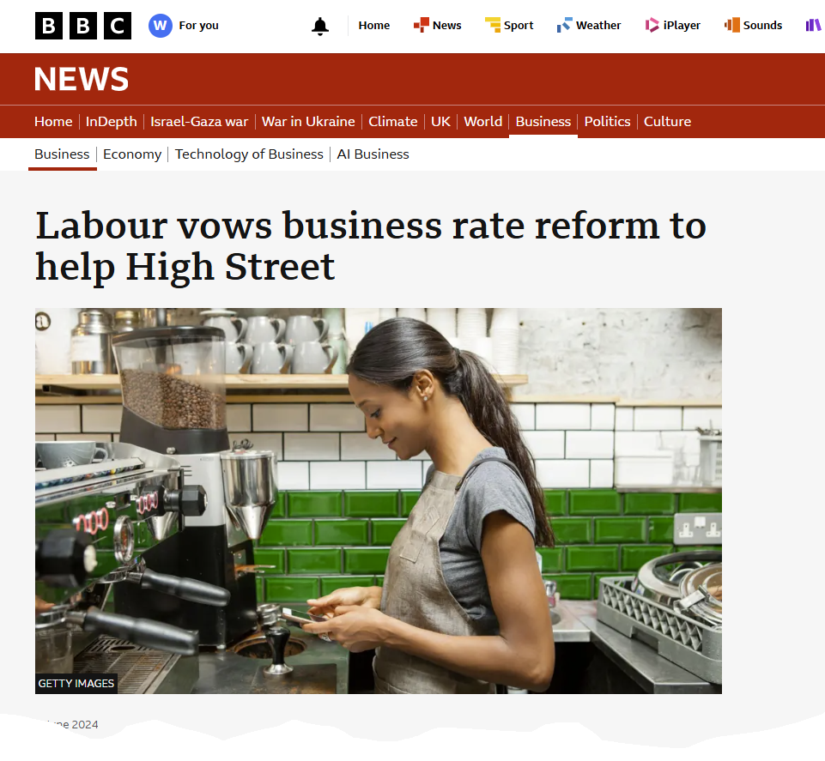

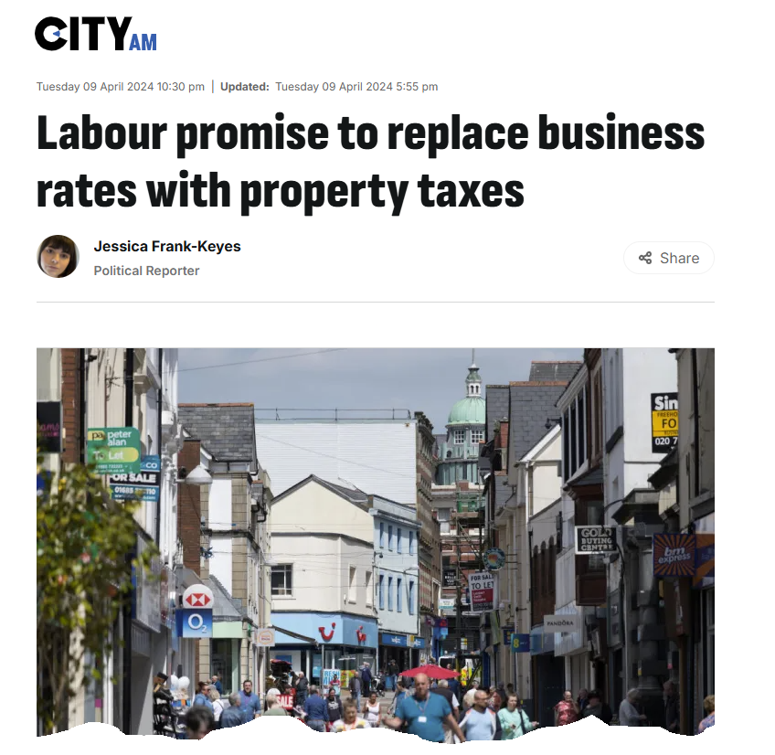
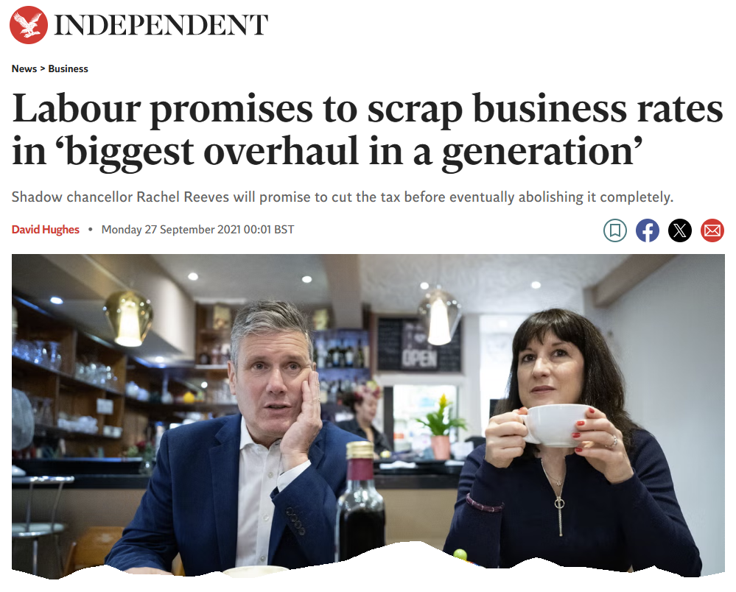
What they promised on Business Rates…
18 MONTHS OF A LABOUR GOVERNMENT – HOW IS IT GOING?

Slide 5
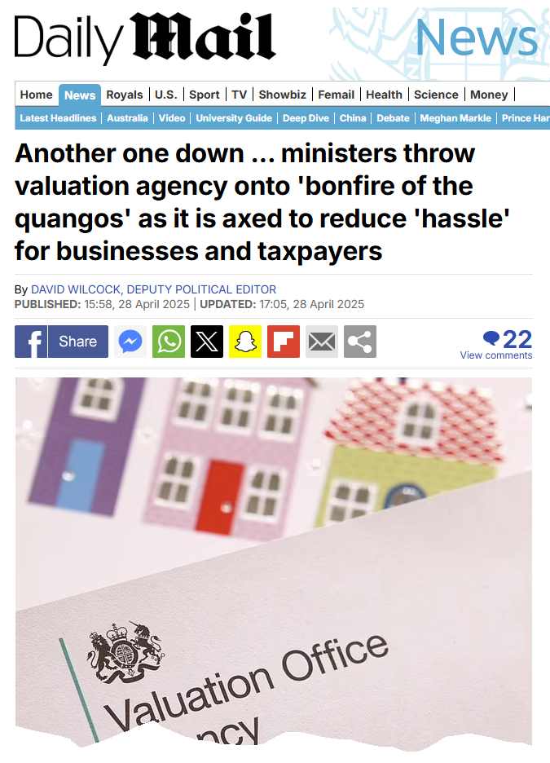

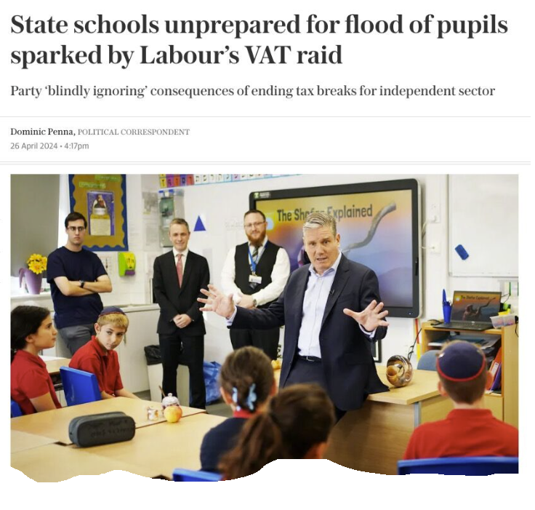
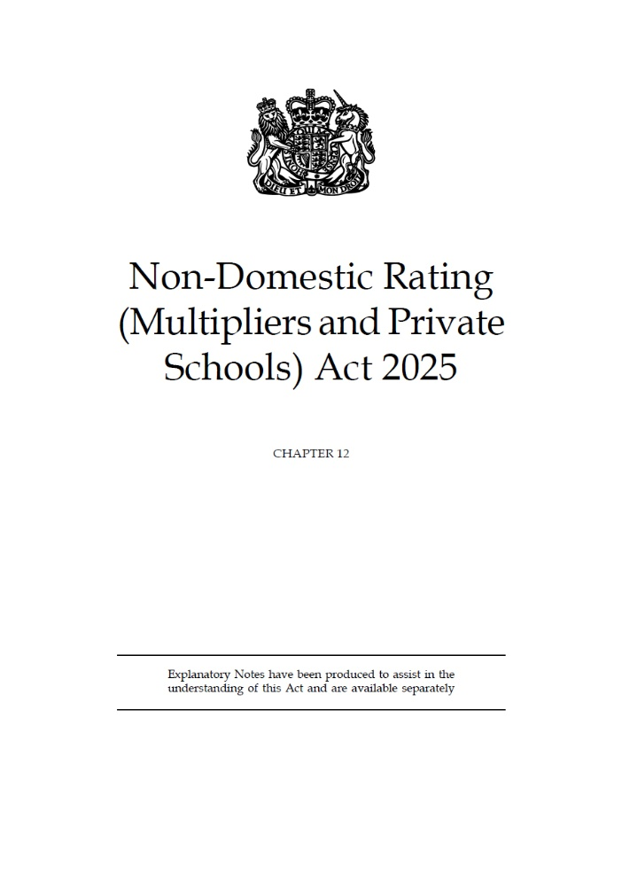
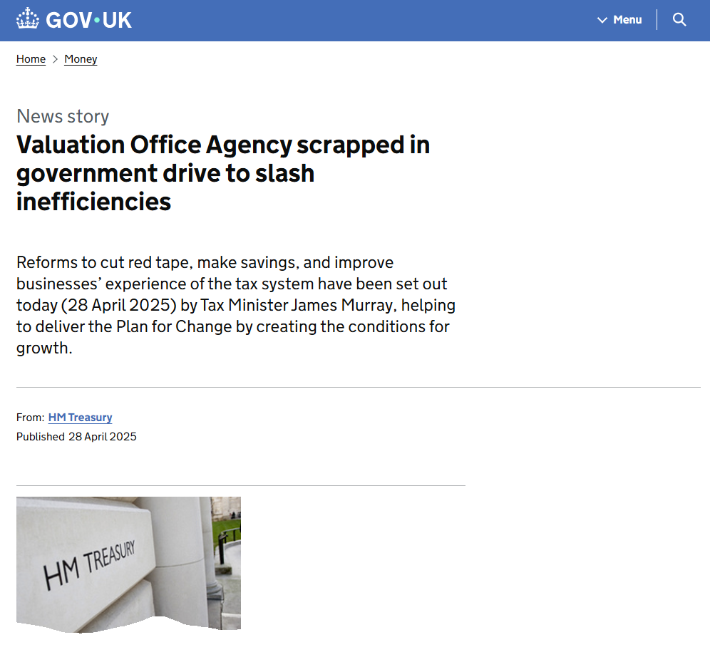
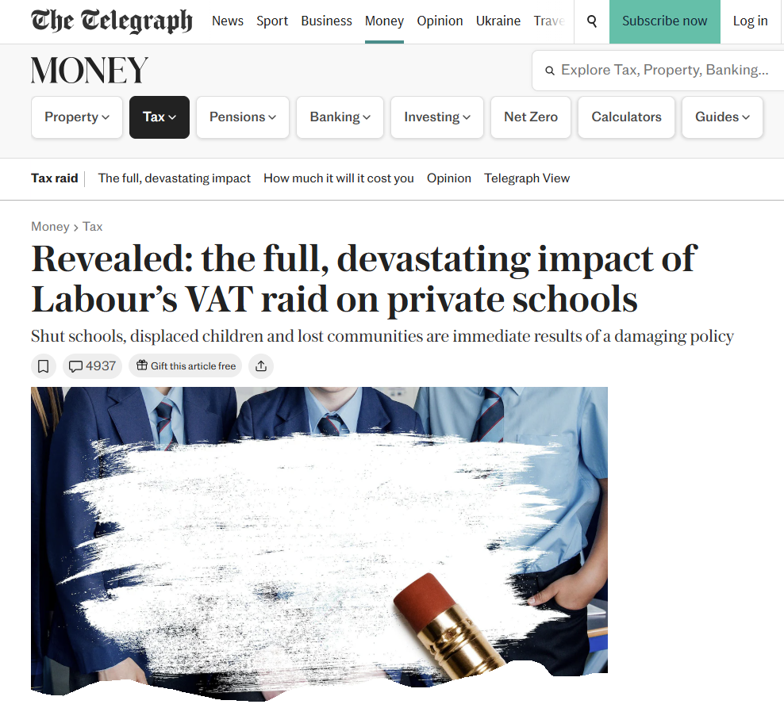
What they delivered…
18 MONTHS OF A LABOUR GOVERNMENT – HOW IS IT GOING?

Slide 6
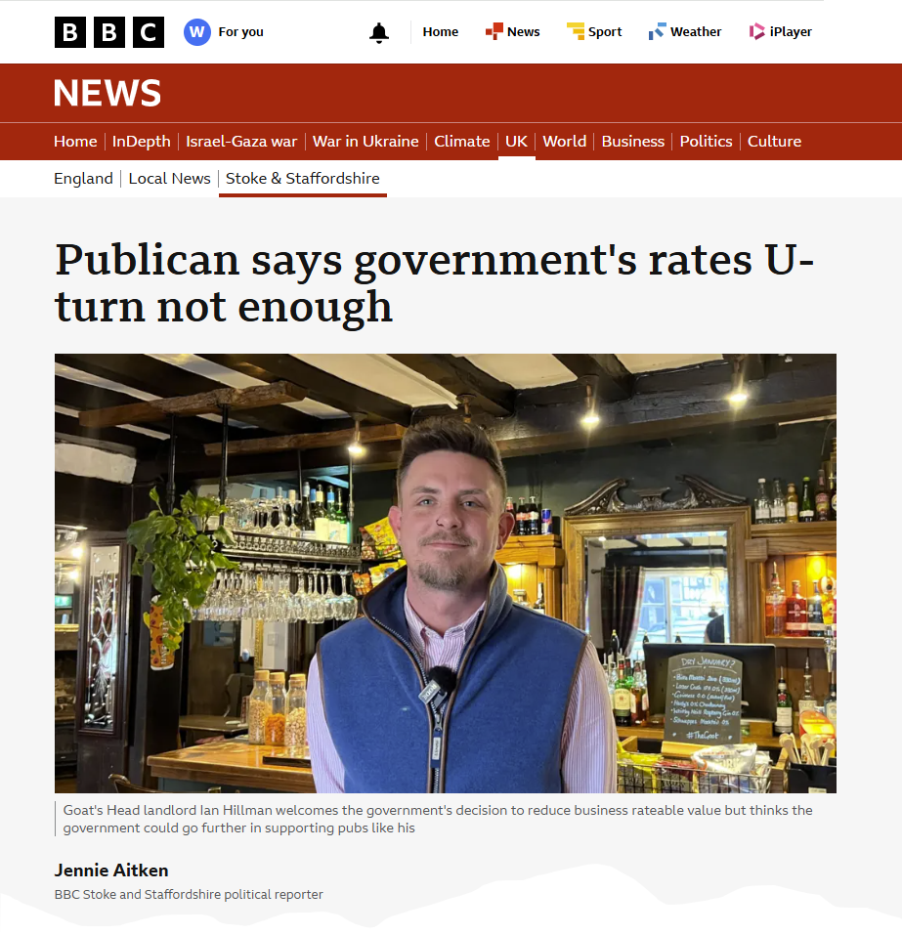
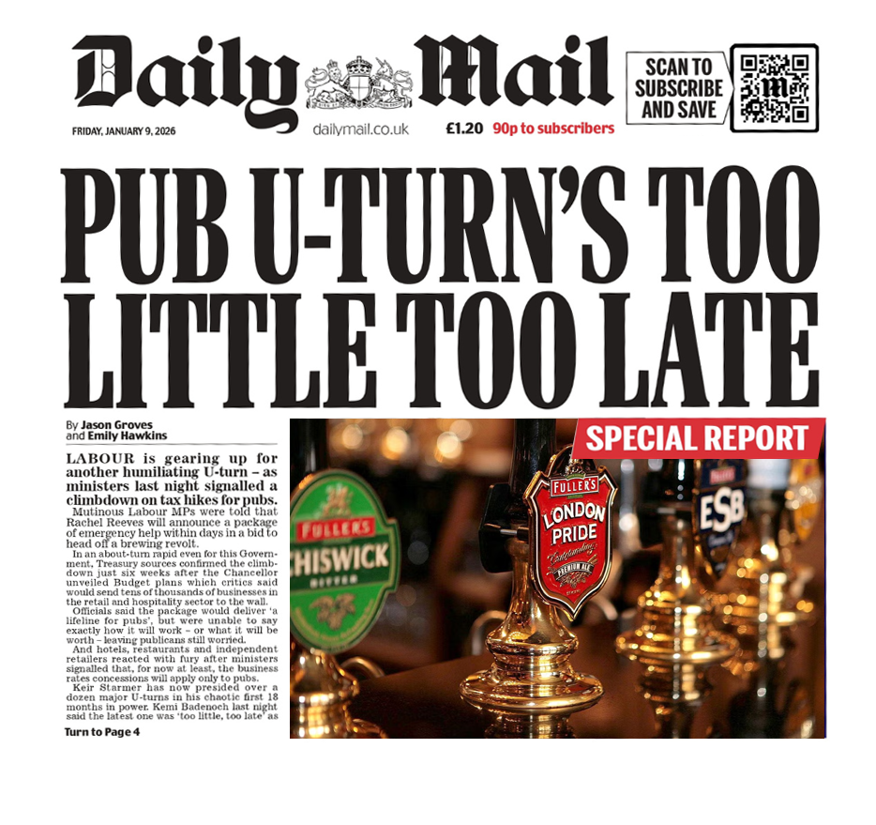
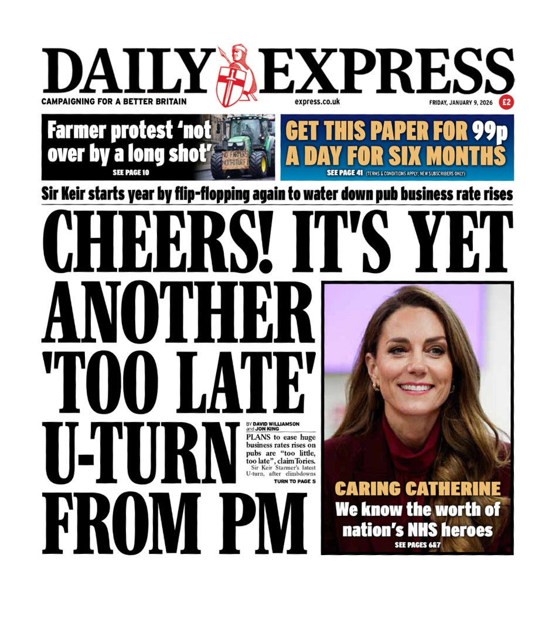

What they delivered…
18 MONTHS OF A LABOUR GOVERNMENT – HOW IS IT GOING?

Slide 7
CCA – how are things going
18 MONTHS OF A LABOUR GOVERNMENT – HOW IS IT GOING?
Challenges against the England 2023 rating list by case status and month
In the latest quarter (April to June 2025), 7,020 Challenges were registered, up from 6,160 the quarter before and 2,550 Challenges were resolved, up from 2,460 the quarter before. Challenges take longer to clear as it is necessary to exchange and discuss evidence with ratepayers. There is a statutory deadline of 18 months to clear Challenge cases.
2,800
Resolved
Registered
2,400
2,000
1,600
Number of CCA Registrations
1,200
800
400
0
A
M
J
J
A
S
O
N
D
J
F
M
A
M
J
J
A
S
O
N
D
J
F
M
A
M
J
2023
2024
2025
Source: Checks, Challenges and Changes against the 2023 local rating list, England, Table EW23_3_2

Slide 8
CCA – how are things going
18 MONTHS OF A LABOUR GOVERNMENT – HOW IS IT GOING?
Resolved CCA cases by case type and outcome against the England 2023 NDR list
The chart compares the proportion of resolved Check and Challenge cases which resulted in a rateable value (RV) increase, decrease, or no change.
For Checks, 71% result in no change to RV, 26% result in a decrease and 3% result in an increase to RV.
For Challenges, 39% result in no change to RV, 60% result in a decrease and 0.6% result in an increase to RV.
For Appeals, 46% result in no change to RV, 54% result in a decrease and 0% result in an increase to RV.
100%
3%
1%
26%
80%
60%
54%
60%
Increase
Decrease
Number of CCA Registrations
No Change
40%
71%
20%
39%
46%
0
Checks
Challenges
Appeals
Source: Checks, Challenges and Changes against the 2023 local rating list, England, Table EW23_4_1

Slide 9
CCA – how are things going
18 MONTHS OF A LABOUR GOVERNMENT – HOW IS IT GOING?
Progress – Tsunami coming?
The graph shows that 162,440 Checks were registered in England since the start of the 2023 rating list (1 April 2023 to 30 June 2025). Of these, 145,120 were resolved, and 17,330 remained outstanding.
Some of the resolved Checks will progress to Challenges and as such, 35,910 Challenges were registered since the start of the 2023 rating list (1 April 2023 to 30 June 2025). Of these, 9,340 were resolved, 6,410 were marked incomplete (does not contain all the detail required in legislation) and 20,160 remained outstanding.
180,000
160,000
Resolved
Outstanding
Incomplete
140,000
120,000
100,000
Number of CCA Registrations
80,000
60,000
40,000
20,000
0
Checks
Challenges
Source: Checks, Challenges and Changes against the 2023 local rating list, England and Wales, Table EW23_1_1

Slide 10

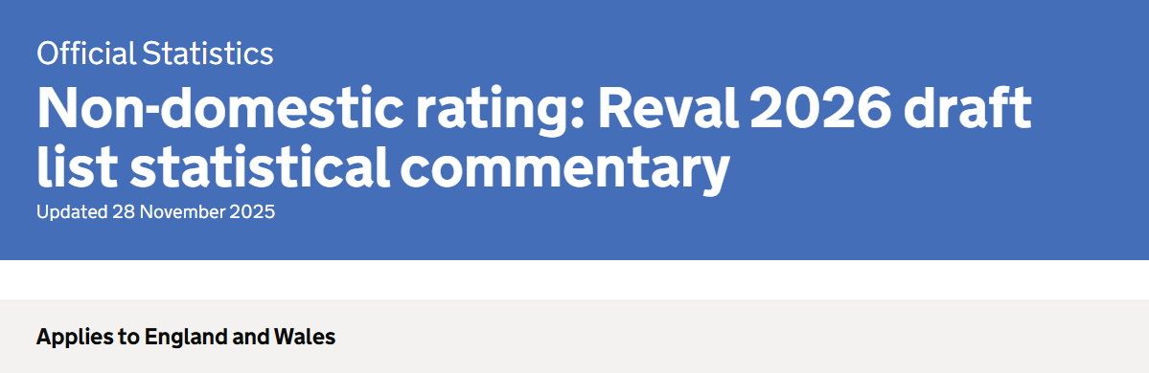
REVALUATION – DRAFT LIST HEADLINES AND BUDGET UPDATE

Slide 11
1. Headline figures
REVALUATION – DRAFT LIST HEADLINES AND BUDGET UPDATE
The 2026 revaluation has shown an increase in the total rateable value across England and Wales.
1.1. Local list
There were 2.13 million properties on the 2026 draft list in England and Wales as of 16 November 2025.
The total rateable value of these properties was £84.4 billion compared with £70.8 billion on the 2023 rating list.
Total rateable value on the local lists for England and Wales increased by 19.2%.
Total rateable value for England increased by 19.4%.
Total rateable value for Wales increased by 15.2%.
In addition:
Rateable value in the London region saw the largest percentage increase of any region in England, with an increase of 22.3%.
Rateable value in the East Midlands region saw the smallest percentage increase of any region in England, with an increase of 16.0%.
Rateable value increased in all sectors across England and Wales at revaluation, with the largest percentage increase in the other sector, with an increase of 28.2%.
The retail sector saw the smallest percentage increase of any sector across England and Wales, with an increase of 9.3%.

Slide 12
2. Total rateable value by sector
REVALUATION – DRAFT LIST HEADLINES AND BUDGET UPDATE
This section compares the total rateable value on the 2023 local rating list and the draft 2026 local rating list for each sector in England and Wales.
Figure 1
Total rateable value on the 2023 and 2026 rating lists by sector, England
2023 Rating list
2026 Rating list
Retail Sector
Figure 1 shows the total rateable value (£billions) in England on the 2023 local rating list and the 2026 draft list for each sector. All sectors in England showed an increase in total rateable value in the 2026 draft list compared with the 2023 list.
Industry Sector
Office Sector
Source: NDR Revaluation 2026 draft list (Table RVL_4_2)
Other Sector
0
5
10
15
20
25
30
Total Rateable Value (£bn)

Slide 13
2. Total rateable value by sector (cont.)
REVALUATION – DRAFT LIST HEADLINES AND BUDGET UPDATE
Figure 2
Total rateable value on the 2023 and 2026 rating lists by sector, Wales
2023 Rating list
2026 Rating list
Retail Sector
Figure 2 shows the total rateable value (£billions) in Wales on the 2023 local rating list and the 2026 draft list for each sector. All sectors in Wales showed an increase in total rateable value in the 2026 draft list compared with the 2023 list.
Industry Sector
Office Sector
Source: NDR Revaluation 2026 draft list (Table RVL_4_2)
Other Sector
0
0.2
0.4
0.6
0.8
1.0
1.2
Total Rateable Value (£bn)

Slide 14
3. Percentage change in rateable value by sector
REVALUATION – DRAFT LIST HEADLINES AND BUDGET UPDATE
Figure 3
Percentage change in rateable value between 2023 and 2026 rating lists by sector, England and Wales
England
Wales
All Sectors
Figure 3 shows the percentage change in rateable value between the 2023 rating list and the draft 2026 rating list for each sector as well as for all sectors in England and Wales. Across all sectors, England showed a larger percentage increase than Wales.
Retail Sector
Industry Sector
Source: NDR Revaluation 2026 draft list (Table RVL_1_1)
Office Sector
Other Sector
0
5
10
15
20
25
30
% Change in Rateable Value

Slide 15
4. Total rateable value by region
REVALUATION – DRAFT LIST HEADLINES AND BUDGET UPDATE
This section compares the total rateable value on the 2023 local rating list and the draft 2026 local rating list for each region in England and Wales.
2023 Rating list
2026 Rating list
Figure 4
Total rateable value on the 2023 and 2026 rating lists for English regions and Wales, all sectors
North East
North West
Figure 4 shows the total rateable value (£billions) from the 2023 local rating list and the 2026 draft local rating list for each region in England and Wales.
Yorks. & Humber
East Midlands
West Midlands
East
London
Source: NDR Revaluation 2026 draft list (Table RVL_2_1)
South East
South West
Wales
0
5
10
15
20
25
30
Total Rateable Value (£bn)

Slide 16
5. Percentage change in rateable value by region
REVALUATION – DRAFT LIST HEADLINES AND BUDGET UPDATE
This section shows the percentage change to rateable value between the 2023 local list and 2026 draft local list, by region.
Region
Nation
Figure 5
Percentage change in rateable value between 2023 and 2026 rating lists by region and nation, England and Wales, all sectors
London
South East
England
Figure 5 shows the percentage change in rateable value between the 2023 rating list and the draft 2026 rating list for each region in England and Wales. The largest percentage change to rateable value was in London, at 22.3%. The smallest change was Wales, at 15.2%. The region in England with the smallest change was East Midlands, at 16.0%.
North West
England & Wales
East
Yorks. & Humber
South West
North East
West Midlands
Source: NDR Revaluation 2026 draft list (Table RVL_1_1)
East Midlands
Wales
0
5
10
15
20
25
% Change in Rateable Value

Slide 17
New multipliers (England only)
REVALUATION – DRAFT LIST HEADLINES AND BUDGET UPDATE
 | 2025/26 | 2026 onwards | With 1p TR Supplement
Small Business Non-Domestic Rating Multiplier (RV < £51,000) | 0.499 | 0.432 | 0.442
RHL Non-Domestic Multiplier (RV < £51,000) | - | 0.382 | 0.392
RHL Non-Domestic Multiplier (RV >= £51,000 to <£500,000) | - | 0.430 | 0.440
RHL Non-Domestic Multiplier (RV >= £51,000 to <£500,000) | 0.555 | 0.480 | 0.490
Higher Multiplier (RV >= £500,000) | 0.555 | 0.508 | 0.518

Slide 18
Transitional Relief
REVALUATION – DRAFT LIST HEADLINES AND BUDGET UPDATE
If your bill is increasing from 1 April 2026 to 31 March 2029
 | 2026 to 2027 | 2027 to 2028 | 2028 to 2029
Up to £20,000 (£28,000 in London) | 5% | 10% plus inflation | 25% plus inflation
£20,001 (£28,001 in London) to £100,000 | 15% | 25% plus inflation | 40% plus inflation
Over £100,000 | 30% | 25% plus inflation | 25% plus inflation

Slide 19

Specific issues for charities
SPECIFIC ISSUES FOR CHARITIES
Recent cases that may be of interest
Private Schools no longer entitled to mandatory relief 80% from 1 April 2025
London Borough of Merton Council v Nuffield Health [2023] UKSC 18
Charities and Rates Mitigation – Scotland/Wales and England !
Business Rates and Investment Government Consultations 18th February 2026
18
COLLIERS RATING | BUSINESS RATES FOR CHARITIES |

Slide 20

What should ratepayers be preparing for and what actions do they need to take
WHAT SHOULD YOU BE DOING IN THE NEXT FEW WEEKS / MONTHS
2023 Rating List has hardly started – Check, Challenge and Appeal
2026 Draft List – 2 month window to influence
Check the Rates Bill in March – lots of new multipliers !
2029 AVD is 16 months away
Duty To Notify
Rogue Agents – beware !
19
COLLIERS RATING | BUSINESS RATES FOR CHARITIES |

Slide 21

Thank you
20
COLLIERS RATING | BUSINESS RATES FOR CHARITIES |

