Slide 1
CTG Expert Insight Session:
Salary Sacrifice and Electric Vehicles
14 September 2022
#charitytax

Slide 2
Charity Tax Group Expert Insight
14 September 2022

Slide 3
Salary exchange/sacrifice
Nick Bustin
Director of Employment Tax
nbustin@haysmacintyre.com
0207 969 5578

Slide 4
General overview
Salary exchange is a tax efficient method for providing ‘favoured’ benefits to employees
There is a requirement for the employee to agree to a variation in their employment contract
The employee agrees to give up part of their salary in exchange for the provision of the benefit
Be aware of the Optional remuneration arrangements (‘OpRA’) legislation which came into effect from 2017
Where OpRA applies a tax charge arises on the greater of:
The value of the benefit provided; or
The salary sacrificed

Slide 5
Favoured benefits
Examples of favoured benefits include:
Pension contributions
Cycle to work schemes
Additional holiday
Electric vehicles (‘EV’)
Many employers are looking at their salary exchange arrangements to help:
Employees save for their retirement
Address some of the cost of living issues being raised by employees
Support the employer’s ‘green agenda’

Slide 6
The future is electric!
Government’s green agenda
100% zero emissions by 2035
Changing car fleet profiles
Increase in EV sales
The ability to provide cars tax efficiently

Slide 7
Benefit comparissons
Car benefit calculation
List price plus optional extras
Multiplied by the percentage appropriate for the CO2 rate for the car
Currently EV rates of up to 2% compared with a maximum ‘fossil fuel’ rate of 37%
Car fuel benefit
Electricity is not considered as being fuel for car fuel benefit purposes
The benefit for fossil fuel cars are based on
£25,000 x car benefit percentage (maximum £9,361)
Business mileage can be repaid at 5 pence per mile.

Slide 9
Charity Tax Group Expert Insight Session - Electric Vehicles
September 2022

Slide 10
Today’s agenda
Consumer schemes overview
Novalease v Car Salary Exchange
Key Benefits (Employer/Employee)
Questions
Is there anything specific not above which is a priority today?

Slide 11
Consumer schemes overview

Slide 12
SG Fleet Consumer schemes
Salary Sacrifice based on Business Contract Hire
The only truly independent Car Benefit Provider
Salary Sacrifice based on Personal Contract Hire
Increased employee retention
Extremely low / zero administration options available
In-house marketing team support
SSO option
Over 100 live schemes
Used car provision
Personal leases direct with employees

Slide 13
Method Overview
Contract with
In life admin
Risk structure included
BIK benefits & cost
Regulated
Employee
None
No
No
Yes
Employer
Fines, payroll adjustments,
out of contract charges
Yes
Yes
No
Employee
Payroll adjustments
Yes
Yes
Yes
Zero administration
Extremely quick and easy to implement
Open to all employees – not exclusionary
Takes advantage of HMRC approved mechanism
Scheme savings can be made
Operates very similar to existing company car methodology
Takes advantage of HMRC approved mechanism
Scheme savings can be made
Completely de-risked
Contract is between employee and sgfleet

Slide 14
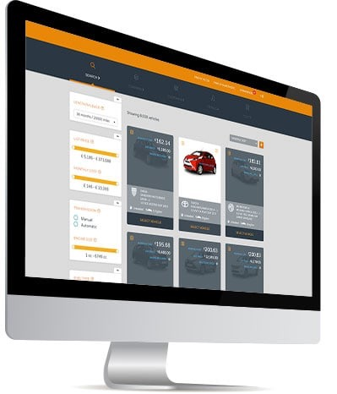
Novalease v Car Salary Exchange
Novalease | Car Salary Exchange
Uniquely based on personal leases | Based on Corporate business Hire
No cost or risk to your company/minimum administration | Slightly more Employer risk/admin
No need for corporate credit facilities | Requirement for corporate credit facilities
Affordability based on Employee credit check/NMW check | Affordability based on NMW check only
FCA regulated, providing full consumer rights to employees | Non regulated
Robust Employee risk structure included | Robust Employee risk structure included

Slide 15
Employer benefits
Benefit provision with mitigated risk
Lowest admin available in the market
Increased retention.
De novation/
termination rate is sub 0.5%
Contribution to CSR policy
Can explore onsite charging station inclusion as part of partnership
Link off intranet or benefits site
Employer NI savings

Slide 16
Employee benefits
Cost effective routes to a new car (90% take up is electric)
Low hassle charge and go
Trusted partner/ source of the second largest expense they have
Access to special offers
Choice of payroll deduction or paying via DD depending on scheme/ salary
Robust risk structure
Mileage management during contract
Corporate & Tax/NI savings

Slide 17
Any Questions?

