Slide 1
Payroll Giving
Mervi Slade, Product & Programme Manager – Payroll Giving
Cancer Research UK
2023

Slide 2
What is Payroll Giving?
Payroll Giving lets you give tax-free donations through your pay as a one-off or each payday.
You can give any amount, to any number of charities, all without handing over any bank details.
Your donation | Cost to 20% tax payer | Cost to 40% tax payer | Cost to 45% tax payer
£10 | £8 | £6 | £5.50
£25 | £20 | £15 | £13.75
£50 | £40 | £30 | £27.50
Notes:
What is Payroll Giving?
Payroll Giving lets you give tax-free donations through your pay each payday. You can give any amount, to any number of charities, all without handing over any bank details.
Payroll Giving originated as a government scheme, which allows anyone who earns a salary to give to charity directly from their pay.
Because the gift is taken out before tax, it means that Payroll Giving is the most efficient way to give for higher earners.
Deductions/payments are taken pre-tax, but after National Insurance.

Slide 3
Payroll Giving Month
Launched in 2021 as Payroll Giving Week
Sector initiative that came from Payroll Giving Forum
Creating a moment for Payroll Giving similar to Remember a Charity week
Charities, PGAs, PFOs, CIoF and CIPP working together
Idea is to raise awareness of the scheme with charities, employers and employees
Webinars organised for charities and employers leading to the month
Social media focused to start with due to lockdowns, but more workplace activities (F2F campaigns) expected this year
Payroll Giving Month video
Please share content on social media!

Slide 4
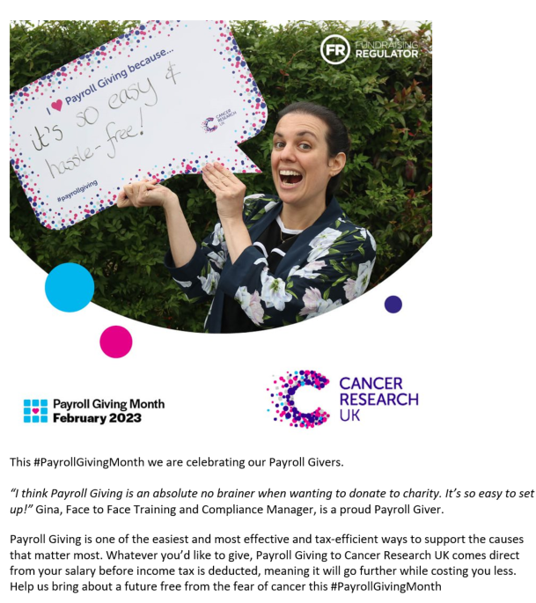
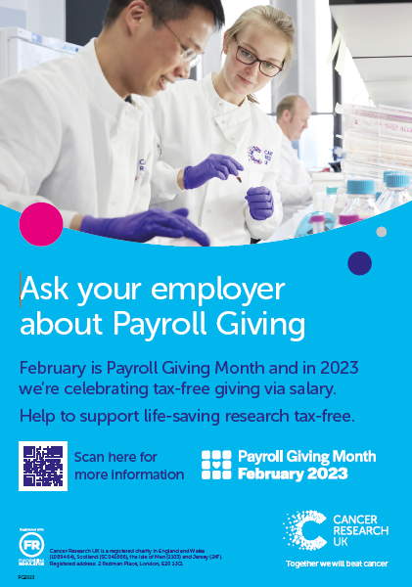
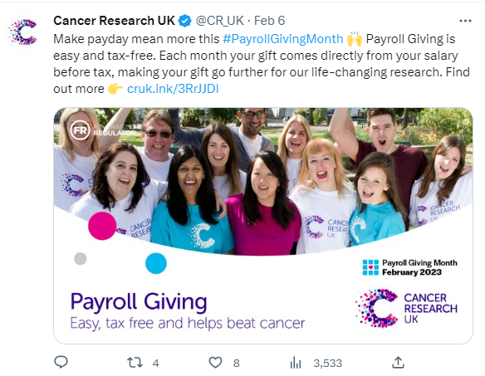
CRUK activities during Payroll Giving Month
Posters on display in charity shops
Social media posts (Linkedin, Twitter and Instagram) including £5k in paid advertising
Instagram posts show CRUK staff members and their quotes on why they give via Payroll Giving
Regional fundraising and Legacies having conversations with supporters
Internal comms in CRUK Weekly as well as Yammer posts

Slide 5
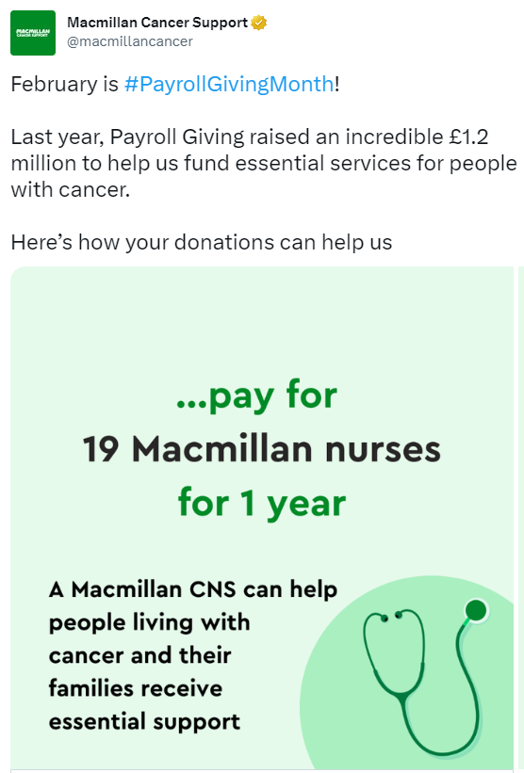
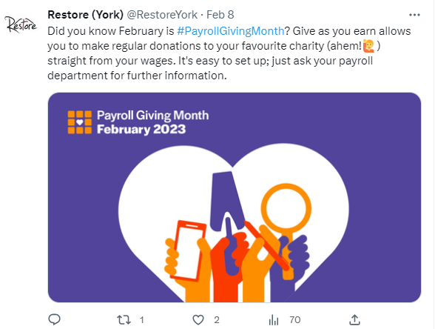
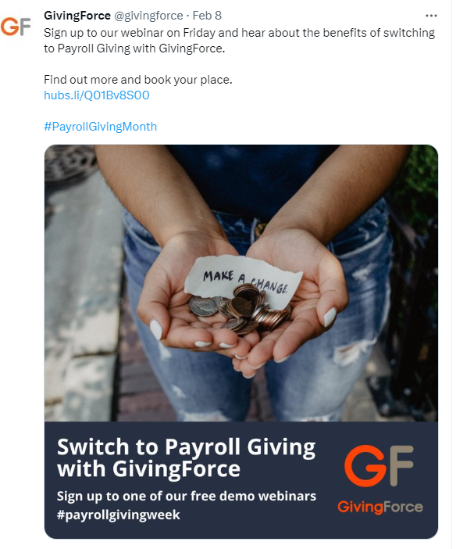
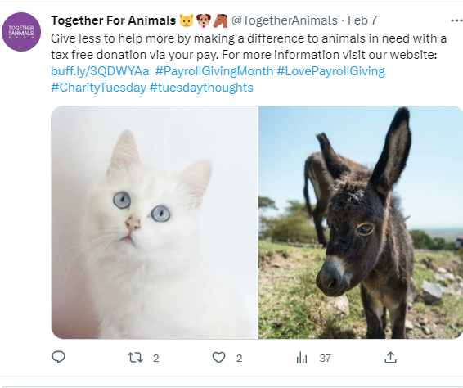
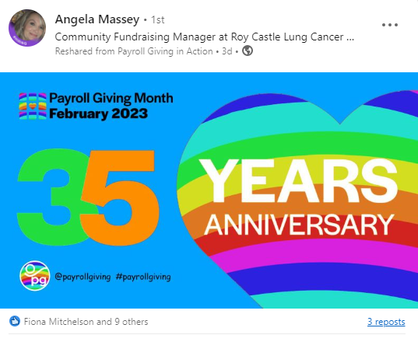
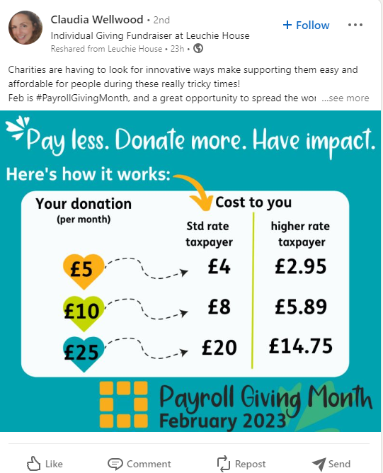
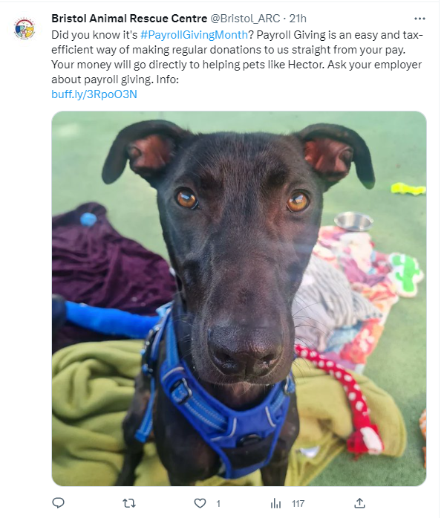
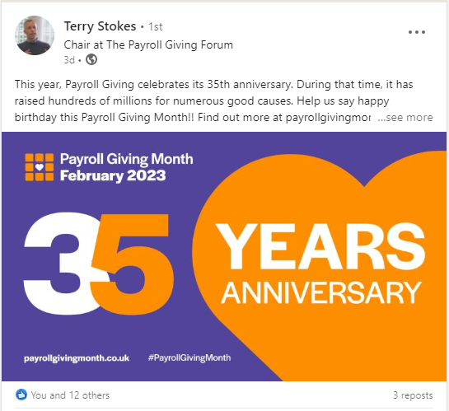
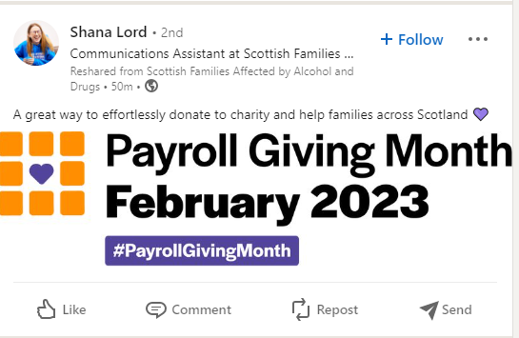

Slide 6
Insight into the life of a Payroll Giver
Average length of giving via Payroll Giving is 7-8 years (8.4 at CRUK) which is comparable to regular giving
Differences between different sectors in length of giving
Legacy regular income from CoTY partnerships
Pandemic changed work culture and has had an effect on donor recruitment (not as many people in the workplace)
Attrition since the pandemic has been extremely low
Income has stayed very stable
Employer matching boosts Payroll Giving income

Slide 7
Most common myths about Payroll Giving
‘It is difficult to set up’
There is no need for new payroll software, all modern payrolls can deal with Payroll Giving deductions.
‘We can’t afford it’
It is free to set up!
‘Our employees are not interested’
You might be surprised how many of them actually are.
‘It only works for large charities’
Smaller, local charities often have good relationships with local employers and could really benefit from this regular source of income.
‘Our staff cannot afford to give’
Payroll Giving is especially good now as it gives a discount on the donations.

Slide 8
Michael Duncan
Head of Giving Strategy and Programmes
NatWest

Slide 9
Payroll Giving
It just makes sense
Wednesday 22 February 2023
Ollie Lashbrook
Senior Operations Manager

Slide 10
Employer Benefits
Offers employees the ability to give
Supports staff retention and recruitment
Boost the impact of a charity partnership
Low running costs
Quality Marks
Payroll Giving Excellence Awards

Slide 11
Supporter Benefits
Tax Efficient
Costs less to give more
Easy to set up and manage
Support as many charities as you like
Amend or cancel at any time
Secure
Quick and convenient
One off donations can be made

Slide 12
Charity Benefits
Regular source of income
Aids in planning
Unrestricted income
Long-term supporters
Low administration costs
Low recruitment costs compared to other fundraising
Attract supporters who may not otherwise give
Supporters may choose to give more
No Gift Aid claims required

Slide 13
Corporate Partners
Employee Fundraising
Commercial Opportunities
Volunteering
Payroll Giving
Sponsorship

Slide 14
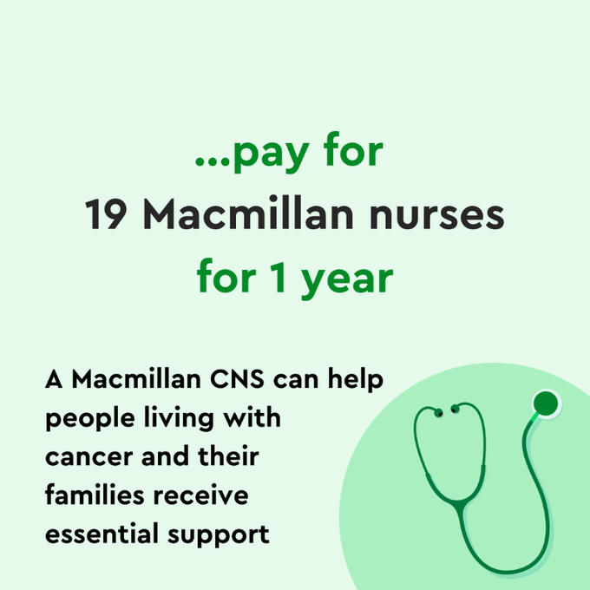
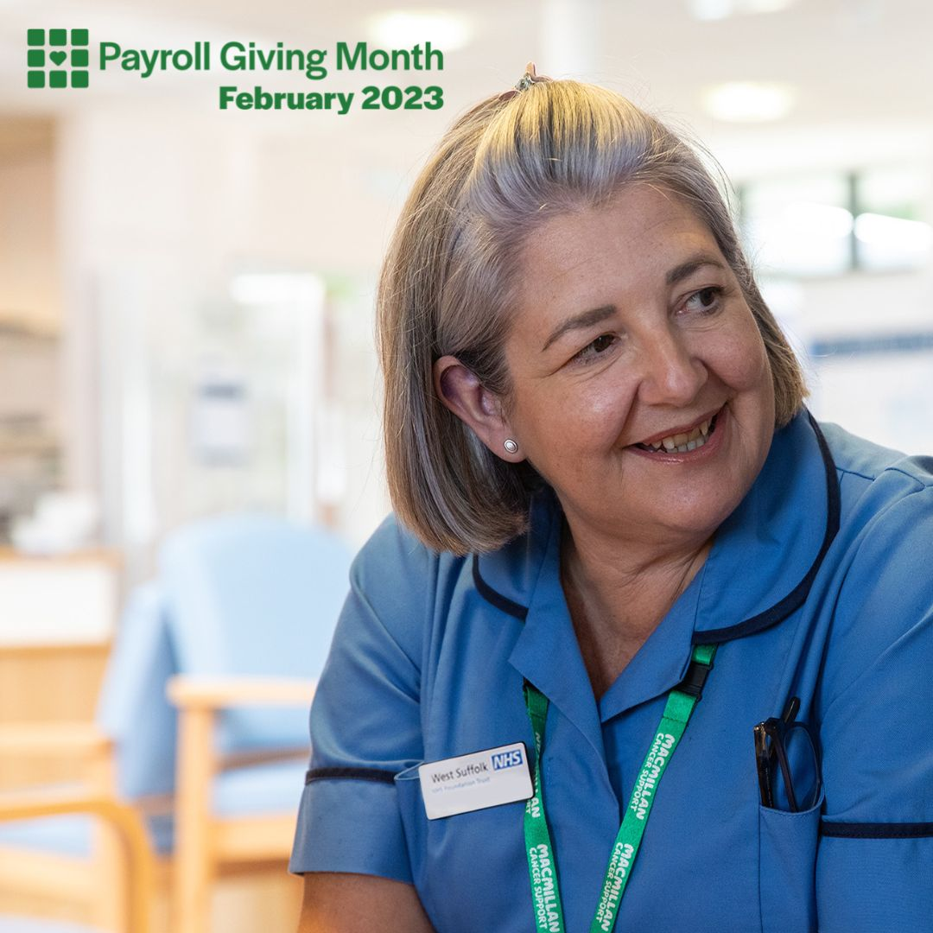
Payroll Giving at Macmillan

