Slide 1
CTG Tax Conference
28 March 2017
@CharityTaxGroup
#ctgtaxconference

Slide 2
Charities and tax
A view from the Government
Jane Ellison MP, Financial Secretary to the Treasury

Slide 3
Topical VAT updates
Graham Elliott, CTG Technical Adviser

Slide 4
Topical VAT update
VAT Expert Group
Representation on the JVCC
Work with HMRC to update grants/contracts and sponsorship guidance notes
VAT case law tracker
The voice of charities on Tax

Slide 5
VAT cases
Longridge on the Thames and Gravel Road Records
Adecco
British Film Institute
Aviva and DNB Banka
Durham Cathedral
Newcastle University
Halle Concerts Society
Taylor Wimpey
The voice of charities on Tax

Slide 6
Longridge and Gravel Road
Defined ‘economic activity’ for purposes of Relevant Charitable Purpose (RCP)
Did not produce favourable outcome for charity
‘Lord Fisher’ tests not approved, and difficult now to use
Old cases of Yarbrough and St Pauls now in doubt
Possible continued application to small scale operations (see Gravel Road Studios)
The voice of charities on Tax

Slide 7
Adecco
Whether self employed temp workers subject to VAT on wage element
Appeal from First Tribunal to Upper Tribunal
Decided on facts and on the contractual terms
Held that Adecco made full supply so VAT applies to wage element
Not clear whether to be appealed further
Creates significant tax imbalance in different ‘employment’ arrangements
The voice of charities on Tax

Slide 8
British Film Institute
Relates to culture and what can be included for the exemption
CJEU decided that the UK law ‘list’ of favoured activity is compatible with EU law
Hence cinema cannot be regarded as ‘culture’
Same applies to others, e.g. botanical gardens
Perhaps list is too narrow in any case…
The voice of charities on Tax

Slide 9
Cost sharing exemption
Advocate General Opinion in Aviva and DNB Banka
If followed by CJEU will confirm very narrow basis of CSE
AG says a separate ‘VAT entity’ needed for CSE supplies
AG says no margin applicable to cost recharges even as low as 5%
Surprising view that final non-taxable activity cannot be a finance exemption
The voice of charities on Tax

Slide 10
Sveda revisited
Durham Cathedral tribunal case
Based on Sveda
Does not deny that Sveda applies to charities
No sign of HMRC policy on Sveda application to charities
The voice of charities on Tax

Slide 11
Imported agency services
Whether services of overseas based agents to find students are subject to reverse charge
Newcastle University case, held that the supply was made to the UK university and not to the students
Therefore not third party consideration for supply to student
Large VAT liability on reverse charge
Question – could ‘examination service’ exemption apply instead?
The voice of charities on Tax

Slide 12
Philanthropic exemption
Halle Concerts Society
Meaning of ‘philanthropic’
HMRC’s restrictive view versus the wider possible view
The voice of charities on Tax

Slide 13
Blocking order
Whether the rule under which the VAT on white goods, carpets, etc in new residential buildings cannot be claimed is wrong in EU law
Taylor Wimpey appealed to Upper Tribunal
Appeal dismissed – Blocking Order is good law
Relevant to charities developing social housing for sale
The voice of charities on Tax

Slide 14
Other VAT updates
University of Cambridge case on VAT and investment management fees delayed
Brockenhurst – AG Opinion published
Group registration review
Policy concerning pre-registration input tax
Direct mail – feedback requested on HMRC assessments
The voice of charities on Tax

Slide 15
Gift Aid practical issues
Steve Carroll, HMRC

Slide 16

Steve Carroll
HMRC (Specialist Personal Tax)
Charities Savings & International
Notes:
Tuesday 17 May 2016 @ 2.00pm
East India Club,
16 St James’s Square,
London SW1Y 4LH

Slide 17
What will we talk about today?
HMRC’s Donor Education Programme.
Recent changes to the on-line donation process and the reason for those changes.

Slide 18
Why the change?
Declaration
Checks by HMRC have found that increasing numbers of GA donations do in fact not qualify for gift aid.
Previously HMRC have simply asked are you a UK taxpayer via the Gift Aid Declaration.
Recent research has highlighted a high number of non-eligible donations have and in some cases still are passing through on-line platforms without any verification checks by either HMRC or the platform provider themselves.
This had resulted in up to 1 million GBP in Gift Aid being paid out every month when none was due.
Notes:
18

Slide 19
Gift Aid declaration
Declaration
Via a Declaration by the individual confirming that;
“I am a UK taxpayer and understand that if I pay less Income Tax and/or Capital gains tax than the amount of Gift Aid claimed on all my donations in that tax year it is my responsibility to pay any difference.”
Notes:
19

Slide 20
The Gift Aid Eligibility Test
HMRC recognised that for improvements to be made education to the donor would need to be increased .With this in mind we have worked closely with the larger on-line providers encouraging them to improve education via their fundraising packs and by introducing an on-line gift aid eligibility test.
We have improved the Guidance on certain situations which may apply when giving on-line and this can be found at Chapter 3.44 on the detailed guidance notes.
We accept however that there is little chance of this advice being read by an individual immediately prior to a donation being made.
So we are working with the On-Line providers and the Charities themselves to try an improve education with the aim that Gift Aid is claimed only when it is due.

Slide 21
Gift Aid knowledge quiz
QUESTION 1
A fundraiser who is a UK tax payer collects money from office colleagues and in his local pub cover a two month period and banks all of the money in his own bank account.
He then uploads the total donations part of which is his own donation by using his own debit card.
When donating on-line he confirms he is a UK tax payer and completes the declaration to confirm this.
Can he make this payment as a Gift Aid payment?

Slide 22
Answer
No - Gift Aid can be claimed.
The fundraiser is simply passing on donations he has collected from various different sources.
He only way he can claim gift aid on his own donation is if he splits that out by making a separate donation.

Slide 23
Question 2
Kate organises a ‘Fun Day and exhibition match’ at her local rugby club in memory of her late father.
Entry is by ticket only, and other funds are raised through a raffle, tombola, fairground rides, bouncy castle and free-will donations, £1,000 is collected from all sources.
Kate then pays this to her chosen charity using her social giving account and includes the message ‘In loving memory of my father, Frank’.
Can he make this payment as a Gift Aid payment?

Slide 24
Answer
No - Gift Aid can be claimed.
Money raised from the sale of raffle tickets, fairground rides and ticket sales are not eligible Gift Aid payments
Advice should be given in any fundraiser hand-out that all of the above cannot attract gift aid.
If the event ticket is free and a free will donation is made then this can be gift aided only if the Gift Aid Declaration is made by the person making the free –will donation. Not if he or she passes the money to a third party who then uploads the donation.
If an individual collects the full name and address of the individuals that made the free will donations and then passes the list to the charity along with a cheque for the donations collected then the charity themselves can claim gift aid by attaching the names and address to their own gift aid schedule when making a claim direct to HMRC.

Slide 25
Donor Education & Confirmation
So this is what HMRC are looking to encourage all charities to do. Improve education.
HMRC have worked closely with all of the large on-line platform providers over the last twelve months and if you make a donation via one of those sites you will now see an additional step in the donation process.
These are 3 questions that should be answered by donors or,
Donors should be asked to confirm 3 statements apply to them;

Slide 26
Confirmation Statements
I am donating my own money and the funds have not come from anyone else including family members or from an office or bucket collection
The money I am donating is not the proceeds from sales of goods or services or the sale of tickets
I have not received something in return for this donation such as an entry ticket to an event or a raffle ticket.
There can be slight variations to the on-line advice but the overall message must be the same.
Only freewill donations made by the individual are eligible Gift Aid donations subject to the individual being a UK tax payer.
In the past nobody has ever thought beyond the statement ‘Are you a UK taxpayer’.

Slide 27
Important advice- The Christmas Card Scenario
When we talk about family and friends we are not looking to disallow Gift Aid claimed by an individual made on behalf of their and their partner’s behalf or of immediate family members.
So when Steve Carroll makes a donation of £20 and adds his wife's and children’s names to the good will message on the fundraising page we assume that the £20 has come from Steve’s own money and he has merely added immediate family members just as you would on a Christmas card.
HMRC have given clear guidance to the larger platform providers that this type of donation can qualify for gift aid. But it does not extend to the broader family such as Aunts and Uncles Grandparents etc.

Slide 28
Next Steps
HMRC are in regular contact with the on-line providers sharing best practise and one on-line provider is it the process of implementing an additional validation check by asking an additional opening question ‘Are you donating your own money’
This is of high importance as data held indicates that a high percentage of the ineligible claims to gift aid are made by the fundraiser uploading funds collected via third parties to his/her own web page.

Slide 29
Further Steps
It is not possible for HMRC to review each and every Charity platform and their fundraising packages so I am asking all charities to have a look at their own on-line services and their hand-outs and look to see what improvements can be made to provide better education.
HMRC have recently carried out joint consultation with one of the UK’s larger charities and I am offering the same service and support to any charity who is willing to implement the recommendations we have talked about today.
In addition to implementing an ‘Eligibility Test’ look to provide advice via the fundraising packs as quite a number of the recommended fund raising ideas involve non-qualifying events such as bake sales sweepstakes etc.

Slide 30

HMRC guidance on digital giving & social giving accounts
In April 2016, HMRC added a new section to its Detailed Guidance Notes for Charities
Chapter 3 – Gift Aid now includes section 3.44 – ‘Digital giving & social giving accounts

Slide 31
Common Problems
1. Wrong Authorised Official/Agent/Nominee
Please remember to advise HMRC each time there is a change via the form CHV1.
2. Claiming excessive GASDS
There are annual limits of £5,000 up to 5 April 16 and £8,000 from 6 April 2016.
If you do collect donations in excess of these figures do not reflect this in your claim. Keep within the appropriate maximum as otherwise your claim will be delayed.
3. Out of date GASDs Claims
Remember that GASDs operates a tax year basis not an account year.

Slide 32
Common Problems
Errors completing a paper claim form
  The form is scanned and read electronically . Do not put lines through boxes or ‘N/A’ . The guidance notes advise that these boxes should be left blank
  Additional correspondence is sometimes included –The guidance notes ask charities not include additional correspondence
  ‘Aggregated donation’ box ticked as well as the name of the donor. Charities should not tick ‘aggregated’ when they have a regular donor – just the name address, date of donation and amount will do as per guidance notes
  Missing information. The forms are first sent to HMRC’s scanning office. Forms with errors are then extracted and sent to the Outreach team which can cause a delay in repayments
  Non-Qualifying donations –Out of date or company donations

Slide 33
Contacts;
Steve Carroll---- Steven.Carroll@hmrc.gsi.gov.uk---03000546552

Slide 34
Brexit + EC/OTS VAT reviews
Dermot Rafferty, EY
Luigi Lungarella, PKF Littlejohn
John Hemming, CTG Chairman

Slide 35
EU Referendum: Six months on
Brexit – Tax implications

Slide 36
Where are we today?

Slide 37
Brexit – HMRC position
  HMRC has set up a cross departmental team - the EU Transition Unit (EUTU) to respond to the vote to leave the EU. This is part of HMRC’s Customer Strategy and Tax Design group.
  The EUTU liaises with the Department for Exiting the EU and the Department for International Trade.
  HMRC and HM Treasury carrying out review of possible implications and options.
  We have ongoing and regular dialogue.

Slide 38

Post Brexit uncertainty
What will
happen to
exchange rates?
What trade deal will the UK strike with the EU? How would new tariffs impact my supply chain?
What will
happen to our share price?
What will
happen to
exchange rates?
What will happen with the political situation?
Is capital
available for borrowing?
How will the
legal/regulatory environment change?
Will we need new
systems and
processes?
What will
happen to
UK tax rates?
Will we able to move our labour force around?
What will happen to interest rates?
Risk of Activity Paralysis

Slide 39
Three questions for most businesses
1
What are the likely impacts and opportunities for
our business from a
changing UK economy?
3
How should our business
change as a result?
Plan
Evolve
2
What should we
be doing now?
Act
Notes:
All of this is quite complex, and we have boiled it down to three questions that you need to ask. Two of them have been posed since the vote, but we have added a third:-
Question 1 PLAN: (“What are the likely impacts…”) what’s going to happen and how does this impact my business. Because if I knew that I would know how to PLAN for it
Question 2 ACT: (“What should we...”) given the timescales we have talked about, is there anything I can do now / or should I wait?
Question 3 EVOLVE: (“How should our business…”) A final question, which reflects back on this new world of uncertainty and relentless change
“Is it enough for my business to operate as it has done or are there aspects of how I run my business that I should do differently?”..
“Is it ok for me to respond to change in a controlled and planned way like before – or do I need to EVOLVE my business to be more Agile?”
Speaker note: Which of these questions are you asking and where are you on each? (be prepared to go straight to one particular question for further discussion)

Slide 40
Brexit – How could the UK exit?
What is planned?
Negotiated withdrawal under Article 50 of the Treaty of Lisbon
Notice in March 2017?
Great Repeal Bill
  Repeal of European Communities Act 1972
  Incorporate EU law into UK law
Constitutional questions
Devolved assemblies: consent vs consultations
Does Parliament vote on Article 50 notice?
Is Article 50 reversible?
Does the exit agreement cover UK arrangements with EU post Brexit?
Is it a mixed agreement?
Article 50
Any MS may decide to withdraw from the Union …
A MS which decides to withdraw shall notify the European Council of its intention. … the Union shall negotiate and conclude an agreement with that State, setting out the arrangements for its withdrawal, taking account of the framework for its future relationship with the Union. … It shall be concluded on behalf of the Union by the Council, acting by a qualified majority, after obtaining the consent of the European Parliament.
The Treaties shall cease to apply to the State in question from the date of entry into force of the withdrawal agreement or, failing that, two years after the notification referred to in paragraph 2, unless the European Council, in agreement with the MS concerned, unanimously decides to extend this period.
For the purposes of paragraphs 2 and 3, the member of the European Council or of the Council representing the withdrawing MS shall not participate in the discussions of the European Council or Council or in decisions concerning it.
If a State which has withdrawn from the Union asks to rejoin, its request shall be subject to the procedure referred to in Article 49.

Slide 41
Article 50: Potential timeline
  Once notice given, negotiations start and clock is running – when to give notice? Government committed to March 2017 at the latest.
  Treaty provides for two years could be shorter if agreed or longer if extended by unanimity
June 2019
Aug-Oct 2017
Apr/May
2017
French Presidential Election
German Federal Election
EU Parliament Elections
13 Jul 2016
New UK Prime Minister
Notice
March 2017
UK leaves EU
March 2019?

Slide 42
Brexit – Does the EEA position need to be addressed?
What is the issue?
Does triggering withdrawal under Article 50 of the Treaty of Lisbon automatically mean that the UK leaves the EEA?
Is the UK a member of the EEA in its own right or only as a member of the EU?
Constitutional questions
Can the UK choose to benefit from the EEA agreement by not giving notice to leave (as opposed to having to apply)
Does Parliament need to vote on triggering an Article 127 notice, if it is applicable?
Judicial review application to start on 19 January arguing Parliament must vote on grounds that Article 127 was not an issue in the referendum
Article 127
Each Contracting Party may withdraw from this Agreement provided it gives at least twelve months' notice in writing to the other Contracting Parties.
Immediately after the notification of the intended withdrawal, the other Contracting Parties shall convene a diplomatic conference in order to envisage the necessary modifications to bring to the Agreement.
Transitional stage
Membership of the EEA may provide a way of transitioning out of the EU. This may be particularly useful in areas such as social security.
However, membership of the EEA unlikely to be a long-term solution.

Slide 43
Brexit – Need for transitional arrangements
  Commons Treasury Committee has issued a call for written submissions on ‘transitional arrangements’.
  Transitional arrangements refer to any arrangement that takes effect between the point at which the UK formally leaves the EU and the point at which the UK's final, settled relationship with the EU becomes effective.
  EU Lords Committee report of 13 December 2016 recommends that the Government should establish a clear ‘game plan’ for a transitional arrangement at the outset of negotiations under Article 50
  Chancellor appeared to give his support to the need for such arrangements in his appearance before the Treasury Committee on 12 December 2016
  However, the ‘Brexit Secretary’ David Davis would accept such arrangements "if it's necessary and only if it's necessary".
  And Guy Verhofstadt, the European Parliament's chief Brexit negotiator, has said in reply that any transitional arrangement should have a strict time limit

Slide 44
Soft or hard Brexit
Soft
  Join EEA like Norway
  Access to single market
    Customs union?
    Non tariff barriers?
  Able to negotiate free trade agreements?
  Some restrictions on EU workers
  Contribution to EU budget
  No say in EU rule making
  Possible half way house to full exit
Hard
  Leave EU
  Trade on WTO rules like US, Japan, China
  Free trade agreement with EU like Korea
  Able to negotiate free trade agreements
  Restrictions on EU workers
  No contribution to EU budget
  No say in rule making

Slide 45
Risks and opportunities
  Wider benefits of EU membership
  Opportunities for reform
  Priorities for the charity sector
  Impact of case law of the CJEU
  Divergence in UK VAT law post Brexit
  Understanding the landscape
The voice of charities on Tax

Slide 46
VAT review – European Commission
Consultation closed 20 March 2017
EC consulted on two options for permanent VAT system:
  keep standard rate at 15% and regularly update the list of goods and services eligible for reduced/zero rates
  remove the minimum rate of 15% and abolish the list of reduced/zero rates, granting greater discretion for Member States in fixing their own VAT rates
The voice of charities on Tax

Slide 47
VAT review – European Commission
CTG led formulation of ECCVAT response, highlighting continuing difficulties of VAT system for charities
Welcomed flexibility of option 2, noting Governments better able to address VAT distortions if unrestricted by current need for unanimity for amending VAT rules
BUT noted need for appropriate safeguards to ensure that recognition for items of social benefit continues
Option 1 - the prudent approach?
Interaction with the Commission’s Action Plan on VAT
The voice of charities on Tax

Slide 48
Extension of reduced VAT rates to e-publications
Hard copies vs e-publications
Consultation on reduced VAT rates
December 2016 European Commission developments
Interaction with Brexit
Amendment of Directive 2006/112/EC - ECOFIN debate
EU Member States discretion
Rzecznik Praw Obywatelskich ECJ Judgment
The voice of charities on Tax

Slide 49
VAT review – Office of Tax Simplification
Report published 7 March 2017, highlighting key areas of complexity and calling for ideas for future system
Areas where simplification is being considered include charities – OTS aware that since VAT rules introduced, size and diversity of the charity sector has increased
The voice of charities on Tax

Slide 50
VAT review – Office of Tax Simplification
CTG asked to respond on key focus areas:
  Identify the implications of a high registration threshold
  Highlight multiple rates as a cause of complexity
  Consider possibility of simplifications to partial exemption, option to tax and capital goods scheme
  Look at viability of Special Accounting Schemes
  Assess VAT implications of MTD agenda
The voice of charities on Tax

Slide 51
Topical Tax Developments
Karen Atkinson, City of London Corporation
Justin Bevan, Oxfam
John Hemming, CTG Chairman

Slide 52
Apprenticeship Levy - Payment
Collection via PAYE from April 2017 (next month!)
Levy set at 0.5% of employer’s paybill
£15k allowance means only annual paybills in excess of £3m are affected (joint paybill for groups of charities)
CTG encourages members to give feedback about experience of Levy in practice, once it goes live
The voice of charities on Tax

Slide 53
Apprenticeship Levy – Using funds
Employers with workers living in England can register for an apprenticeship service account now
Funds will remain in accounts for up to 24 months
Register of apprenticeship training now published
Funds can be spent on apprenticeships in England – CTG calling for extension to volunteers
10% of unused funds transferrable from 2018 – CTG calling for 100%
The voice of charities on Tax

Slide 54
Apprenticeship Levy – Devolved issues
Return of funds for apprenticeships is classed as skills spending – a devolved competency
Employers working exclusively in devolved nations have no access to apprenticeship service accounts
Funds return to devolved nations as part of their block grant and are not ring-fenced for skills spending
Devolved administrations must individually commit to spending funds on apprenticeships
The voice of charities on Tax

Slide 55
Off-payroll workers in public sector
Legislation (known as IR35) to go live from 6 April 2017
Issue of ensuring proper income tax and NICs paid by public sector workers employed through a PSC
Responsibility moving from worker to hirer
The voice of charities on Tax

Slide 56
Off-payroll workers in public sector
“Public sector” according to FOI Act definition – will catch more charities than might be expected
HMRC has published new Employment Status checker – will stand by results
Legislation will apply to work done prior to 6 April 2017 but paid after – confirm status of contractors now!
The voice of charities on Tax

Slide 57
Insurance Premium Tax
IPT to rise to 12% in June – doubled in 2 years
Survey currently showing cost of increase from 10% to 12% at over £1m this year (100 charities)
Government currently has no intention to set special charitable rate of IPT
Village halls & charities with large property portfolios particularly affected
The voice of charities on Tax

Slide 58
Tax on “restitution interest”
45% corporation tax rate on “amounts taxed as restitution interest” introduced in 2016
CTG secured exemption for charitable companies by highlighting inappropriate application to the sector
Important for charities seeking compound interest on Fleming/Conde Nast VAT repayment claims following Littlewoods
The voice of charities on Tax

Slide 59
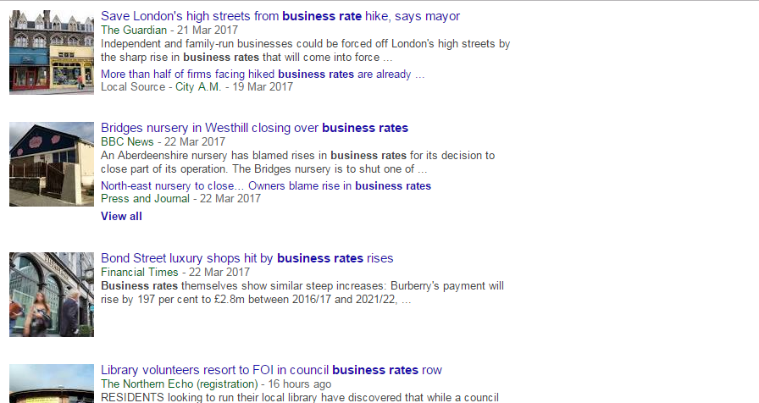
Business rates – making headlines
The voice of charities on Tax

Slide 60
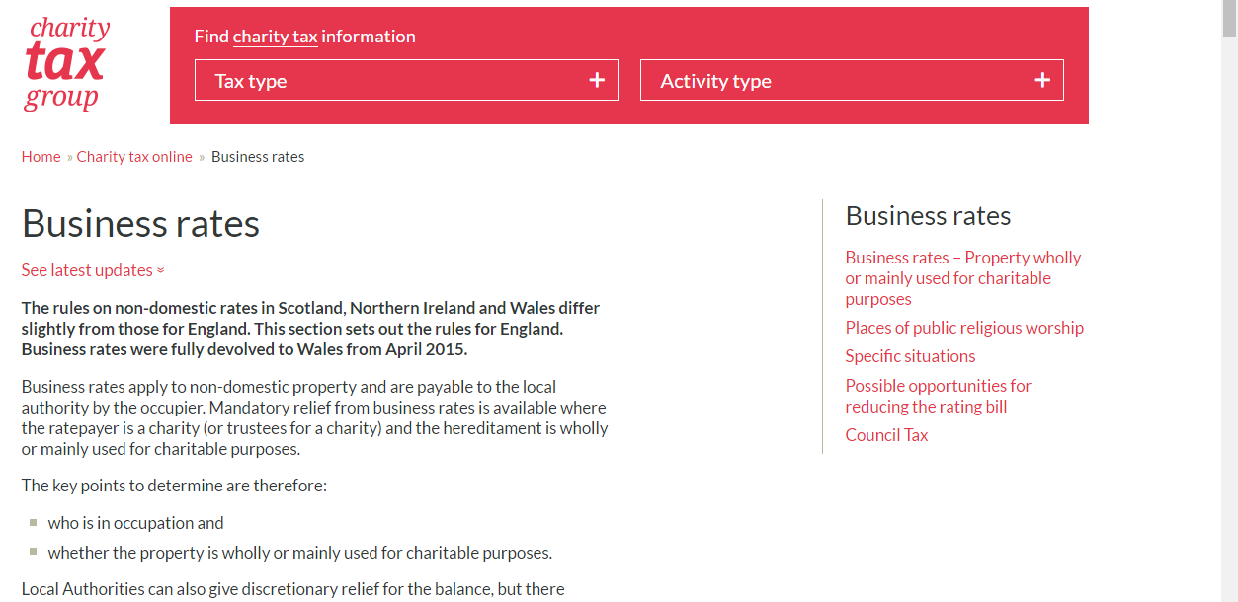
Business rates – CTG updates
The voice of charities on Tax

Slide 61
Business rates – England
Local Authorities to gain full control – puts further pressure on discretionary relief
Government committed to protecting mandatory relief – vitally important worth up to £1.8bn a year
Budget announcement gives LAs budget for further discretionary relief to those affected be revaluation
Charities face “postcode lottery” re discretionary relief with some LAs reviewing who is “deserving”
The voice of charities on Tax

Slide 62
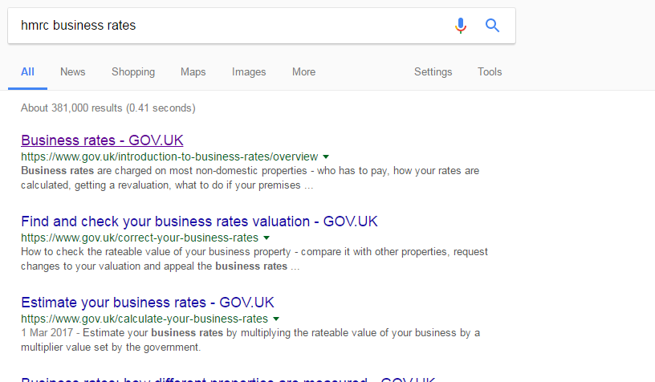
Business rates – worked example...step 1
The voice of charities on Tax

Slide 63
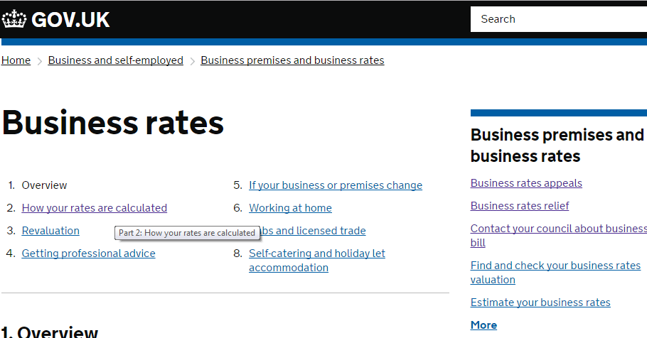
Business rates – worked example...step 2
The voice of charities on Tax

Slide 64
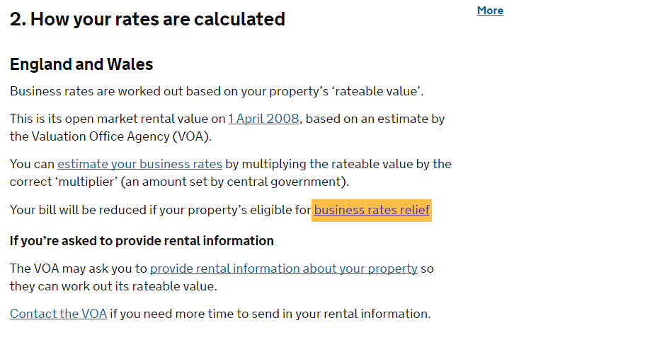
Business rates – worked example...step 3
The voice of charities on Tax

Slide 65
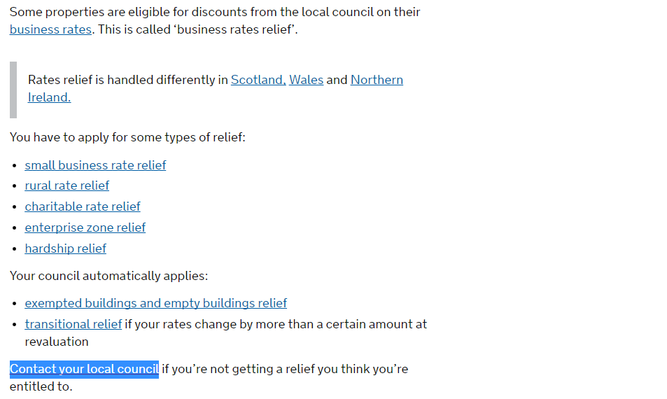
Business rates – worked example...step 4
The voice of charities on Tax

Slide 66
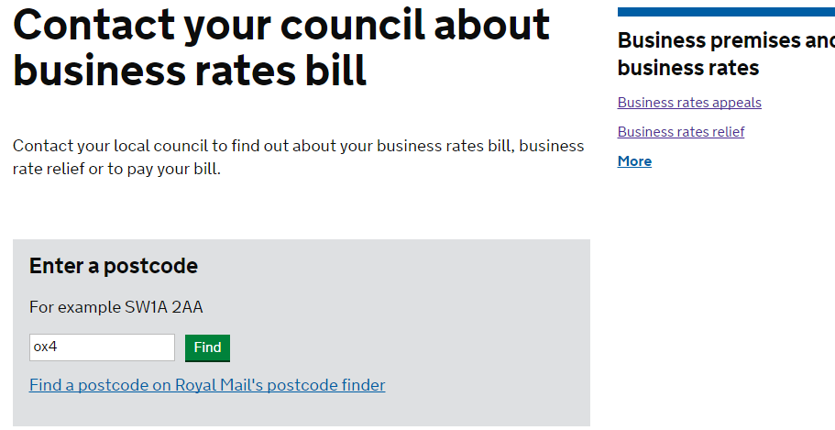
Business rates – worked example...step 5
The voice of charities on Tax

Slide 67
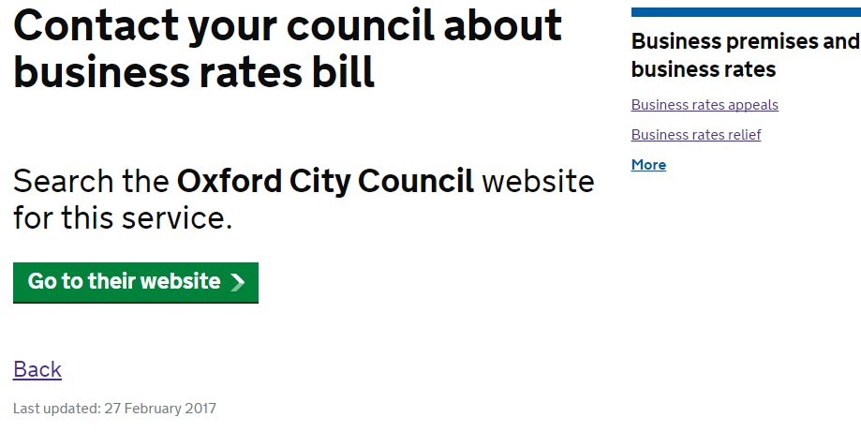
Business rates – worked example...step 6
The voice of charities on Tax

Slide 68
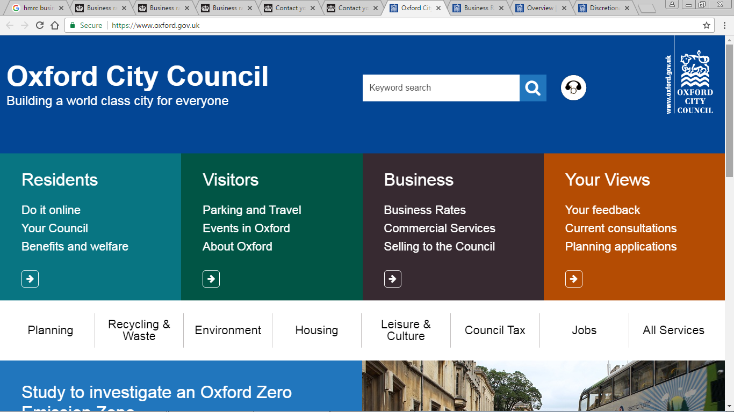
Business rates – worked example...step 7
The voice of charities on Tax

Slide 69
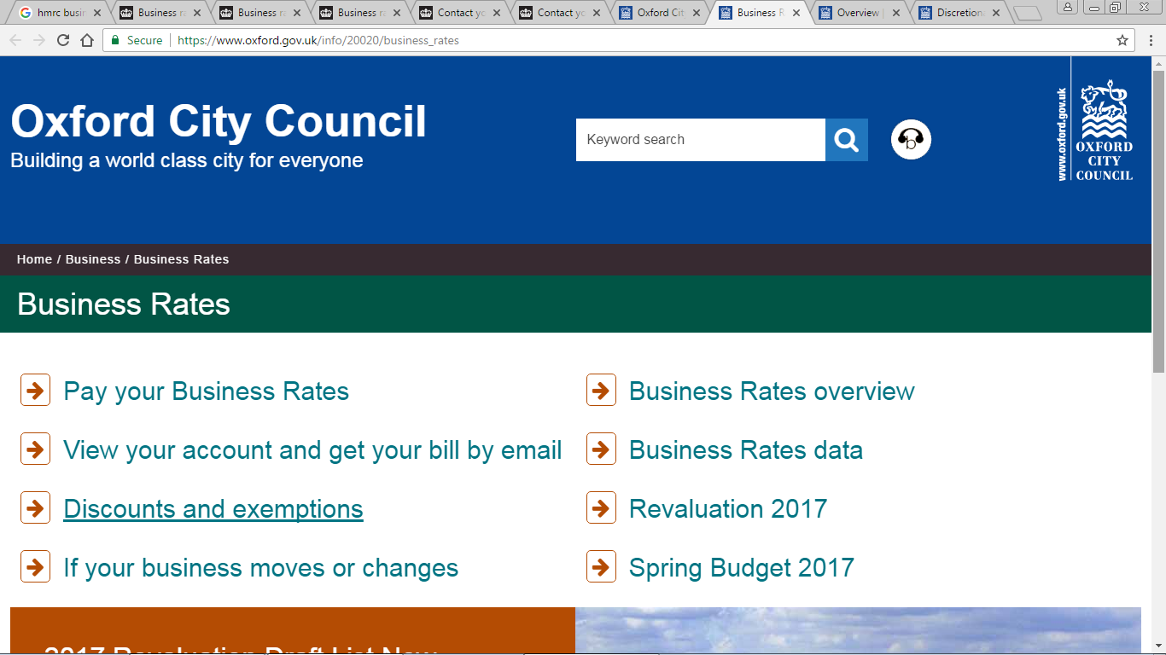
Business rates – worked example...step 8
The voice of charities on Tax

Slide 70
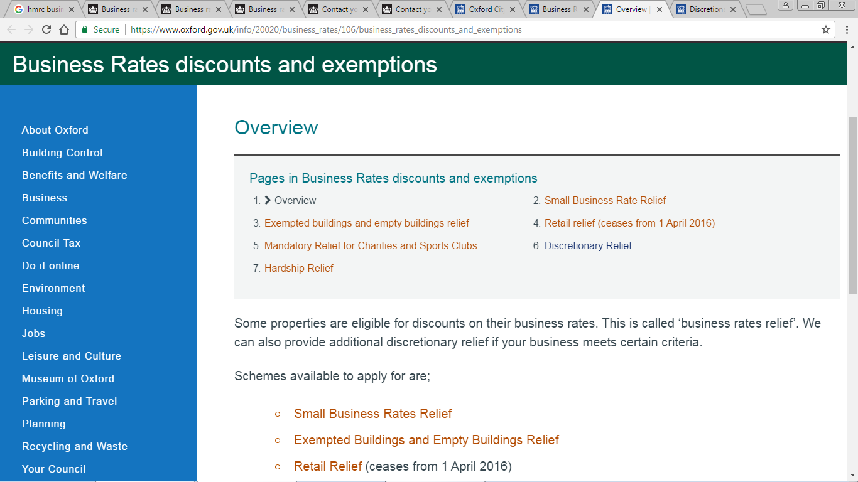
Business rates – worked example...step 9
The voice of charities on Tax

Slide 71
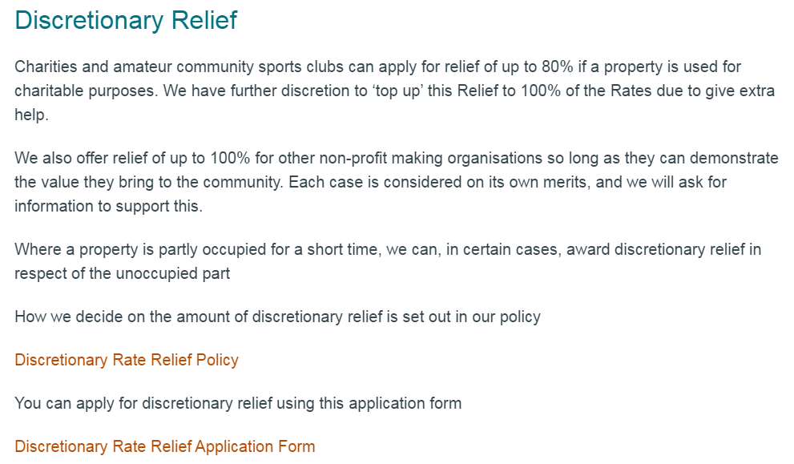
Business rates – worked example...step 10
The voice of charities on Tax

Slide 72
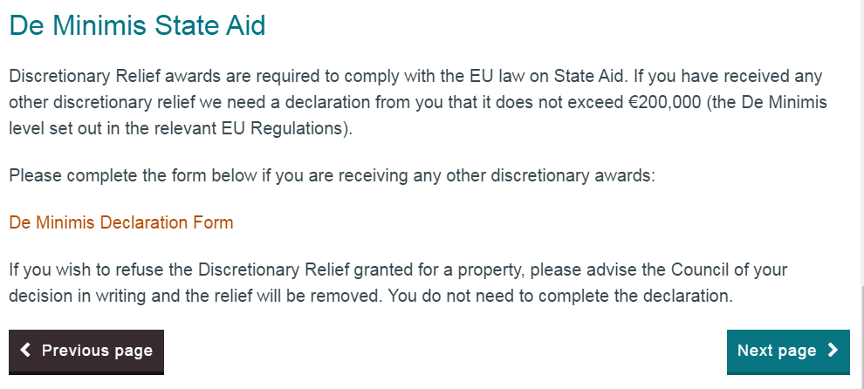
Business rates – inconsistency?
The voice of charities on Tax
Notes:
Whether discretionary relief is within scope of state aid rules is an example of potential inconsistent treatment; certainly not in line with CTGs understanding (note – don’t share: local authority genuinely has the power to lower the rate of tax and bears the cost, similar to federal state system so not part of state aid)

Slide 73
Business rates – Northern Ireland
Package of measures proposed by ex-Finance Minister, to make sure that “everyone pays something”
Charity shops face liability between 10-20% from 2019
Exemption for student Halls of Residence to be removed from April 2018
Remains to be seen how new Executive will affect these proposals (if at all)
The voice of charities on Tax

Slide 74
Business rates – call for interest?
Proposal for CTG members business rates network to collate and share knowledge in one place (CTG website)?
  Understand application of reliefs process for each Local Authority
  Responsibilities and procedures related to Rating Authority or VOA
  Rateable Value changes and transitional arrangements
The voice of charities on Tax
Notes:
We want to be compliant, we want to pay the right amount: not too much and not too little – and we want to understand that we have a fair and consistent system too

Slide 75
Community Infrastructure Levy
CIL has not raised as much revenue as hoped. Review blames exemptions and patchwork implementation
Recommends replacing CIL with a new Tariff with “no or few exemptions”
Government yet to respond to recommendations
CTG helped secure charity CIL exemption and will work to ensure exemption to any successor tax
The voice of charities on Tax

Slide 76
Research and Development Credit
Government looking to review tax environment for R&D
Universities and charities currently unable to claim RDEC after Government u-turn
CTG working with AMRC to regain access to RDEC
The voice of charities on Tax

Slide 77
Employer-provided living accommodation
CTG met with HMRC and responded to “fact-finding exercise” in early 2016
Consultation on BiKs including accommodation to be published shortly
Strong case for maintaining exemption as necessary for “proper performance of duties”
Very important exemption for churches, schools, universities, heritage charities and others
The voice of charities on Tax

Slide 78
“Fit and proper person” test
HMRC updated declaration and helpsheet for managers of charities and CASCs claiming tax relief
“Managers” applies to persons having general control and management over the running of the charity/assets
Fit and proper persons test is a statutory requirement
Signatories must confirm no involvement in tax avoidance
Managers that have signed the old declaration do not need to submit an updated declaration
The voice of charities on Tax

Slide 79
Common Reporting Standard
Following representation from CTG and others, HMRC decided charitable companies would no longer be included
CTG still working to extend this to trusts
Detailed charity guidance now published and human rights and data protection concerns addressed
CRS came into effect from 1 January 2016 – FIs will have to make first report to HMRC by 31 May 2017
The voice of charities on Tax

Slide 80
Museums and galleries tax relief
New tax relief for museums and galleries alongside commitment to maintain free access and grant funding
Relief will be set at 25% for touring exhibitions and 20% for non-touring exhibitions
Capped at £500,000 of qualifying expenditure per exhibition
The voice of charities on Tax

Slide 81
Social Investment Tax Relief
SITR now implemented fully but take-up fairly low
Government has applied for State Aid clearance for an enlarged SITR scheme
Social Enterprises up to 7 years old will be able to raise up to £1.5m through SITR
The voice of charities on Tax

Slide 82
Gift Aid policy developments
Daniel Pease, HM Treasury
Adrian Coates, HMRC
David Warrellow, National Trust
Gillian McKay, ICAEW

Slide 83
Gift Aid Small Donation Scheme
From 6 April 2016
Annual limit increased from £1,250 to £2,000
From 6 April 2017
New charities can qualify straight away
Collections can take place outside Community Buildings
Contactless payments can be accepted

Slide 84
Donor Benefits
Consultation published 11 November 2016
Deadline for responses 3 February 2017
37 Responses received
Next Steps:
  Advice to ministers before Summer
  Will be able to share more when we know more

Slide 85
Gift Aid donor benefits
David Warrellow, National Trust

Slide 86
Gift Aid Benefits: CTG comments
Low value disregard
Single threshold
Dual threshold
Practical example
The voice of charities on Tax

Slide 87
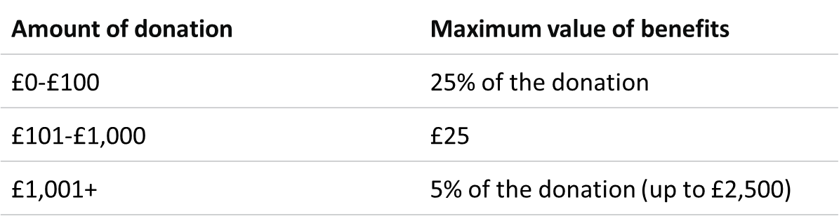
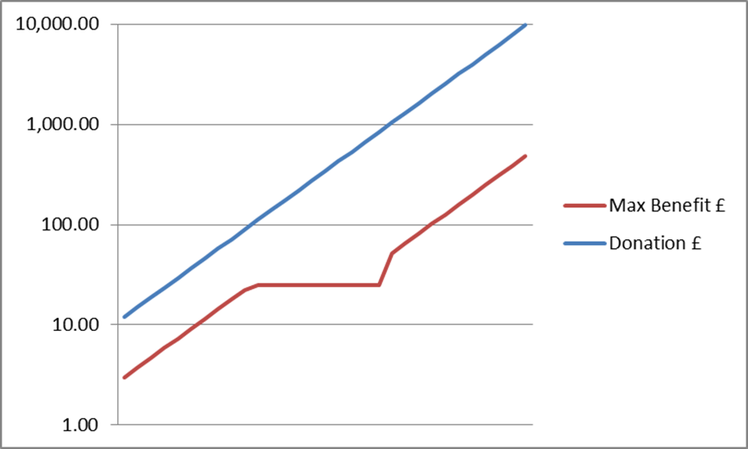
Current benefits threshold
The voice of charities on Tax

Slide 88
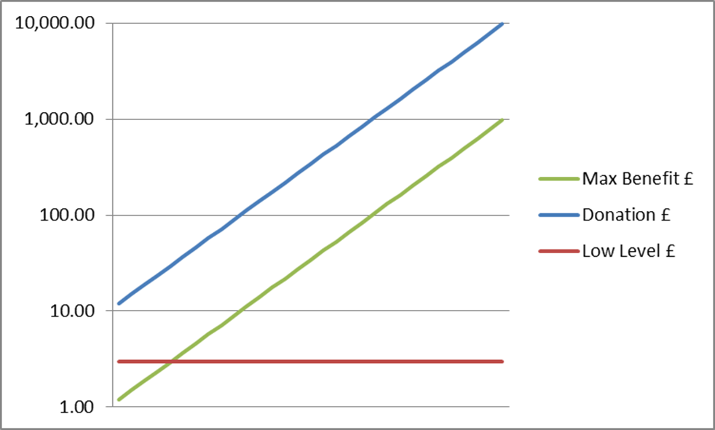
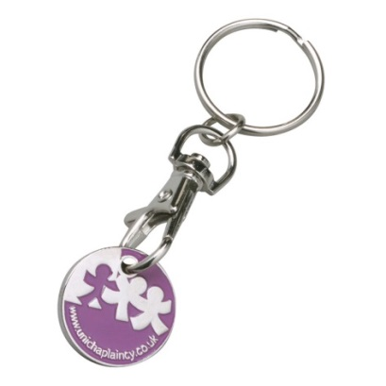
Single threshold + disregard
Amount of donation | Maximum value of benefits
£0-£25,000 | 10% of the donation
£25,001+ | £2,500
The voice of charities on Tax

Slide 89
Dual threshold (‘sliced’)
Amount of donation | Maximum value of benefits
£0-£100 | 25% of the donation up to £100
£101+ | £25 + 5% of excess over £100 (up to a max benefit of £2,500)
Example 1: Donation of £500
Current limit: £25
Proposed limit: £25 + (5% x £400) = £45
Example 2: Donation of £5,000
Current limit: £250
Proposed limit: £25 + (5% x £4,900) = £270
The voice of charities on Tax

Slide 90


Slide 91
Guest Promotion Benefit Calculations
Calculate value of free tickets by voucher (= supporter)
Get list of donations by supporter (where Gift Aided)
Identify ‘voucher originators’ in this list
Compare benefit value against supporter donation
Limit breached? > repay Gift Aid to HMRC
Higher Rate relief? > Write to supporter?
Alternative: average value of free entry x vouchers redeemed x average Gift Aid take-up %
The voice of charities on Tax

Slide 92
Intermediaries rules
  From 6 April 2017:
  New process allows intermediaries to create Gift Aid Declarations on donor’s behalf
  Intermediaries to provide annual statement to each statement by 31 May following the tax year in which donations made, unless:
    Donor only gives to one charity through the intermediary, or
    Total donations through intermediary are £20 or less
  Penalty regime for non-compliant intermediaries

Slide 93
HMRC/HMT Forward look
Working group to consider cumulative effect of tax policy on charities
FST writing to MPs to encourage charitable activity, and explaining tax reliefs available and where to go for help
HMRC writing to all charities that have claimed Gift Aid but not GASDS
Communications Strategy to promote tax reliefs
Review of guidance

Slide 94
Gift Aid donations from subsidiaries
Gillian McKay, ICAEW

Slide 95
Background
Prior practice of gift aiding taxable profits to reduce corporation tax to nil
In the event taxable profits > accounting profits this would result in a distribution from reserves
Practice endorsed by Charity Commission CC35
ICAEW Technical Release 16/14BL, October 2014, concluded this is an illegal distribution under company law
ICAEW Technical release, CC35 and HMRC guidance updated February 2015

Slide 96
Accounting
“Distribution” accounted for as a dividend and therefore not accrued
Creates tax charge and provision in the accounts
Reversed as tax never paid
Accrues in full in the charity & subsidiary accounts
No tax charge as taxable profits nil
Substance over form

Slide 97
Contact details
Gillian.McKay@icaew.com
Direct line: 020 7920 8594
Mobile: 07918 746 958

Slide 98
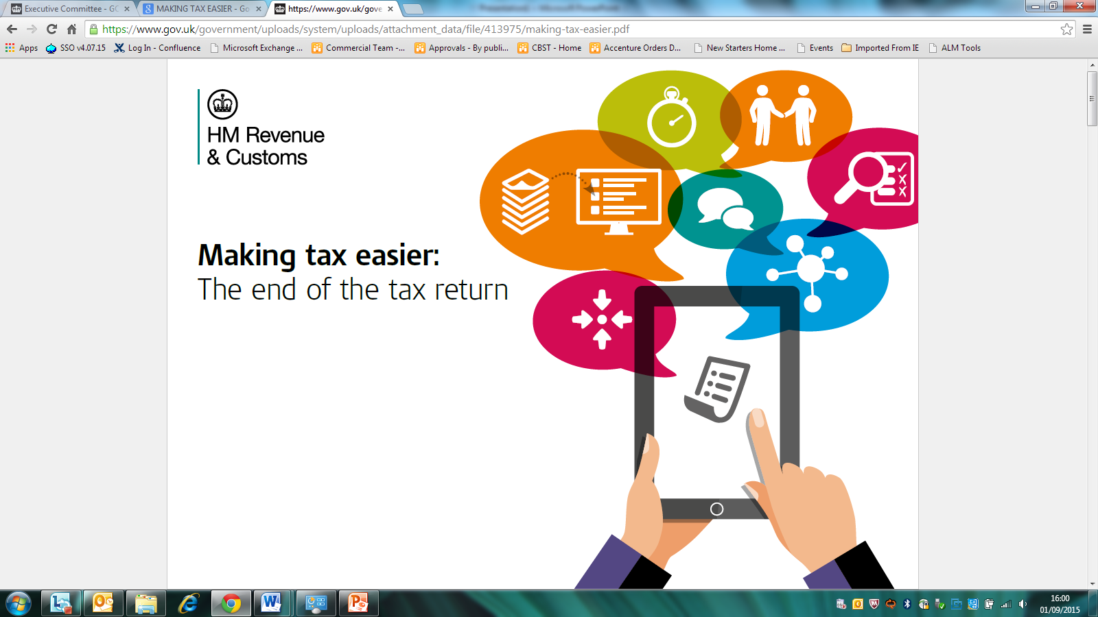
Making Tax Digital for Business
Charity Tax Group – 28 March 2017
Ted Comerford
HMRC Customer Readiness and Stakeholder Engagement team

Slide 99

Making Tax Digital for Business - the vision
Modernising the tax system, making it easier for businesses to get their tax right and keep on top of their affairs
Helps reduce:
  the £8bn cost to public purse due to avoidable error
  the cost, uncertainty and worry that businesses face when HMRC is forced to intervene to put things right
Better use of information

Slide 100
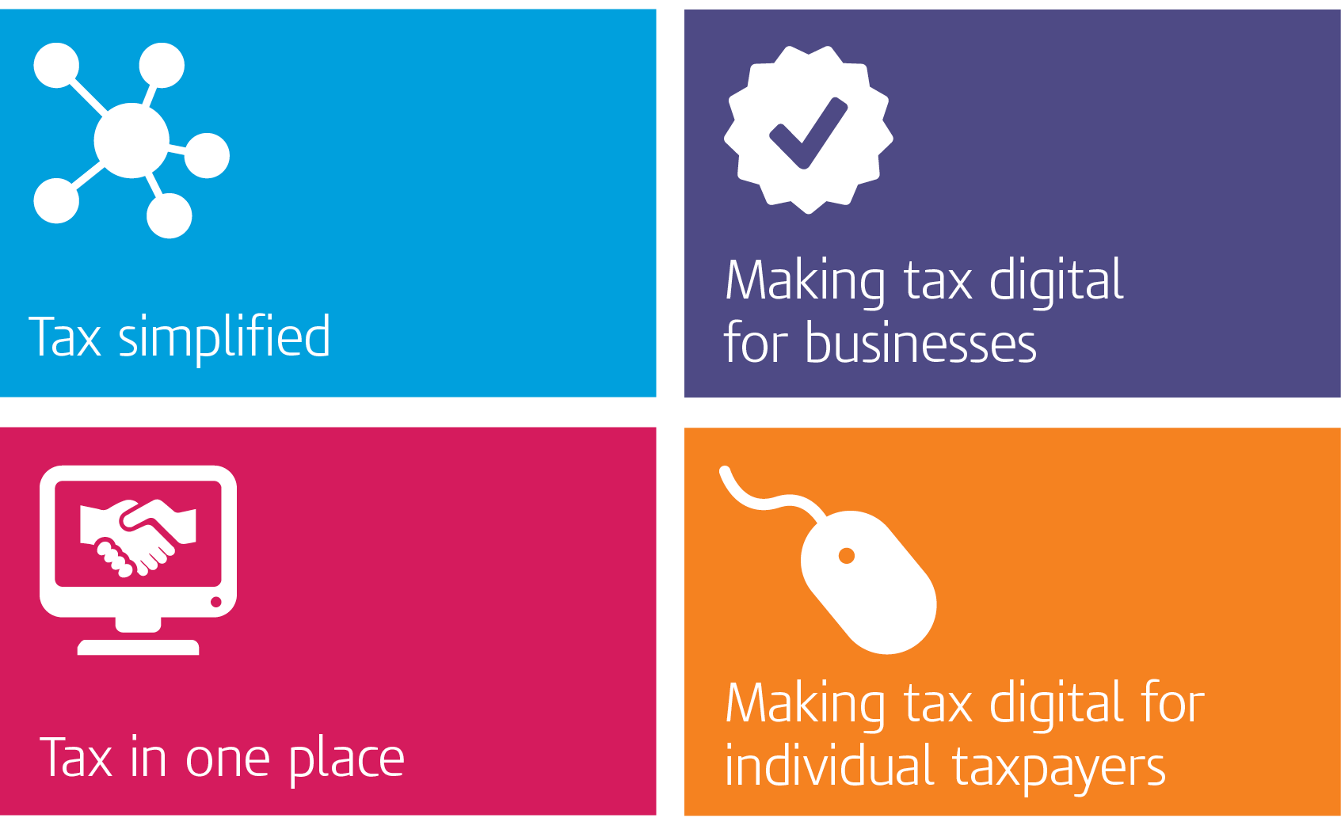
Making Tax Digital for Business - four foundations
Better use of information
Tax in real time
Single financial account
Interaction digitally with customers

Slide 101

Making Tax Digital - What does it mean for you?
Business records kept digitally, and quarterly updates provided to HMRC summarising the key information
Software uses built-in checks to help prevent errors before information is sent to HMRC
Updates to HMRC are simple in many cases – sending a quarterly update will require little, if any, adjustments to the summary information automatically calculated by their record keeping software
Able to see your latest tax position on your digital account, giving you more certainty about your tax position and helping you plan for your tax bill
If you use an agent, you will be able to give them access to see and do what you can
Payment deadlines unchanged but able to make ‘pay as you go’ tax payments should you wish

Slide 102
The MTDfB consultations
Bringing business tax into the digital age
Simplifying tax for unincorporated businesses
Simplified cash basis for unincorporated property businesses
3,000 responses – wide ranging support for a move to digital
Changes to Tax Administration
Voluntary Pay As You Go
Transforming the tax system through better use of information

Slide 103
Main consultation themes – business
Wide ranging support for digital tax system
but worried about the pace of change
2m business already use software
but some lack the capability to use digital technology
Costs to businesses
(both transitional & on-going)
Agent Access
18%
Data Security
23%

Slide 104
Summary of Consultation Responses: Digital Age
Spreadsheets can be combined with software for record keeping
3-line accounts will continue, option to categorise into 15 items
Year end activity by 31st Jan/10 months after last day of period of account
Digital exemption: religious society, disability, age, remoteness of location, or any other reason
Final decisions on exemption/deferral will be made before legislation is laid later this year; alongside fiscal impact
Free software for businesses with the most straightforward affairs
Some exemptions (e.g. CASCs, Lloyds Underwriters) Charities exempt, but not trading subsidiaries. Partnerships with turnover £10m+ deferred until 2020 for Income Tax/NICs – VAT 2019

Slide 105
Summary of Consultation Responses: others
More work on late submission penalties with further consultation to come. Will also consult further on late payment penalty interest
Entry level for cash basis raised to £150k; exit threshold £300k
Capital vs Revenue rules simplified for those in cash basis. Further consideration to basis period reform
Cash basis by default for c2m landlords (up to £150k); flexibility for jointly owned property
Gradual approach to further sources of third party info
No change to enquiry powers

Slide 106
Charities: Response to the consultation
“Charitable organisations agree with HMRC that there are significant potential benefits for charities in maintaining digital records and in using software to update their digital tax account when they need to file a VAT return or less regularly to make a return for Corporation Tax or Income Tax Self-Assessment. However, for practical reasons, we agree with HMRC’s recommendation that charities be exempt from the requirements to maintain digital records and to update HMRC at least quarterly.
“Experience indicates there is great benefit in voluntary registration as it allows charities to transition at a pace suitable to them and avoids costly unbudgeted upfront expenditure on infrastructure and new processes. Given the potential long-term benefits of maintaining digital records we would recommend the production of charity-specific guidance (and case studies) to support those charities that do decide to register voluntarily. We also welcome the Government’s commitment to working with charities, local libraries or other community locations to provide assistance and Wifi facilities.”

Slide 107
Key milestones and next steps
  April – Pilot starts (aiming for hundreds of thousands of businesses before April 2019)
  Spring – Call for evidence/high level discussion document on complex businesses (formal consultation to follow) and further consultation on penalties
  On-going – continue to engage closely with key stakeholders on MTDfB design issues

Slide 108

MTDfB Pilot
A CGL of an MVP to validate APIs, DES, ETMP, and DTAs – simple!

Slide 109



Subscription
Businesses will subscribe to MTD – new Terms & Conditions
Agents will subscribe to Agent Services
April 2017 – MTD Pilot starts for income tax and Class 4 NICs
c.400k businesses with turnover above the VAT threshold – April 2018 mandate
c.3.1m businesses with turnover below the VAT threshold – April 2019 mandate
Phased introduction of:
. Numbers participating – to ensure everything works as intended
. Functionality – building to full coverage of in-scope businesses by October

Slide 110
Dates for your diary
1 April 2017
  New rules for VAT on adapted motor vehicles for disabled
  VAT thresholds increase
  National Minimum Wage increases
  Museum and Galleries Tax Relief in force
6 April 2017 (new tax year)
  Off-payroll workers rules start
  Apprenticeship Levy begins
  Changes to the GASDS
  Gift Aid and intermediaries rules change
  SITR enlarged
  Changes to BiK under a salary sacrifice scheme
The voice of charities on Tax

Slide 111
CTG Tax Conference
28 March 2017
@CharityTaxGroup
#ctgtaxconference

