Slide 1
CTG Expert Insight Session: Relationship between charities and their tax advisers
15 June 2022
#charitytax

Slide 2
Today’s session
Richard Bray, CTG Chair – Introduction
Paul Knight, BDO
Louise Hillman, Medical Research Foundation
Trudi Amy, Macmillan Cancer Support

Slide 3
Ctg expert insight session
Charities interaction with their tax advisers
Paul Knight, BDO LLP

Slide 4
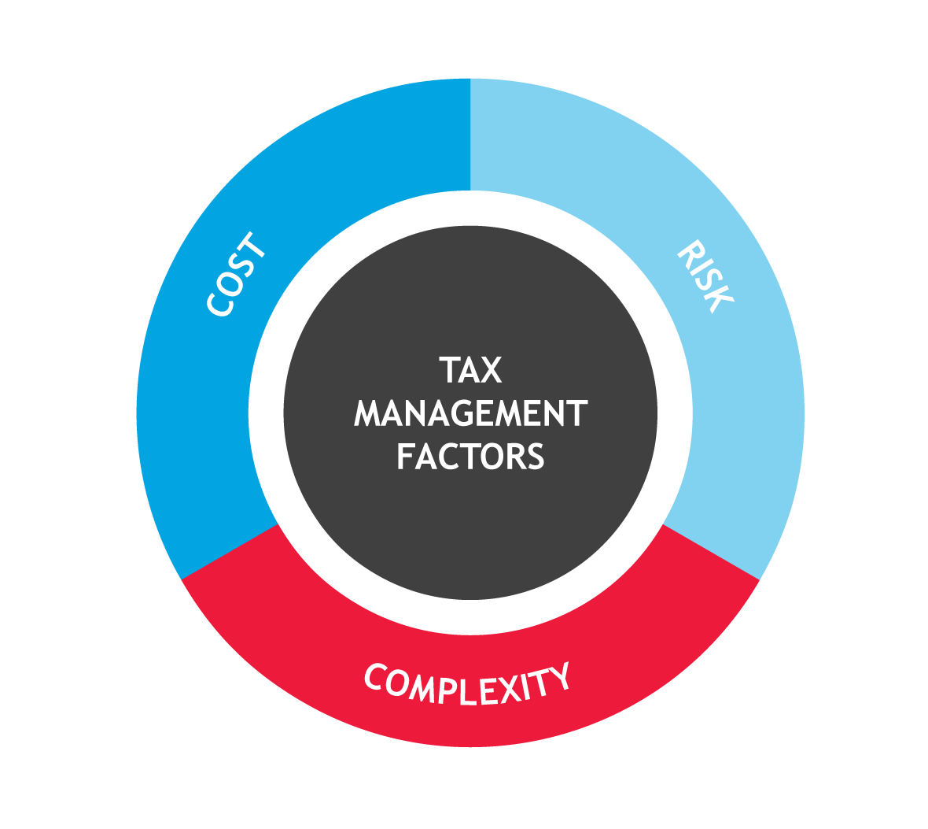
Tax Adviser landscape
BOARD
Identify and communicate tax strategy
Oversight of implementation
SENIOR MANAGEMENT
Delivery of strategy
Responsibility for key reporting matters - SAO
Oversight of compliance
Management of tax processes
Tax communication and training
ACROSS BUSINESS
Implementation and day to day delivery
Tax compliance, financial reporting
Audit separation

Slide 5
Areas to consider
Clarity of objectives – what do you want to achieve commercially and from the advice
  Getting value from a report
    Advice vs implementation
Collaboration and the value of accumulated knowledge
Procurement – allowing space for a value assessment

