Slide 1

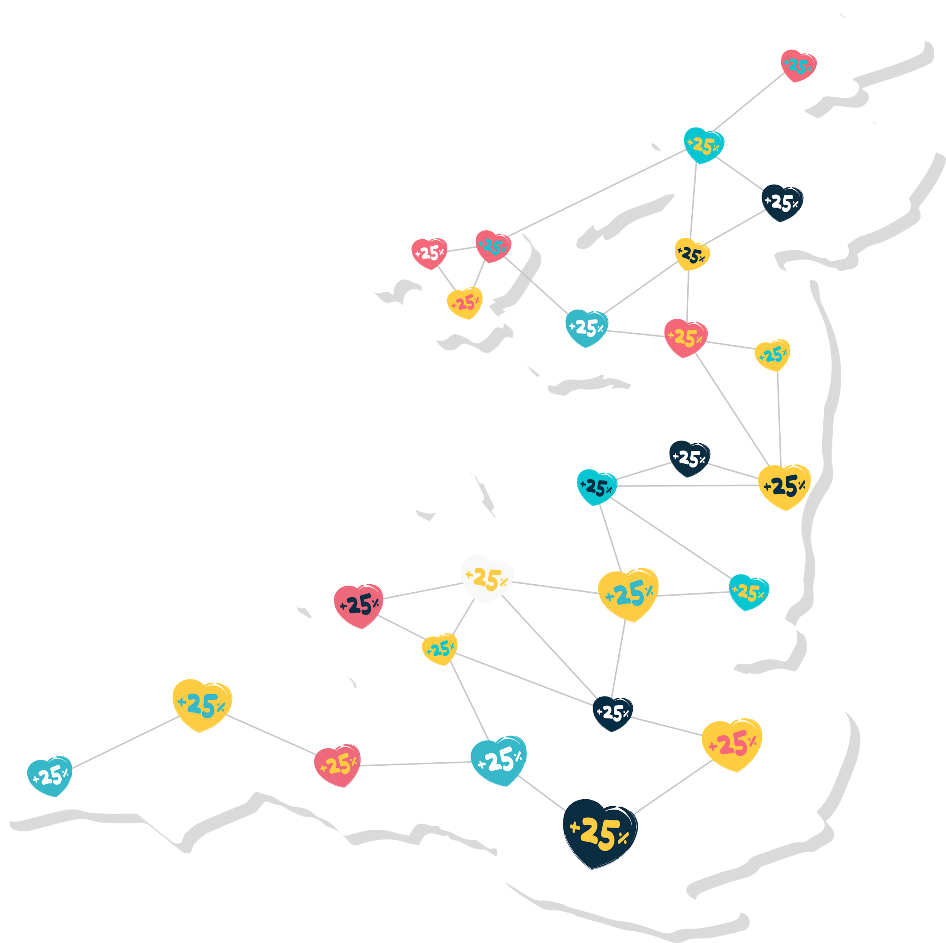
Together we can help charities all across the UK claim Gift Aid more easily
It's estimated, over £1.5 million in Gift Aid missed every day!

Slide 2


£7m
Phone / ATM
£88m
Tins & Buckets
£197m
Direct Debits
£12m
SMS
~£564
MILLION
MISSED
EVERY YEAR
£21m
Charity websites
Charitable Giving and Gift Aid research report
£24m
Online Sponsorship
£42m
Sponsorship
£96m
Cash collection
£75m
Envelope / Cheque
Another £180 million claimed in error
Notes:
The problem hasn't gone away.
£197 million missed Gift Aid on Direct Debits.

Slide 3
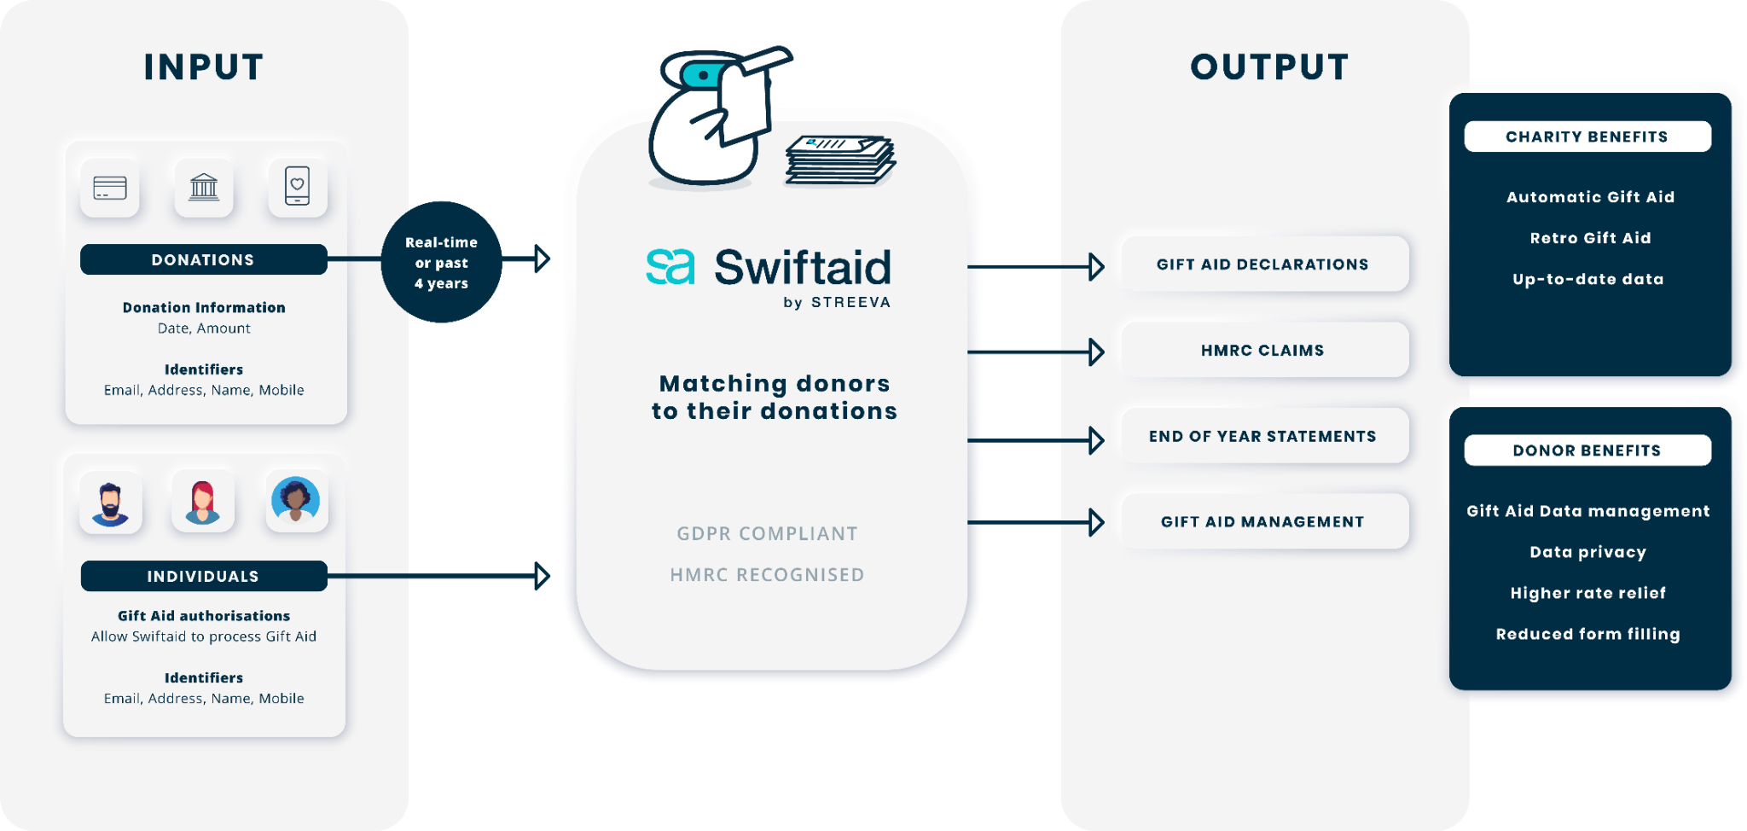
Swiftaid - The Gift Aid Network

Slide 4
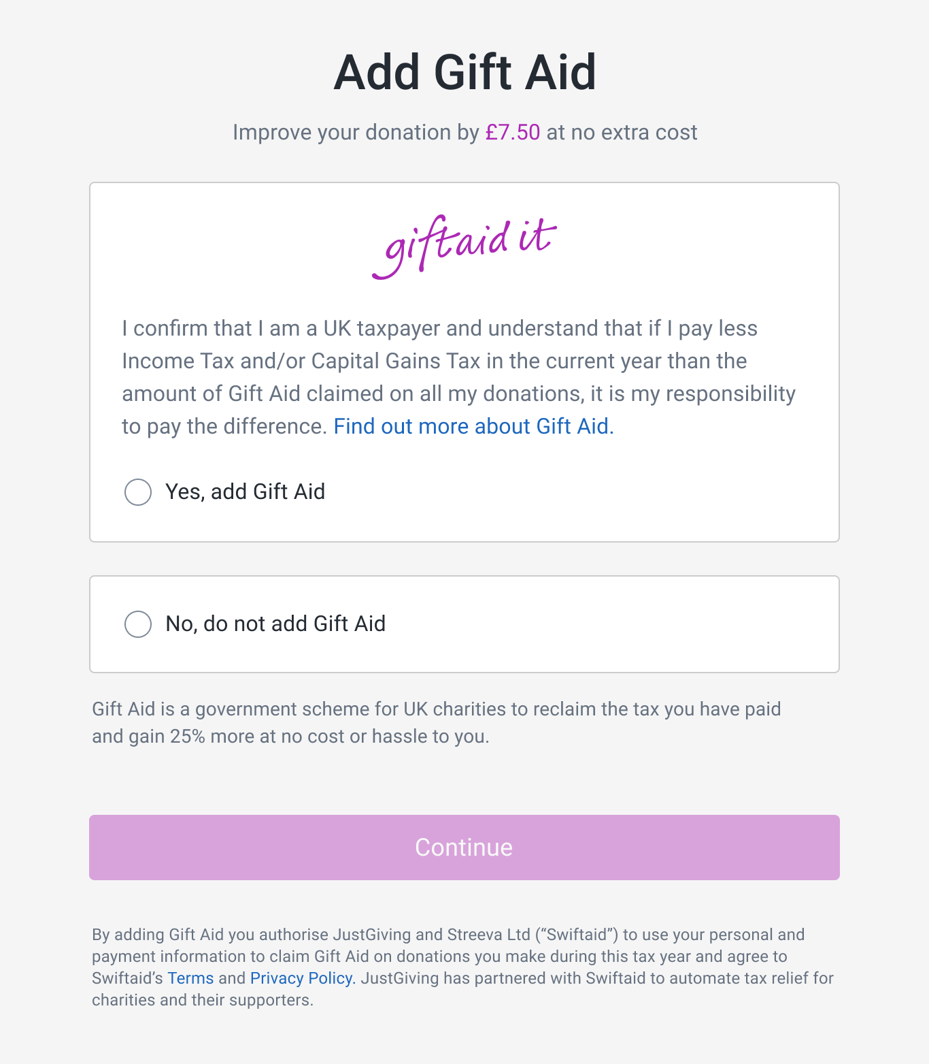
Swiftaid registration included with Gift Aid declaration

Slide 5
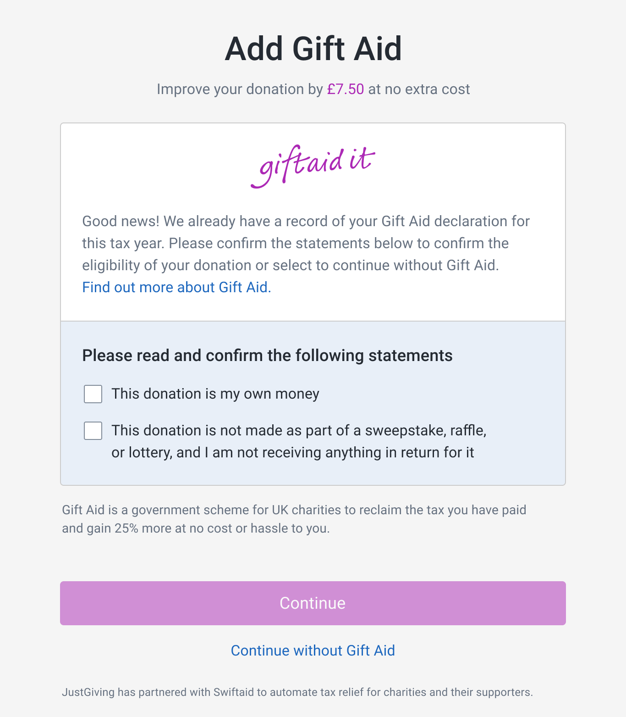
Simplified Gift Aid experience for users that are already enrolled with Swiftaid.

Slide 6
Following integration, eligible donors on the JustGiving platform will authorise Swiftaid to create Gift Aid declarations in the current tax year to any charity.
By Q4 2021 an estimated 15,000 net-new taxpayer records/ day will be added to the Swiftaid database via Justgiving
Any participant to the network will be able to use these constituents and their on-file GADs as well as add records of their own, and leverage Swiftaid to automate the Gift Aid submission process
Swiftaid will facilitate the identification of ‘retrospective’ Gift Aid as well as improve the quality of shared data

Slide 7
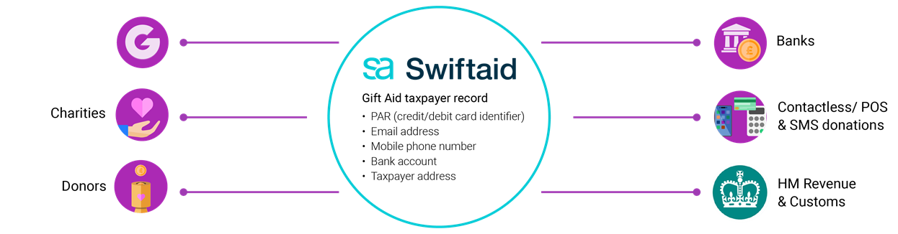


Justgiving’s role in the wider Gift Aid network
Swiftaid provides technical solution to address key challenges
Taxpayer data silos
Unwieldy, excessively manual collection/submission processes
                ill-suited to changing donation behaviours
JustGiving provides breadth and scale of donation volume
Network effect generates value
Scale of federated database is correlated to the value each network participant derives
Model is extendable to multiple donation modalities (present and future) and optimisations (e.g.- higher rate taxpayer management)

Slide 8
Benefits for charities
No change on how charities work with JustGiving.
Increased income of Gift Aid through JustGiving and all other donations methods linked to the network.
Charities can integrate with Swiftaid directly to add donors and add gift aid to current and retrospective donations.
Unlock Gift Aid on historical donations.
Gift Aid can be collected on donations that would otherwise be missed, for example Contactless.
The best donor experience - one time sign up across the network.
Up-to-date donor data - one place for donors to update their Gift Aid info rather than with each individual charity.
Donations are fed into the network and matched with the donor to automatically create declarations.
Swiftaid works closely with HMRC to ensure best practice and compliance with Gift Aid and GDPR requirements.

Slide 9
312
DAYS
8
HOURS
43
MINUTES
18
SECONDS
On the 6th April
half a billion pounds of Gift Aid
will be lost forever

Slide 10
Thank you, any questions?

