Slide 1
Justgiving Gift Aid management

Slide 2
Agenda
Background - the great Gift Aid reset of 2018
Current set-up and processes – frontend experiences and back-office
Recent and future developments - Swiftaid
Q&A discussion
Notes:
Enter presenter mode to view step-by-step GIF

Slide 3
Background – 2018 and prior
Gift Aid at Justgiving
UK’s leading fundraising platform
Serves around 20,000 charities
Largest Gift Aid agent in the UK by volume with approximately £65m/year of claims to HMRC
5% fee applied on processed Gift Aid amount
Eligibility rules prior to 2018 poorly enforced/understood on the platform
Universal Gift Aid mandate applied on an ongoing basis across charities for each donor
No explicit presentment of the GAD in most cases
Personnel changes on both sides meant we lost close feedback loop with HMRC
Consumer education on Gift Aid remains a challenge (still largely viewed as ‘free money’ by donors when asked)
HMRC requirements
Close the ‘Gift Aid gap’ – discrepancy between eligible vs paid out Gift Aid funds
Facilitate & reinforce consumer education
‘cleanse’ Gift Aid submission of glaringly ineligible items where practical
Expand approach to rest of sector
Notes:
Enter presenter mode to view step-by-step GIF

Slide 4
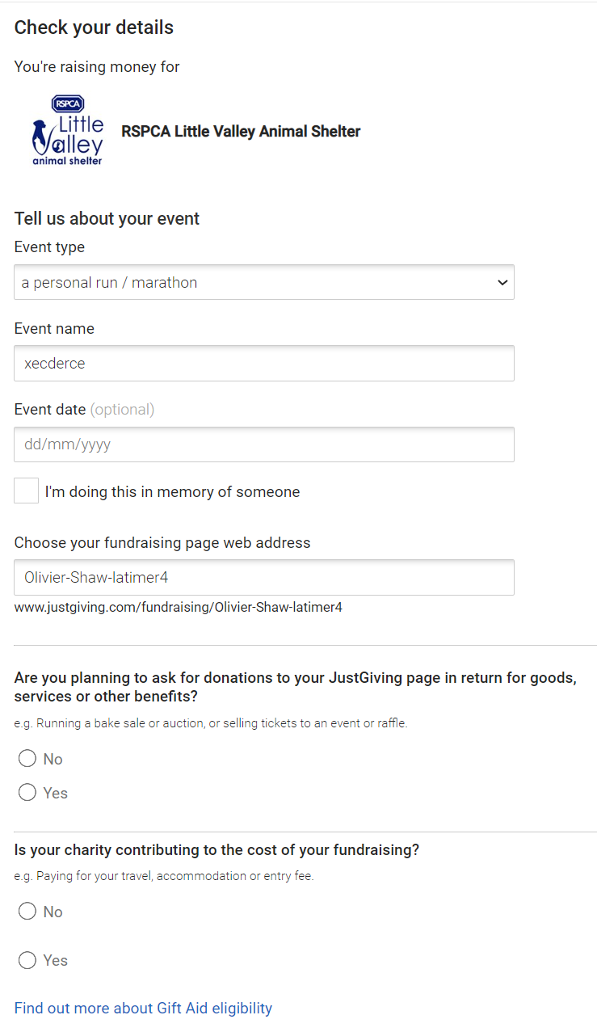
The platform today – multi-layered Gift Aid eligibility validation
The fundraiser experience - frontend
Notes:
Enter presenter mode to view step-by-step GIF

Slide 5
The platform today – multi-layered Gift Aid eligibility validation
The fundraiser experience - frontend
2 challenge questions presented as part of the process to set up a fundraising page
Focused on charity sponsored and ‘benefit in kind’ scenarios
Positive responses to either/both deactivates Gift Aid from the associated fundraising page experience
A selection via radio buttons vs single tick box is required
HMRC preference is to present both statements separately as well as a ‘more info’ link in order to underpin consumer education on the tax implications of Gift Aid
Notes:
Enter presenter mode to view step-by-step GIF

Slide 6
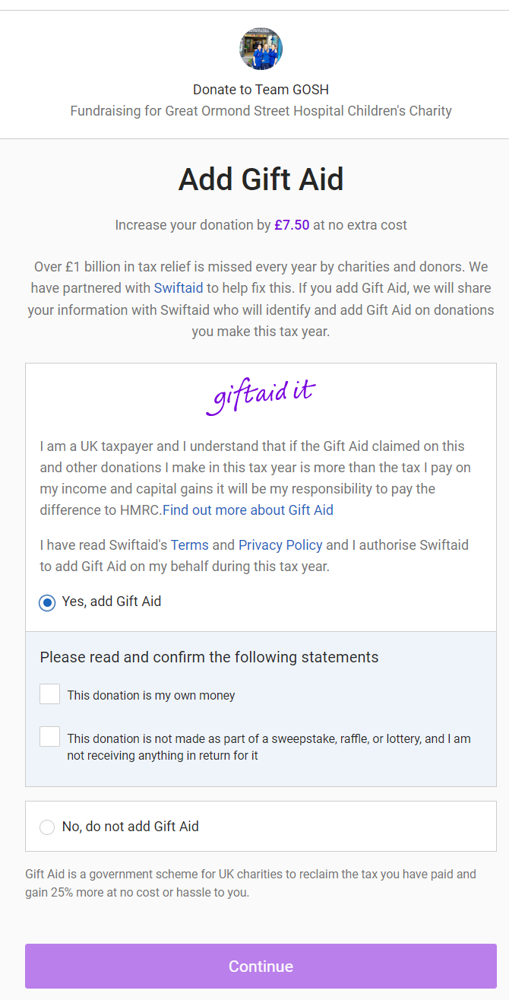
The platform today – multi-layered Gift Aid eligibility validation
The donor experience - frontend
Notes:
Enter presenter mode to view step-by-step GIF

Slide 7
The platform today – multi-layered Gift Aid eligibility validation
The donor experience - frontend
2 ‘filter’ questions presented as part of the consumer Gift Aid declaration process
Only present on fundraising page scenarios, not required on direct giving models
Focused on donor ‘own funds’ and ‘benefit in kind’ scenarios
HMRC preference is to present both statements separately and not pre-ticked, again in order to reinforce the correlation between Gift Aid and tax status of the consumer
Like most attributes of the Justgiving checkout, extensively AB tested to balance HMRC objectives (consumer education, mitigation of ineligible claims) with performance metrics (overall checkout abandonment, Gift Aid adoption rates)
Notes:
Enter presenter mode to view step-by-step GIF

Slide 8
The platform today – multi-layered Gift Aid eligibility validation
The donor experience – taxpayer details validation (frontend)
Name and surname details filtered vs list of blacklisted terms to pre-empt non-individual details being input
UK and overseas address modes both supported – overseas address requires full form input
UK post codes are REGEX’ed and looked-up against the same Post Office validation service as HMRC
For returning donors, taxpayer details are stored and displayed for verification on next donation experience
Notes:
Enter presenter mode to view step-by-step GIF

Slide 9
The platform today – multi-layered Gift Aid eligibility validation
Back-office scanning process
Donations are reviewed daily based on a pre-determined list of criteria into one of the following lists
Green – No action, proceeds to HMRC submission
Red – Gift aid is removed automatically
Amber – Gift aid approval/removal is manually reviewed by the Finance team
The following associated data points are used to cross-reference eligibility rules:
Donor first name
Donor last name
Amount
Sponsorship name (avatar selected by donor, e.g. ‘Big Joe’)
Address
Donor message
Page owner name
Key scenarios of ineligibility that are targeted are:
Gift Aid claimed on funds not originating from the taxpayer directly (group/corporate/family donations)
Donations involving any form of benefit in kind (eg- bake sales, raffles, tombolas…)
Non-UK registered taxpayers
Notes:
Enter presenter mode to view step-by-step GIF

Slide 10
The platform today – multi-layered Gift Aid eligibility validation
Back-office configuration
Overall, 500 separate terms/character strings/rules trigger a Gift Aid removal event or review. Below are some typical use cases and actions.
98% of flagged donations are managed automatically, with the remainder being reviewed and actioned on a discretionary basis by a member of the team
Donor first name | Donor second name | Amount | Sponsorship name | Taxpayer address | Donor message | Page owner name | Eligibility alert | Action
Joe | Bloggs | £10 | Surfer Joe | 123, Anywhere St W1 2AB | From everyone in the Accounting dept | Bob | Group donation | Gift Aid removed
Joe | Bloggs | £20 | Surfer Joe | 123, Anywhere St W1 2AB | Thanks for the cupcakes | Bob | Benefit in kind | Gift Aid removed
Joe | Bloggs | £10 | Surfer Joe | 123, Anywhere St W1 2AB | Donation on behalf of the Smith family | Bob | Taxpayer is not the donor | Review
Dental | Surgery | £35 | Happy Abi | 1 Aquinas St, Liverpool LV1 3ZW | Keep up the good work | Jane | Corporate donation | Gift Aid removed
Dr | Smith | £10 | The Doc | 123, Anywhere St W1 2AB | Void | Jane | Ambiguity on individual | Gift Aid removed
Emma | Robertson | £40 | Em | 1 Aquinas St, Guernsey | Love your work | Bob | Outside Gift Aid jurisdiction | Gift Aid removed
Joe | Bloggs | £10 | Surfer Joe | 123, Anywhere St W1 2AB | You f***** legend! | Harry | Profanity | Review
Anna | Brady | £100 | Ms Brady’s bunch | 123, Anywhere St W1 2AB | From Ludo the dog and all the kids at Little Hands nursery | Tom | Not an eligible taxpayer | Review
Emma | Robertson | £457.78 | Em | 123, Anywhere St W1 2AB | You’re amazing | Emma Robertson | ‘Offline’ donations loading | Review
Notes:
Enter presenter mode to view step-by-step GIF

Slide 11
Ways of working and looking ahead
It’s been painful (really) but we are now in a good place with our systems and processes
JG’s Gift Aid management model is now a standard of HMRC compliance ☺
Right balance between compliance and performance
Changes required initially hit overall Gift Aid adoption by 7% (ouch); Managing unhappy donors
We continue to iterate and have optimised our way back to previous performance and beyond
After initial investment cost, process is now run largely programmatically
Positive collaboration with HMRC; any proposed changes or tests are run past their team
Roadmap of upcoming initiative to further improvements
Gradual loosening in review scenarios where we can demonstrably establish eligibility is maintained
Swiftaid
Notes:
Enter presenter mode to view step-by-step GIF

Slide 13
Phone / ATM
£7m
Tins & Buckets
£88m
Direct Debits £197m
SMS
£12m
~£564 MILLION
MISSED EVERY YEAR
Charity websites
£21m
Charitable Giving and Gift Aid research report
Online Sponsorship
£24m
Sponsorship
£42m
Cash collection £96m
Envelope / Cheque £75m
Another £180 million claimed in error
Notes:
The problem is only going to get bigger.
£564m missed Gift Aid each year - 4 years back is a £2.25bn problem!
£180m is incorrectly claimed by non-taxpayers every year
This is mainly due to lack of opportunity to add Gift Aid and donor education. - report hmrc
With more innovative ways of collecting donations appearing every year we predict this problem to continue to grow. Contactless alone is predicted to generate £1.8bn in donations equating to around £450m in potential Gift Aid every year!
Innovation with Gift Aid is critical to maximise the amount collected every year and rescue the £billions missed.

Slide 14
UK taxpayers miss out on over £1 billion every year in personal tax relief

Slide 15
Swiftaid integration
Swiftaid requires a single authorisation from the donor for the tax year
Using donor intermediary legislation, introduced April 2017
Create a Gift Aid declarations during the tax current tax year
Donor receives a welcome email
Donor receives a statement of all Gift Aid given in the previous tax year by the 31st of May
Data is only ever used for Gift Aid
Swiftaid is the data controller and can create Gift Aid declaration for any charity
Implementing data cleansing to an equivalent level as JustGiving
Notes:
Enter presenter mode to view step-by-step GIF

Slide 18
https://swiftaid.co.uk/info
3 minute video on Swiftaid
1 minute video on Gift Aid
Gift Aid eligibility checker
Further information

Slide 19
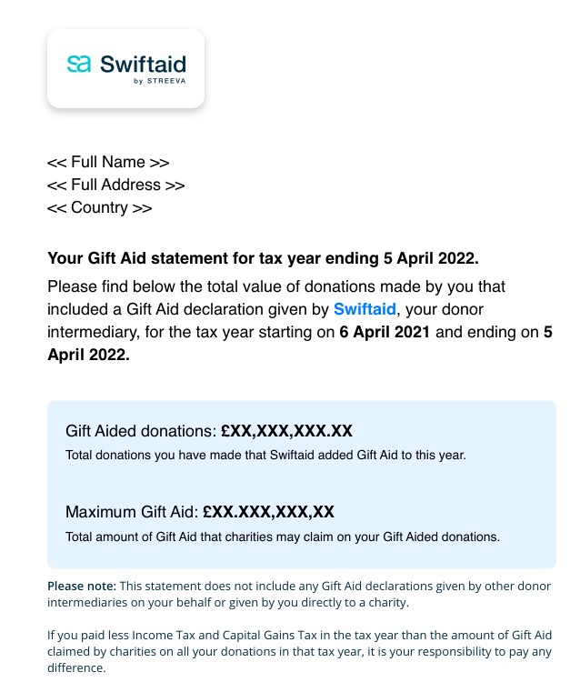
David Michael
1 High Street
Guildford
GU1 1AA

Slide 20
Swiftaid is the first ever universal solution for charitable tax relief
Over 1.6 million registered taxpayers in under 6 months
100,000’s new users joining every month at zero cost of acquisition
100’s of registered charities
Technology partner for Comic Relief / Red Nose Day 2022
Recognised by HMRC and listed on their registered software providers
Single authorisation
End of year statement
Retrospective Gift Aid
Learn more about Gift Aid on slide xxx
~3,000,000 Registered taxpayers July 2022
More than 200,000 joining every month
We have created a growing network of over a million UK taxpayers, hundreds of charities and fundraising providers.
Notes:
3m donors (over 200,000 joining every month)
That’s over 10% of UK taxpayers that donate to charity

Slide 21
Swiftaid is the first ever universal solution for charitable tax relief
Over 1.6 million registered taxpayers in under 6 months
100,000’s new users joining every month at zero cost of acquisition
100’s of registered charities
Technology partner for Comic Relief / Red Nose Day 2022
Recognised by HMRC and listed on their registered software providers
Claim submission
Increased Gift Aid income
Reduced administration
Learn more about Gift Aid on slide xxx
320+ Registered charities and integrators July 2022
We have created a growing network of over a million UK taxpayers, hundreds of charities and fundraising providers.
Notes:
Supported XXXX Gift Aid processed so far
Over 1.6 million registered UK taxpayers in just 5 months
Live partnership with the UK’s leading fundraising provider, JustGiving
Technology Partner for Comic Relief / Red Nose Day 2022
The first fully digital charity onboarding flow approved by HMRC.
First solution recognised to automate Gift Aid on contactless donations.
Technology and strategy behind an industry collaborative project ‘The Future of Gift Aid’
Swiftaid mentioned in multiple industry reports including the latest Office of Tax simplification report.

Slide 22
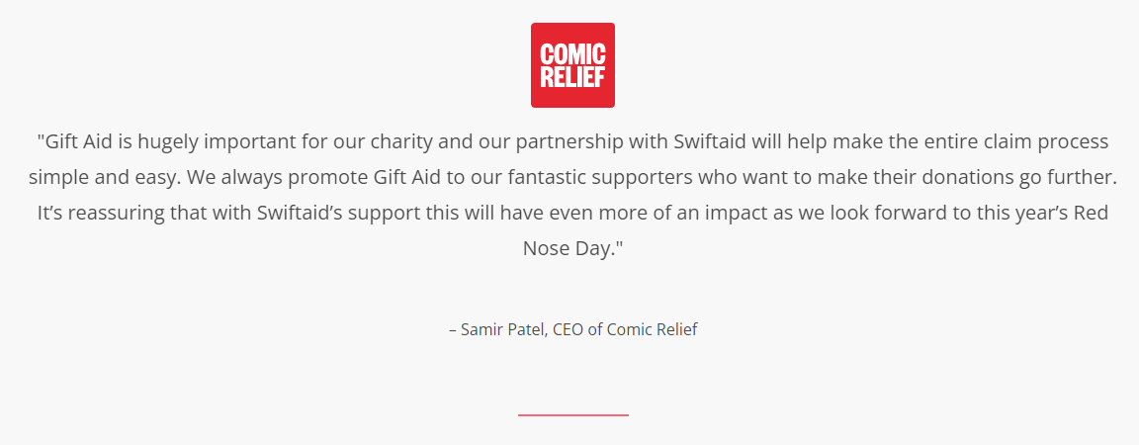

Slide 23
Why Swiftaid?
✅ HMRC recognised and listed as a trusted supplier
🔓 ISO 27001 and 22301 accredited (highest standards for Information Security and Business continuity)
📃 Methods published academically in the journal: ‘Formal Aspects of Computing’
💮 FCA regulated

Slide 24
Why Swiftaid?
🇬🇧 Publicly funded through Innovate UK
🚀 Leading technically on an industry wide project ‘The Future of Gift Aid’
💻 Fully digital charity sign up process (CHV1)
📃 Saves time and reduces burden of GDPR compliance/record keeping

Slide 25
Retrospective Gift Aid
£400,000
in ‘missed’ Gift Aid has been unlocked for charities on JustGiving

Slide 26
Future ready
Personal Tax Accounts
Retail
Admissions
Contactless
Micro-donations
SMS

Slide 27
Facts and figures
3 million donors
Over 1 million payment cards
21.7% of all declaration

Slide 28
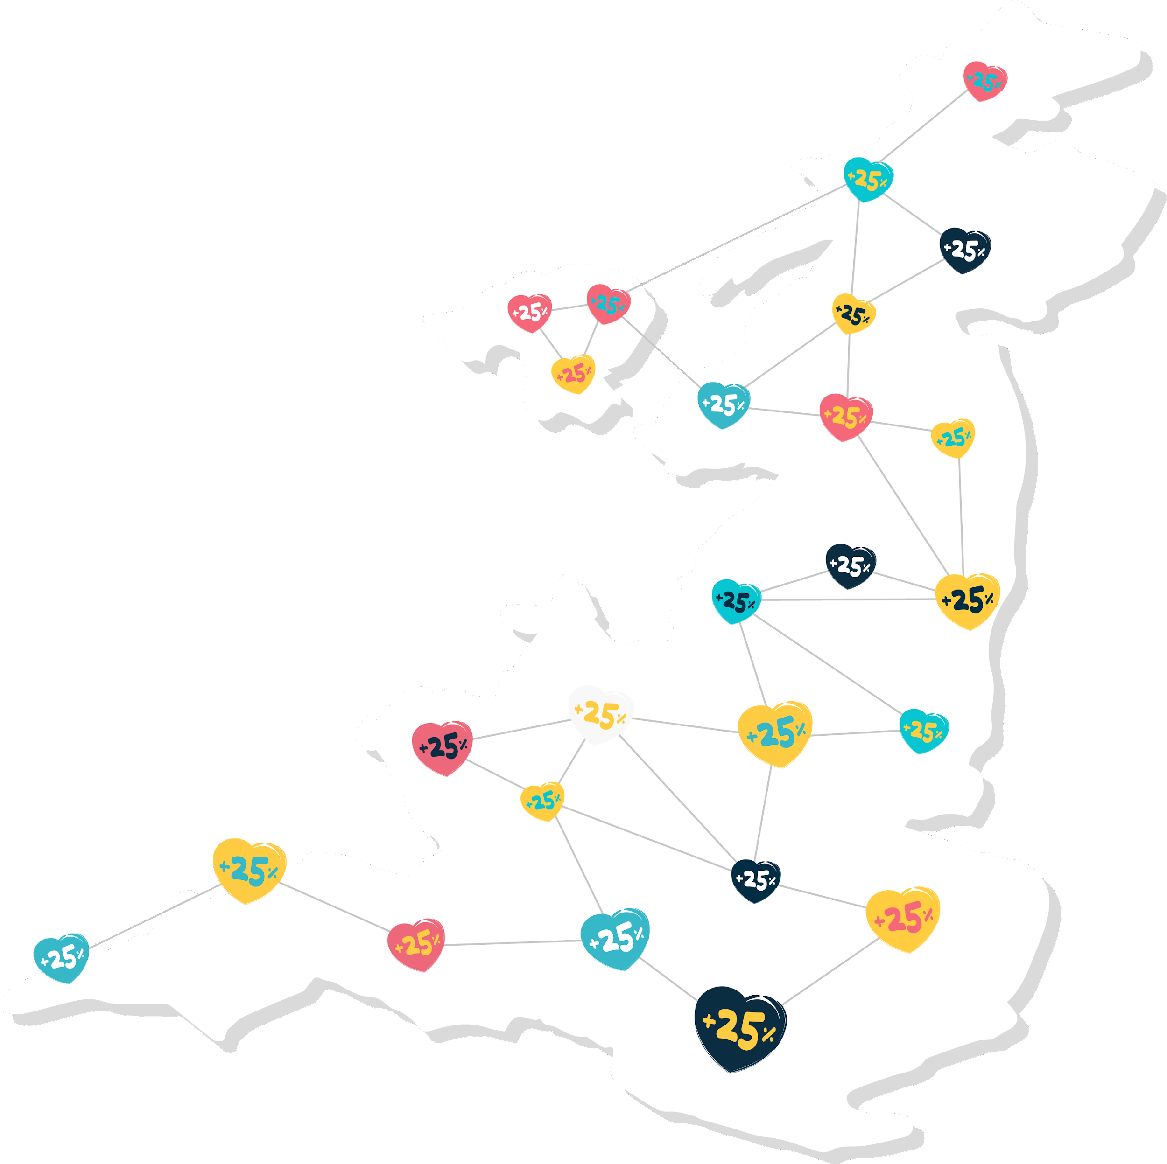
An estimated £1.5 million in missed Gift Aid every day!
Together we can help everyone claim Gift Aid more easily.

