Slide 1
New VAT Penalty regime
For VAT Accounting periods starting on or after 1 January 2023

Slide 2
1 | Old regime – default surcharge
2 | Penalty points – late submissions
3 | Late payment penalties
4 | Late payment interest
5 | Late repayment interest

Slide 3
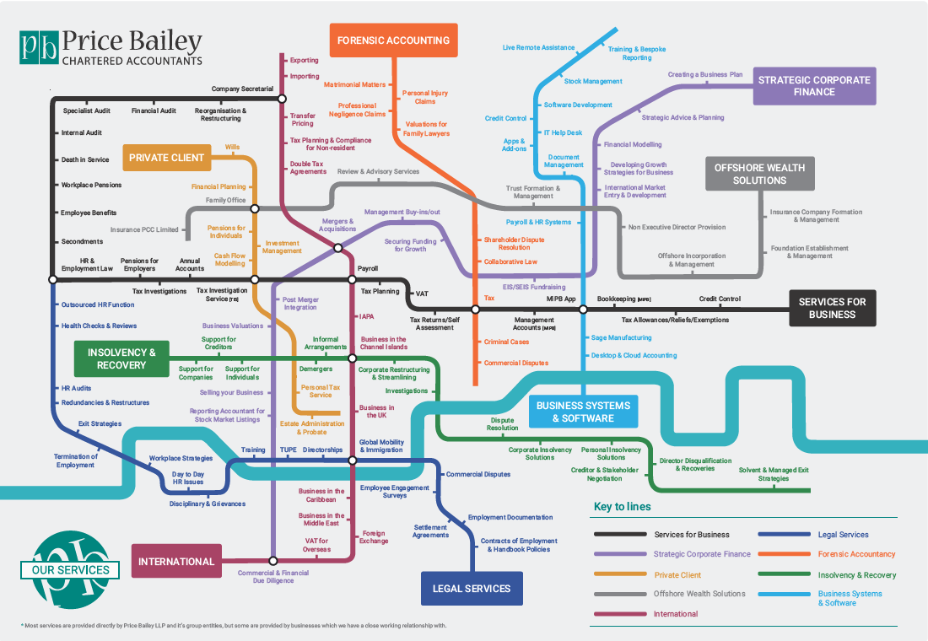
Who we are
We are a top 40 accountancy and business advisory firm serving private clients and regional, national and international business.
Our services include:
Accounting
Audit and Assurance
Corporate Finance
Employment Law and HR
Group Structuring
Insolvency and recovery
Tax
Services for Individuals
Valuations

Slide 4
Overview of Penalty Reform Changes from HMRC
‘A new points-based system for late submissions is designed to be more lenient to those who make the occasional slip-up whilst still penalising those who deliberately avoid their obligations.
The late payment penalties will be charged at different rates based on when the payment is received, making them more proportionate to the length of time the payment is outstanding.’
‘The new penalties are designed to be fairer and more effective.’

Slide 5
Old regime – default surcharge

Slide 6
Default surcharge regime for late filings and payments
Whilst no penalty is applied to the first late filing/ payment by a taxpayer under the old regime, this does trigger a 12 months default surcharge period.
Taxpayers, who are within a default surcharge period and are late in filing/ making a payment for their last return under the old regime, will be subject to the usual penalties of 2%, 5%, 10% and 15% respectively.
For quarterly VAT Accounting periods ending on 31 January or 28 February 2023, businesses are still subject to the default surcharge regime when VAT returns are filed and paid late.

Slide 7
Default surcharge regime for late filings and payments
First default (either late submission or payment) does not attract a penalty but a Surcharge Liability Notice (SLN) of 12 months will be triggered.
Late submission of nil or repayment returns or where payment is made on time does not incur a penalty but the SLN is extended for 12 month from the end of the latest period in default.
Whilst within the surcharge default period, any additional late submissions (where payments are due) or late payments will trigger an initial surcharge of 2% of the VAT outstanding, which is then increased to 5%, 10% and 15% for additional defaults.
HMRC does not issue a surcharge at 2% and 5% if it is calculated to be less than £400. A minimum of £30 applies to surcharges calculated at 10% and 15%.
Liability to surcharge expires if all returns/ payments are received on time during the surcharge period.
Key points of Default Surcharge Regime

Slide 8
Late Filing VAT Penalty points

Slide 9
Penalty points – Late submissions
A business will receive a penalty point for each VAT return submitted late, until they reach their threshold (based on their filing periodicity- this will be 4 points for quarterly filers), a £200 penalty will then be incurred.
A further £200 penalty will be charged for each subsequent late VAT return submission while the business stays at the threshold.
Please note that the above rules will not apply to a taxpayer’s first VAT return (if newly registered), their final return after de-registration or one off return (for periods other than one month, a quarter or a year).
For accounting periods starting on or after 1 January 2023, the new ‘points-based’ system will apply to late submissions (incl. nil or repayment returns).

Slide 10
Penalty points thresholds
Application to nil and repayment VAT returns
Penalties can now be charged for the late submission of nil and repayment VAT returns
Expiration of Penalty Points
Provided the threshold is not reached, individual points will expire automatically on the last day of the months, 24 months later for VAT or on the last day of the months, 25 months later for personal tax.
It is however possible to remove all penalty points when at the threshold.
Thresholds are dependent on the accounting period a business uses when submitting their VAT returns.
Accounting period | Penalty points threshold
Monthly | 5
Quarterly | 4
Annually | 2

Slide 11
Late submission penalties
Apr 23 Filed late
Jul 23
On time
Oct 23 Filed late
Jan 24
On time
Apr 24
Filed late
Jul 24
Filed late
Oct 24
On time
Jan 25
On time
Apr 25 Filed late
Penalty point example – Quarterly return
Penalty points
£200 penalty applied
£200 penalty applied

Slide 12
Removing penalty points
Accounting period | Period of compliance
Annual | 24 months
Quarterly | 12 months
Monthly | 6 months
If you have reached the threshold, total penalty points can be reset to zero once both of the following conditions are met:
Condition A: Complete a period of compliance
Condition B: Submit all outstanding returns
Condition A – Completing a period of compliance
A company submitting quarterly VAT returns will need to submit VAT returns on time for 12 months. The 12 month period of compliance will start on the first day of the month following the last missed deadline.
For instance, Company X’s last missed deadline was 7 August 2024, so the period of compliance will start from 1 September 2024 and end 12 months later, on 31 August 2025.
Condition B – Submit all outstanding returns
Company X will also need to submit any outstanding returns for the previous 24 months (this is inclusive of the period of compliance).

Slide 13
Removing penalty points
31 March 2023 30 June 2023 30 September 2023 31 December 2023
Late submission
Late submission
4 Points
Return outstanding
Late submission
Example- quarterly VAT filer
Condition A-
next 4 returns are filed on time
Condition B-
outstanding VAT return is submitted
31 March 2024 30 June 2024 30 September 2024 31 December 2024
Filed on time
Filed on time
Filed on time
Filed on time
0 Points

Slide 14
HMRC will also adjust any existing penalty points as follows:
Where an adjustment gives a minus figure (eg monthly to annual -3 points, quarterly to annual -2 points), penalty points will be adjusted to zero.
Changing an accounting period
Previous accounting period | New accounting period | Penalty points adjustment
Annual | Quarterly | +2 points
Annual | Monthly | +3 points
Quarterly | Monthly | +1 point
Agreeing a change of accounting period with HMRC will mean the relevant threshold will be adjusted accordingly eg quarterly (4 points) to annually (2 points)

Slide 15
Transfer of Going Concern (“TOGC”)
In taking over a VAT registered business as a going concern, no penalty points incurred by the business will be transferred to the new owner (even if the VAT number itself is transferred).
VAT Groups
A new representative member will take over any penalty points built up by the previous representative member.
However, the total penalty points of the group will not change if a new member joins (irrespective of their penalty points) or if a member leaves (no points are taken with them).
Additional notes

Slide 16
Appealing a late submission penalty point or a £200 penalty
Appeal a late submission penalty point or £200 penalty:
HMRC will advise a taxpayer as to a late submission point and/ or penalty via a penalty decision letter.
The taxpayer will then be able to request for a review or appeal to the tax tribunal. The taxpayer will apparently be able to view penalties as well as ask for a review via the online portal.
A penalty can still be cancelled if the taxpayer has a reasonable excuse.

Slide 17
Late submission penalty
Example 1
Default surcharge regime
Whilst Paul may be on a continuous default surcharge period following his first late submission, as the outcome of his returns is ‘nil’, repayment or paid in a timely manner to HMRC, no penalties should be incurred by Paul.
Paul is a VAT registered sole trader specialising in website design services which he provides to UK and non UK B2B clients.
As the outcome of Paul’s returns is often ‘nil’ or a small repayment, he is not overly concerned about submitting these on time and has in the past forgotten to submit a return altogether.
Paul does however make sure that all payments to HMRC are made on time.
New Penalty Regime
Paul will receive 1 penalty point for each late submission for VAT periods starting on or after 1 January 2023.
As this applies to all late submissions irrespective of return outcome, Paul can quickly find himself at the 4 points threshold, following which penalties of £200 per late submission will apply.

Slide 18
Late submission penalty
Example 2
Default surcharge regime
On the old regime, Shaun’s first late submission would not have incurred a penalty but would have triggered a default surcharge period. Additional late submission within the period would both extend the period (12 months from the end of the latest period in default) and incur the following penalties:
2nd late submission – 2% of the VAT liability
3rd late submission- 5% of the VAT liability
4th late submission- 10% of the VAT liability
5th and current late submission- 15% x £50,000= £7,500
Shaun is a VAT registered gardener tending to some of London’s most beautiful gardens.
Whilst the gardens he works on are manicured to perfection, Shaun is not as devoted to submitting his VAT returns on time and has already had four late submissions.
He has just submitted his fifth return late showing a payment position of £50,000.
New Penalty Regime
On the new regime however, Shaun would incur a penalty point for each late submission but no penalty would apply until his threshold was reached (in this case Shaun is a quarterly filer so a 4 point threshold).
On his current 5th late submission, Shaun would incur a £200 penalty.
A further £200 penalty would apply to any additional late submission as long as Shaun stays at the threshold.

Slide 19
Late payment penalties

Slide 20
Late payment penalties
Late payment penalties can apply to any payments of VAT not paid in full by the relevant due date except:
- VAT Payments on Account
- Instalments for the VAT Annual Accounting Scheme
For accounting periods starting on or after 1 January 2023, late payment penalties replace the VAT default surcharge.
The penalties are built around the idea that the sooner you pay, the lower the penalty rate will be.
 | First late payment penalty | Second late payment penalty
Payment up to 15 days overdue | None | None
Payment between 16 and 30 days overdue | Calculated at 2% on the VAT you owe at day 15 | None
Payment 31 days or more overdue | Calculated at: 2% of what was outstanding at day 15 Plus 2% of what is still outstanding at day 30 | Calculated at: A daily rate of 4% per year on the outstanding balance Charged everyday from day 31 until the outstanding balance is paid in full

Slide 21
Period of familiarisation
To allow taxpayers to get used to the changes, HMRC has set a period of familiarisation.
During this period, HMRC will not be charging a first late payment penalty until after 31 December 2023, provided that within 30 days of the payment due date, the taxpayer either:
Pays in full
Makes a ‘Time to Pay’ arrangement
12 months period until 31 December 2023

Slide 22
Late payment penalty
Default surcharge regime
Under the old regime, as this is Jenny’s third late payment, she falls within a default surcharge period. Assuming no earlier late filings/payments, Jenny’s first late payment would not incur a penalty but would trigger a default surcharge period. On her second late payment, Jenny would incur a 2% penalty on her liability and a 5% penalty would be applied to her current late payment i.e. 25,000 x 5%= £1,250
Jenny is a successful VAT registered carpenter.
Whilst her business has been thriving over the past twelve months, she struggles to make timely quarterly payments to HMRC and the payment for her March 2023 VAT return of £25,000 did not reach HMRC in time.
This is Jenny’s third late consecutive payment to HMRC.
New Penalty Regime- familiarisation period
As this is Jenny’s first quarterly period to fall under the new regime, no penalty would be charged within the first 30 days.
If payment is made after 50 days, two penalties will be charged at 2% of the VAT liability of £25,000 (based on amounts outstanding on day 15 and day 30 respectively) = £500 + £500 and an additional annual daily rate of 4% will apply to the outstanding amount for each day from day 31 of the payment being overdue, up to and including day 50 (£25,000 x 4% x 20/365 = £54.79). Total penalty payment of £1,054.79

Slide 23
Default surcharge regime
Under the old regime, as this is Jenny’s third late payment, she falls within a default surcharge period. Assuming no earlier late filings/payments, Jenny’s first late payment would not incur a penalty but would trigger a default surcharge period. On her second late payment, Jenny would incur a 2% penalty on her liability and a 5% penalty would be applied to her current late payment i.e. 25,000 x 5%= £1,250
(if 5th late payment/filing – 15% x £25,000 = £3,750)
Late payment penalty
Jenny is a successful VAT registered carpenter.
Whilst her business has been thriving over the past twelve months, she struggles to make timely quarterly payments to HMRC and the payment for her March 2023 VAT return of £25,000 did not reach HMRC in time.
This is Jenny’s third late consecutive payment to HMRC.
New Penalty Regime- familiarisation period
As this is Jenny’s first quarterly period to fall under the new regime, no penalty would be charged within the first 30 days.
If payment is made a year late, two penalties will be charged at 2% of the VAT liability of £25,000 (based on amounts outstanding on day 15 and day 30 respectively) = £500 + £500 and an additional annual daily rate of 4% will apply to the outstanding amount for each day from day 31 of the payment being overdue up to and including day 365 (£25,000 x 4% x 335/365 = £917.81). Total penalty payment of £1,917.81

Slide 24
New Penalty Regime - post familiarisation period
Late payment penalty
0-15 Days
Provided payment is made by Jenny within 15 days, no penalty will be incurred
Jenny is a successful VAT registered carpenter.
Whilst her business has been thriving over the past twelve months, she struggles to make timely quarterly payments to HMRC and the payment for her March 2023 VAT return of £25,000 did not reach HMRC in time.
This is Jenny’s third late consecutive payment to HMRC.
16- 30 Days
If payment is made by Jenny between Day 16 and Day 30, a 2% penalty will be applied to the outstanding liability 2% x £25,000= £500
31 Days or more
If payment is only made by Jenny 50 days after the payment is due, a 2% penalty will apply to the VAT amount outstanding on Day 15 (£500) along with another 2% penalty on VAT outstanding on Day 30 (£500) with an annual 4% applied daily from Day 31 and until the payment is made £25,000 x 4% x 20/365 = £54.79
Total payment due for paying 50 days late =£1,054.79

Slide 25
Appealing a late payment penalty
Appeal a late penalty payment:
HMRC will advise a taxpayer as to a late payment penalty via a penalty decision letter.
The taxpayer will then be able to request for a review or appeal to the tax tribunal. The taxpayer will apparently be able to view penalties as well as appeal these via online portal.
A penalty can still be cancelled if the taxpayer has a reasonable excuse.

Slide 26
Late payment interest

Slide 27
IMPORTANT
All late payments where VAT is due will be subject to interest including:
- A VAT return or a correction of a return
- A late payment on account which is required by large taxpayers
- An assessment made by HMRC
- Overdue late payment penalties
- Overdue late submission penalties
Late payment interest
For VAT accounting periods starting on or after 1 January 2023, late payment interest will be charged (in addition to late payment penalties) from the first day that the payment is overdue until the day it is paid in full.
The interest is calculated at the BoE base rate plus 2.5% (6.75% as of 13 April 2023) .

Slide 28
ABC Limited’s accounting period runs from 1 October 2023 to 31 December 2023, the deadline to submit this return and pay the VAT in full is 7 February 2024.
ABC Ltd submitted the return on time on 7 February 2024, and £7,650 VAT is owed to HMRC. It did not make the payment until 14 February 2024, a week later than the payment due date.
Late payment interest is charged on £7,650 for 7 days, from 8 February 2024 up to and including 14 February 2024.
For this example, the Bank of England base rate is 4.25% making the late payment interest rate 6.75%.
Late payment interest for 7 days is £9.90
(£7,650 x 6.75% x 7/365 days) = £9.90
Late payment interest
Example 1

Slide 29
XYZ Limited’s accounting period running from 1 January 2024 to 31 March 2024, the deadline to submit this return and pay the VAT in full is 7 May 2024.
XYZ Limited submitted the return on time on 7 May 2024, and £5,000 VAT is owed to HMRC. XYZ Limited did not make the payment until 7 May 2025, a year later than the payment due date.
XYZ Limited is charged late payment interest on £5,000 for 365 days, from 8 May 2024 up to and including 7 May 2025.
For this example, the Bank of England base rate is 4.25% making the late payment interest rate 6.75%.
Late payment interest for 365 days is £337.50
(£5,000 x 6.75% x 365/365 days) = £337.50
Late payment interest
Example 2

Slide 30
Late repayment interest

Slide 31
For periods starting on or before 31 December 2022, a repayment supplement may be due if HMRC does not pay a legitimate claim (repayment return) within 30 net days of receipt of the VAT return (as a form of compensation).
Provided all the conditions are met, the repayment supplement will be paid automatically at the same time the repayment itself is authorised, and will be the greater of 5% of the amount claimed on the return or £50.
A taxpayer will not qualify for repayment supplement if:
Their return is received late.
At the time of receipt, there are outstanding returns for other earlier periods.
There are errors on the return which offset the net amount claimed by more than 5% or £250 (whichever is the greater).
Repayment supplement

Slide 32
VAT Repayment interest will be paid at the BoE base rate less 1% (with a minimum rate of 0.5% (3.25% as of 13 April 2023).
Interest will not be paid if you overpay by error e.g. paying £1,000 instead of £100 (i.e. HMRC cannot be used as a bank).
Repayment interest will not be paid until all VAT returns are submitted (in case any are outstanding)
HMRC will pay repayment interest on any tax due to be repaid to the taxpayer – from day +1. Repayment interest ends when HMRC either repays the taxpayer the VAT or the amount is set off against another debt owed by the taxpayer.
Repayment interest
For accounting periods starting on or after 1 January 2023, the repayment interest replaces the repayment supplement.

Slide 33
Interest Rule | As it was | New rules
Late Payment Interest (LPI) | Nil % - Currently LPI is not charged on late payments for VAT returns | 6.75% ‐ Calculated at a rate of 2.5% + the Bank of England base rate (base rate currently 4.25%*, so the LPI would be 6.75%) Late payment interest will be charged from the day the payment is overdue until the day it is paid in full. LPI would also apply to LSP and LPP penalties if paid after 30 days.
VAT Repayment Interest | 5% - Repayment supplement for failing to make repayment within 30 days of the claim. The payment or refund that is due to the customer 5% of the amount that is to be repaid, or £50, whichever one is greater. | 3.25% - RPI will be paid at the Bank of England base rate less 1% (with a minimum rate of 0.5%). At the current base rate of 4.25%*, RPI will be 3.25%. HMRC will pay RPI on any tax due to be repaid to the customer (from day +1 a repayment return is received until the date a repayment is issued.)
VAT Interest Rules
*Base rate as of 13 April 2023.

Slide 34
Repayment supplement vs. Repayment interest
Repayment supplement
A repayment supplement will be due to Tim if there are more than 30 days between the time the date of receipt of the return and the date payment is authorised (deducting any enquiry period and provided the conditions are met).
5% x £10,000= £500
Repayment interest
As Tim has submitted his return to HMRC on time, he will be due repayment interest from the day after his payment deadline (7 May 2023) and until HMRC pays him on 7 June 2023.
£10,000 x 3% x 31/365= £25.48
Tim submits his March 2023 return on 3 May 2023 showing a repayment of £10,000.
HMRC pays the amount on 7 June 2023.

Slide 35
Any Questions?
www.pricebailey.co.uk/blog/a-comprehensive-guide-to-hmrcs-vat-penalty-regime

Slide 36
Contact us:
Dr Charlotte Page, Senior Tax Manager
Tel: 01223 941280
Email: charlotte.page@pricebailey.co.uk
Office: Cambridge
Emma Ryan, Assistant Tax Manager
Tel: 02073 827445
Email: Emma.Ryan@pricebailey.co.uk
Office: City of London

Slide 37
Cambridge Details:
E Cambridge@pricebailey.co.uk
T 01223 565035
Tennyson House Cambridge Business Park Cambridge Cambridgeshire CB4 0WZ
Office contact details
City of London details:
E city@pricebailey.co.uk
T 020 7065 2660
8th Floor Dashwood House 69 Old Broad Street London EC2M 1QS

