Slide 1


Payroll Giving
Terry Stokes, Senior Workplace Giving Manager, Barnardo’s
Caroline Gaskin, Development Manager, Together for Animals

Slide 2
In this session…
You will get a very brief history and benefits of Payroll Giving scheme and how you can introduce it
Hear about image problems Payroll Giving has had
Benefit from some myth busting
Look into the future in the form of:
  Payroll Giving Week

Slide 3

History of Payroll Giving
1987
Introduction of Payroll Giving
2020
During the first ‘lockdown’ quarter of 2020 Payroll Giving donations rose by 9.8%
2020–2021
A total of £143.9 million was donated to causes in 2020/21

Slide 4

A tax efficient way to give
Charity
A way to get full tax benefit immediately
Donor
Tax-free
Higher tax-rate benefit
No gift aid to claim
Higher rate donors – receive up to 45% tax on donation
Higher-rate tax-payers are a crucial donor group

Slide 5
How does the tax work?
Payroll Giving is the best way for charities to get full, immediate tax relief on donations.
Your donation | Cost to 20% tax payer | Cost to 40% tax payer | Cost to 45% tax payer
£10 | £8 | £6 | £5.50
£25 | £20 | £15 | £13.75
£50 | £40 | £30 | £27.50
Notes:
Mervi

Slide 6

Other benefits of Payroll Giving
Charity
Younger audience
Donor
Simple
Corporate
CSR
Unrestricted income
Sustainable income
Cost effective
Support one or multiple charities
Employee engagement
Awards for employers
Matching
Free to implement

Slide 7
Who are the main players
Setting and running a PG scheme is not complicated. These are names you might come across so it is good to know how they fit in the picture.
A Payroll Giving Agency is an NFP organisation that is registered with HMRC which allows them to process employee’s donations before tax is calculated. Normally Charge admin fee of 3-4%. Full list on www.gov.uk/payroll-giving
Charities Aid Foundation (CAF)
Charitable Giving (CG)
Charities Trust (CT)
Professional Fundraising Organisations (PFOs) work with employers to recruit Payroll Giving donors in the workplace on behalf of charities. CRUK pay one-off fee for each donor recruited.
Hands on Payroll Giving
Payroll Giving in Action
StC Payroll Giving
Good Giving
PGA (Payroll Giving Agency)
CRUK receives funds
PFO (Professional Fundraising Organisation)

Slide 8
Steps for setting up and running the scheme
An employer needs to set up a contract with a Payroll Giving Agent (PGA)
The employer then needs to promote the scheme to build staff awareness
Professional Fundraising Organisations (PFOs) are helpful
The payroll department needs to process the deductions (After NI, before tax)
Most modern payroll software is equipped to process this
The deductions then need to be transferred to the Payroll Giving Agent (PGA) together with a list of employees taking part
The PGA disburses the funds to the relevant charities
Notes:
Mervi

Slide 9

Payroll Giving –
Better than it looks!

Slide 10

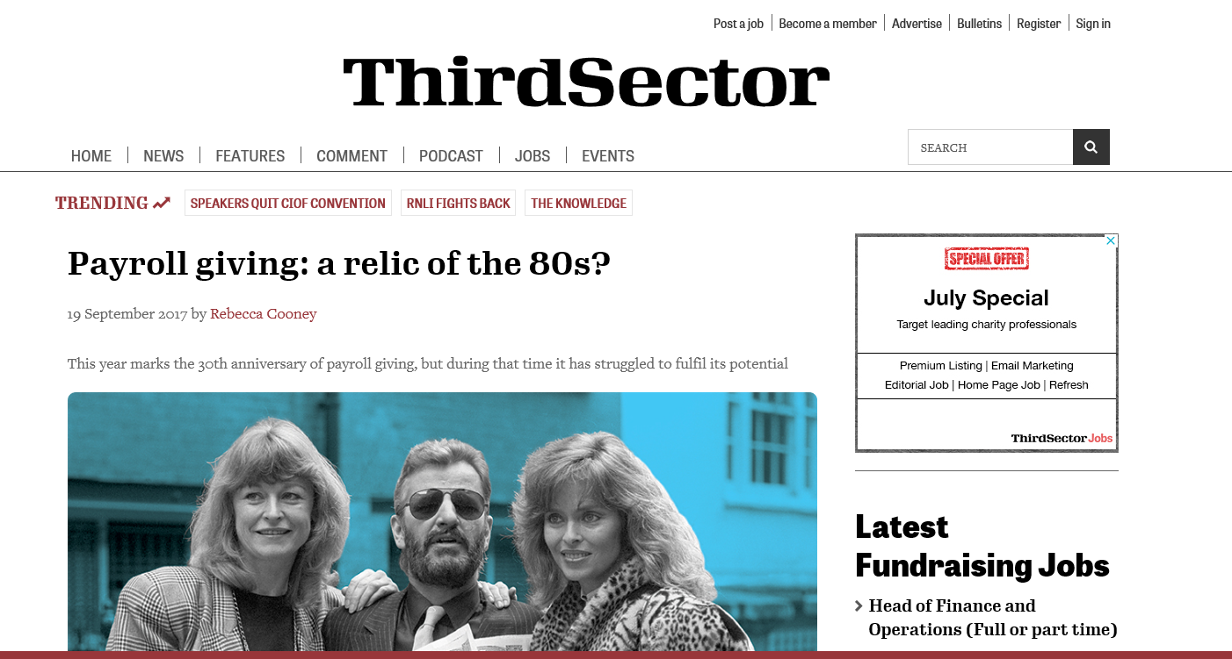
THE MYTHS
Low income
Poor relation of Regular Giving
Not worth the time
Dying form of giving
Corporate partners don’t care
Only works for big charities….

Slide 11
How to start shifting the situation aka. why are we here today
Improving awareness and access of Payroll Giving will benefit the whole sector
Payroll Giving has so much more potential as only approximately 1/3 of employers with 250+ staff have it in place for their employees
Matching alone provides extra income for thousands of charities
Income has stayed stable even during the pandemic
Promoting Payroll Giving does not mean that employees would not take part in fundraising events

Slide 12


Slide 13
From idea to the execution in 3 months..
WHY?
Unlike other areas of fundraising (Remember A Charity Week for legacies), there was no moment for PG. Payroll Giving Week changes that. The aim is to raise awareness amongst employers and charities and to encourage more employees to sign up to a payroll gift.
  First discussed at Payroll Giving Forum in November 2020
  Meetings between charities and stakeholders from Dec 2020
  First week timed for Feb 2021
  Cross-sector support: assets and logo
  Social media focused campaign

Slide 14


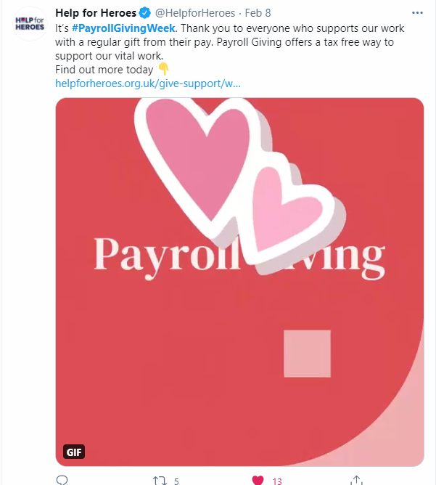



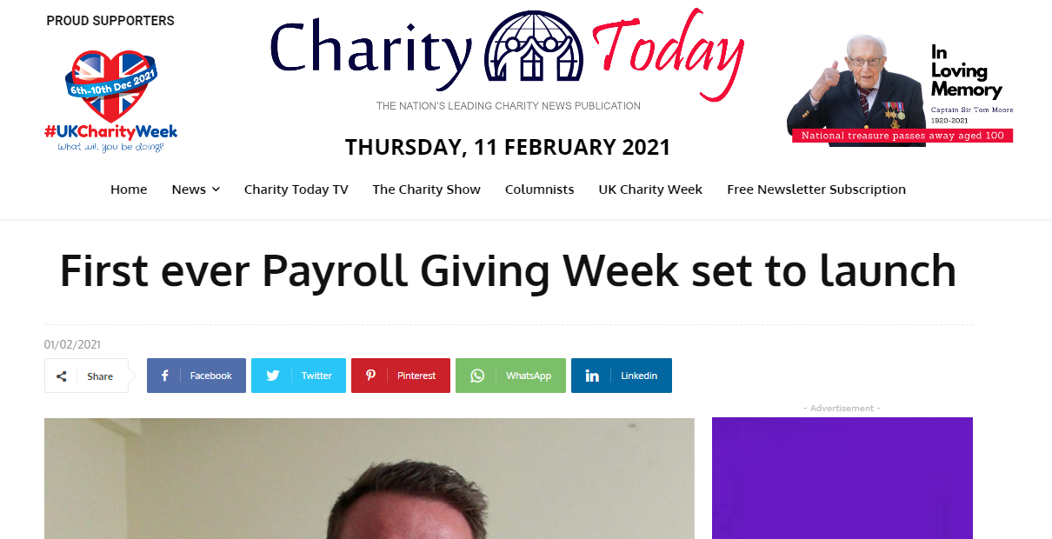
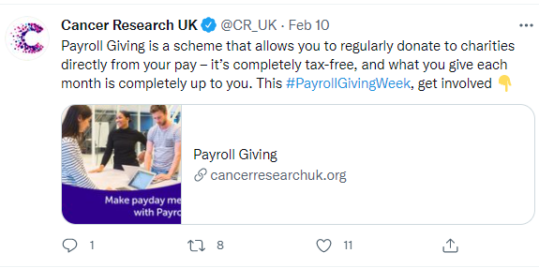
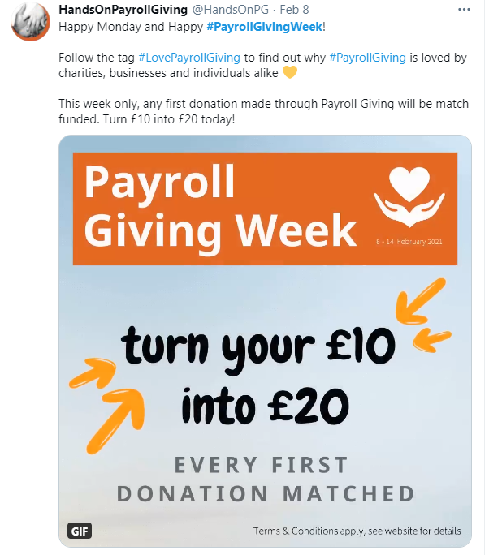
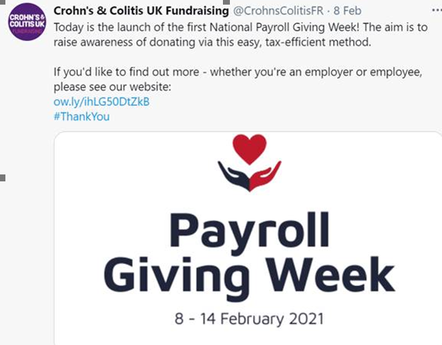
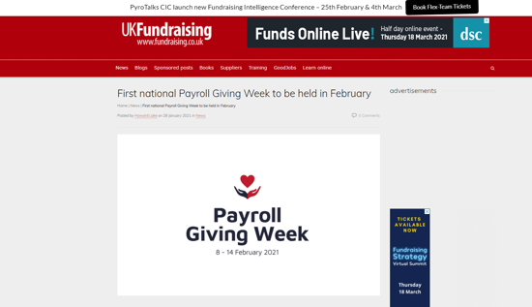
Many organisations joined us – and there was coverage in sector press and on social media…

Slide 15














































Slide 16

And the impact…
Payroll Giving is being talked about across the sector!
LOTS of charities want to know more!
Figures show……
  £147k per annum raised for the sector
  Average gift per month a whopping £37

Slide 17

Payroll Giving Week 2022
7th – 13th February 2022
Get involved: Help us raise awareness. Speak to fundraising colleagues that work on Payroll Giving. Encourage Corporate Partnerships to reach out to supporting companies.
Website – www.payrollgivingweek.co.uk

Slide 18
How to keep up to date?
Email charitypayrollgiving@gmail.com and you can then be added to charitypayrollgiving@googlegroups.com where you can access information and ask questions
Join us on LinkedIn – search Payroll Giving Week
Check out the website – www.payrollgivingweek.co.uk

Slide 19

Any questions?

