Slide 1


Technology and Tax: outlook for charities
23 January 2025

Slide 2
Session synopsis
Explore the evolving landscape of digital tax reporting and its implications for charities.
Is this new age a good or bad thing for charities?
Discover what steps charities should take to prepare for the future, where to invest in technology, and how to navigate potential pitfalls.
Evaluate the opportunities and challenges presented by the digital age for charitable organisations.

Slide 3


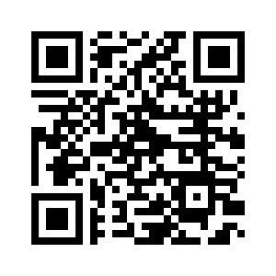
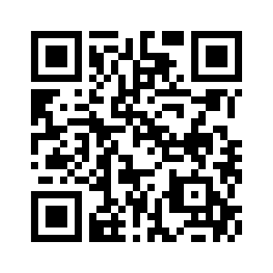
Your speakers
          Scott Harwood
            Indirect Tax Partner
            RSM UK
            scott.harwood@rsmuk.com
          Tom Gilbert
            Tax Technology Partner
            RSM UK
            tom.gilbert@rsmuk.com

Slide 4
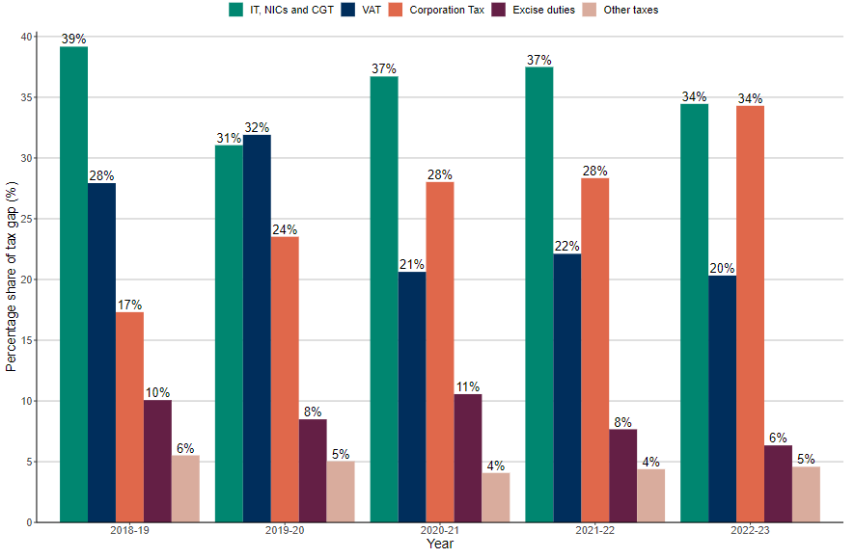
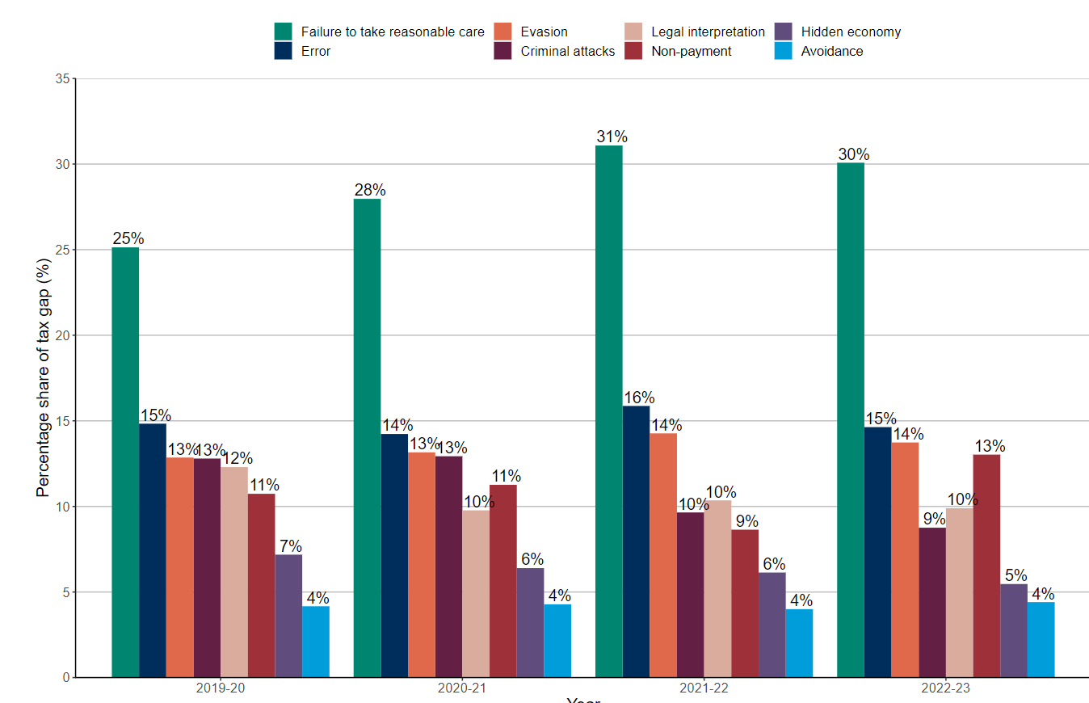
Focus of UK making tax digital
The tax gap is estimated to be 4.8% of total theoretical tax liabilities, or £39.8bn in absolute terms, in the 2022 to 2023 tax year.
Tax gaps: Summary - GOV.UK (www.gov.uk)
Tax gaps: Illustrative tax gap by behaviour - GOV.UK (www.gov.uk)
Tax gap by type of tax
Tax gap by customer behaviour

Slide 5
Impact on the VAT gap

Slide 6
Charities tax compliance
HMRC Consultation:
Charities tax compliance, 30 October 2024
2024 Budget statement:
“This government has decided to make incremental and modest changes to preserve these important tax reliefs for the compliant majority and help to protect the reputation of the sector.”
“strengthen existing charity tax rules from April 2026, to prevent abuse and ensure that only the intended tax relief is given to charities.”
Value of reliefs to the charity sector
£6bn

Slide 7

Blackberry image
Notes:
The journey we’ve been on, from this

Slide 8

iPhone / Huawei / Samsung and then who knows
Notes:
To the latest smartphone.

Slide 9

Notes:
And to the future - with machine learning and artificial intelligence fully embedded in the tax landscape. This was generated by MS co-pilot

Slide 10
Use of innovative technologies by tax authorities
95% using data science and analytical tools.
80% use big data for analytical purposes.
55% using AI and machine learning. (risk assessment and tax evasion/fraud detection)
50% using robotic process automation.
Tax Administration 2023, Comparative Information on OECD and other Advanced and Emerging Economies

Slide 11

Poll question: What innovative technologies does your charity utilise? (tick all that apply)
We use advanced data analytical tools
We use robotic process automation
We use dashboards for reporting and analysis
Other
We have fully embraced AI

Slide 12
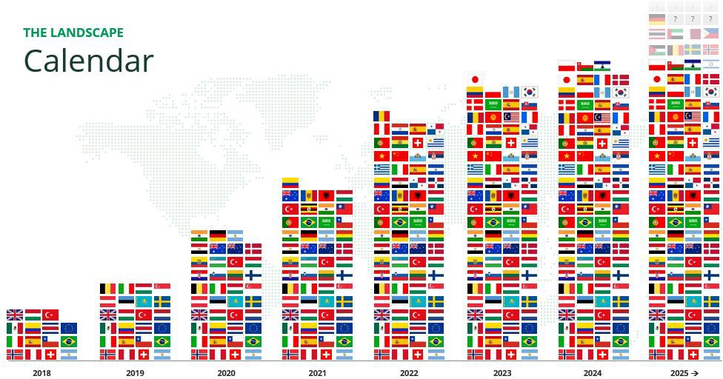
Digital tax reporting – a growing challenge

Slide 13

Global tax authority initiatives
Real-time reporting
SAF-T (Standard Audit File for Tax)
Making Tax Digital
E-invoicing
Split payments
Technology and Tax: future outlook for charities
Notes:
The future of VAT compliance - going digital and data being linked together across the globe
Overview of different types.
UK - waiting for information to be published by HMRC - expected early 2025

Slide 14
Key trends
Significantly increased focus on data
    Businesses – data quality
    Tax authorities – data analytics
“Electronic data from third parties, including other tax administrations, as well as internally generated electronic data is used in an increasingly joined-up way.
The increasing use of large and integrated data sets… has fuelled a significant increase in the use of analytics tools and techniques.”
OECD Tax Administration 2019 report
Tax Administration 2019, Comparative Information on OECD and other Advanced and Emerging Economies

Slide 15
Key trends
2. Traditional compliance role will change
    End of the periodic VAT return (Poland)
    Real-time reporting
    Pre-populated returns - compliance as a check
    Move away from Excel to dedicated reporting systems / platforms
Tax advisor role will change. Businesses will need significant assistance to adapt:
Systems
Processes
Software
Data

Slide 16








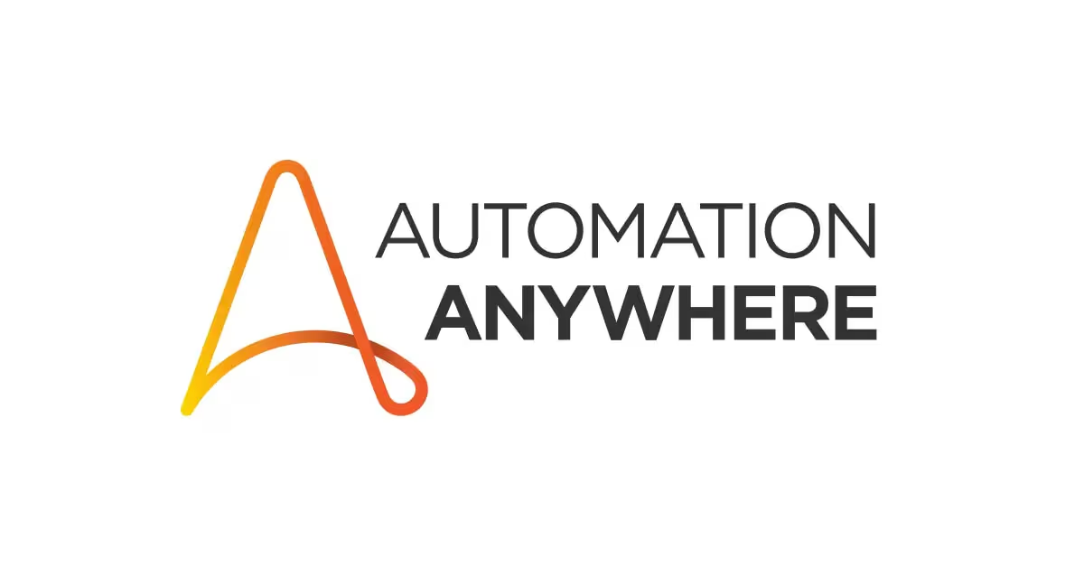



Rise of new technologies to help
Traditional AI: Perform tasks intelligently
Low-code / no-code tools
Predictive analytics
Anomaly detection
Classifying
Generative AI: Create new content
RPA (robotic process automation)
Research
Content and image creation
Text summarisation
Notes:
Before we look at how technology can help in more detail, wanted to cover an important set of guidelines that HMRC published towards the end of last year

Slide 17


Processes and systems (GfC8)

Slide 18
HMRC guidelines for compliance
1
5
General approach
Record to report
2
6
Order to cash
VAT reporting
GfC8:
VAT compliance
3
7
Procure to pay
Adjustments
4
8
Expenses
Outsourcing
Read more on what HMRC's VAT compliance guidelines here

Slide 19
What does good look like?
1
5
Ownership
Risks are recognised
2
6
Roles and responsibilities
Remove human input
3
7
Processes are mapped
Remove complexity
4
8
Reasonable checks
Subject to review

Slide 20
Steps to instigating change
1
5
Seek stakeholder buy-in
Documentation
2
6
Consult with the experts
Aligned risks
Testing and refreshing
Testing and refreshing
3
7
Compare and contrast
Training
4
8
Update systems & procedures
Engage with HMRC
Read more about tax, risk and governance here

Slide 21




Use of technology
IT infrastructure
Artificial Intelligence
Configuration Data
Master data
Source documents
Data input, transmission and output
Interfacing
Standardise, Tax code reviews
Template design
Explainable, Testing
Set-up,
Due diligence
Timing, Accuracy

Slide 22

Guidelines for Compliance 8 (GfC8)
Control point:
“Customer VAT numbers are verified”
General approach to VAT compliance controls (part 2) - GOV.UK

Slide 23
Are VAT numbers being verified?

Slide 24
What is the outcome?
* Based on HMRC ‘Check a UK VAT number’ website query where proof required

Slide 25
Tax technology solutions

Slide 26
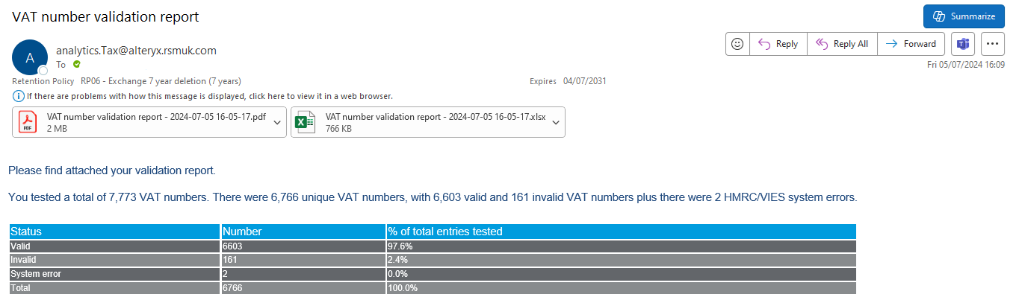
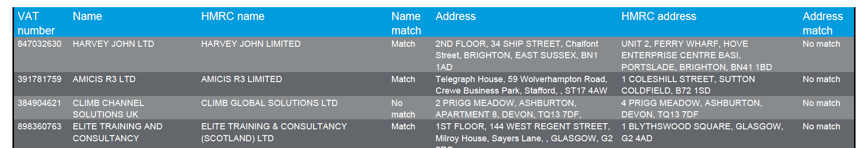
VAT number checker

Slide 27
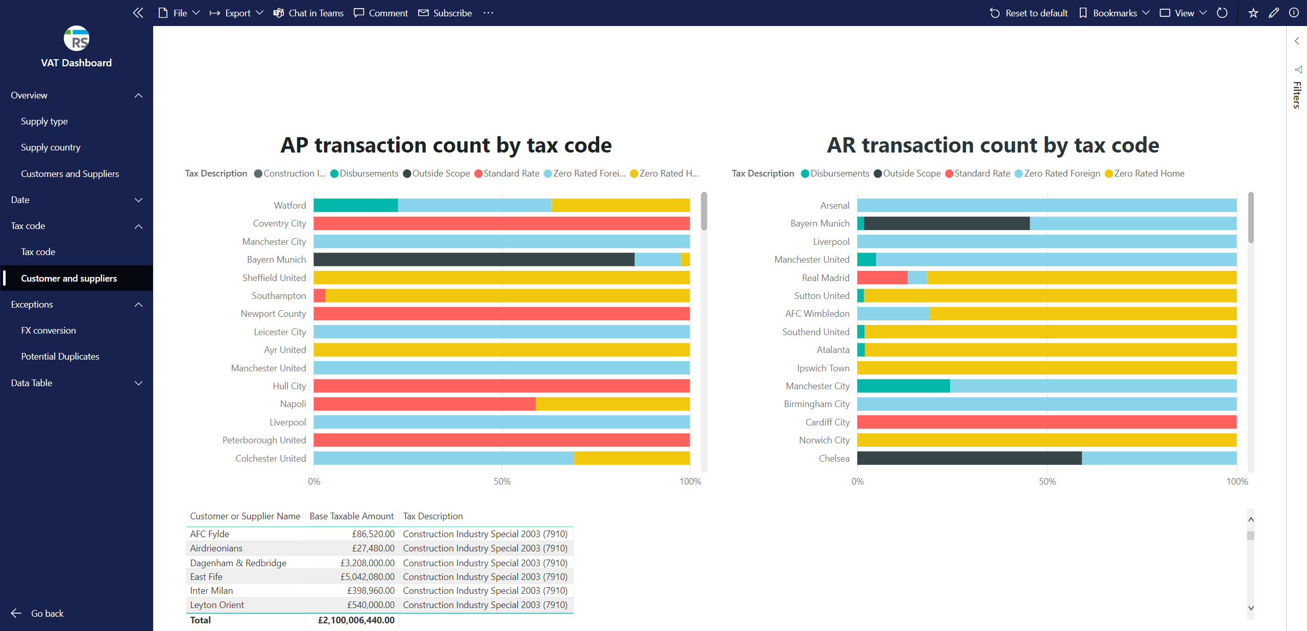
Dashboards to provide greater insight

Slide 28

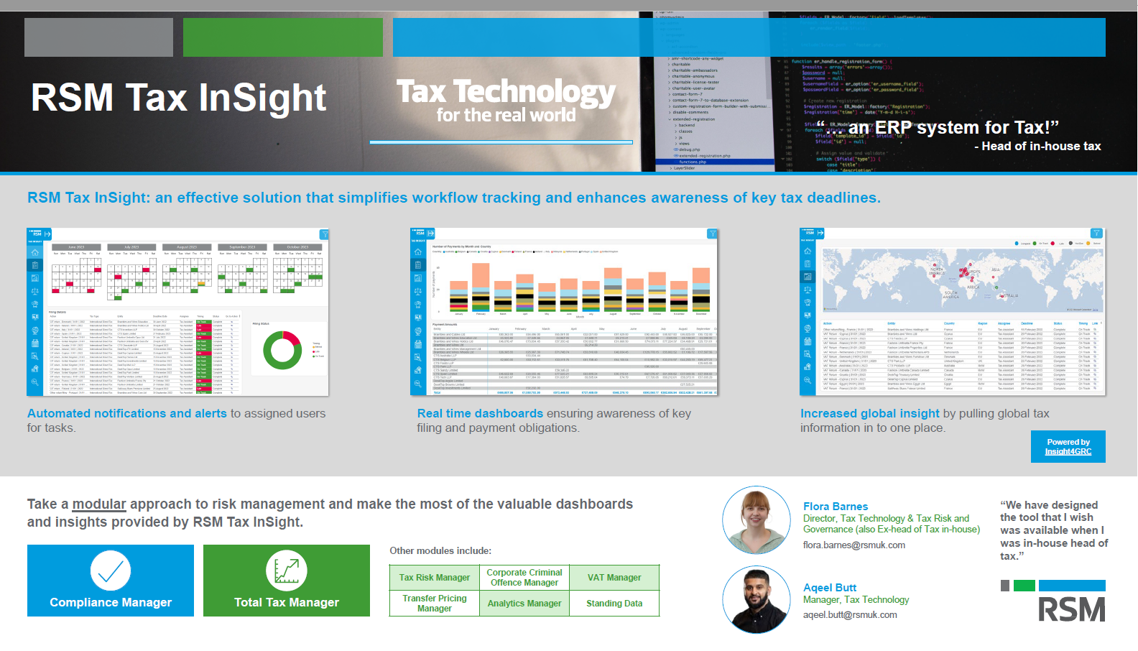
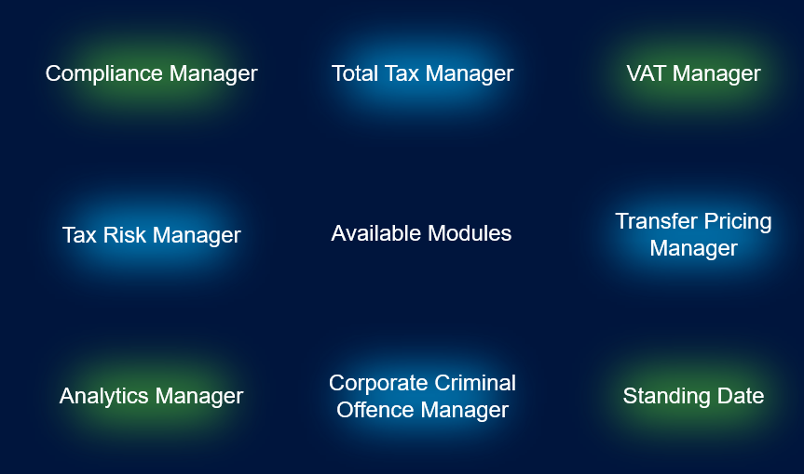
Simplify workflow tracking and enhance awareness of key tax deadlines
Automated notifications and alerts
Assign users to individual or joint tasks
Real time dashboard
Increased global insight
Modular build
Filing deadlines
Payment deadlines
Global tax information in one place
Use the most relevant dashboards for you
Add additional modules as your business requires.

Slide 29
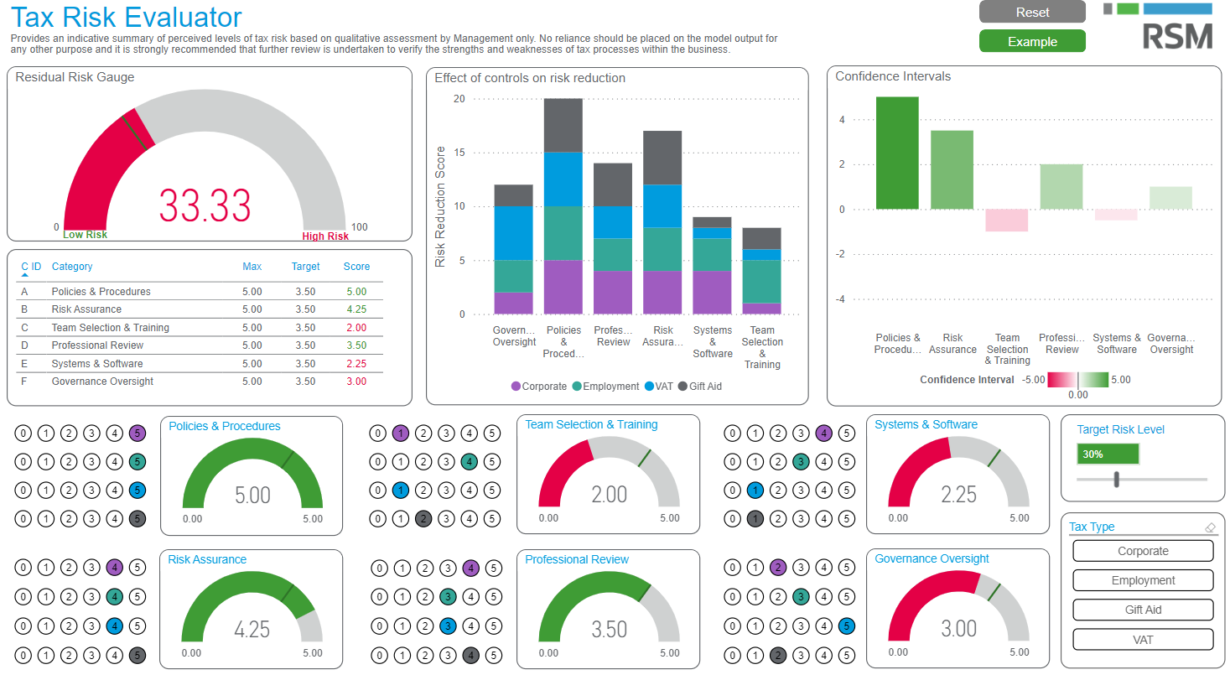
Tax risk evaluator

Slide 30

Case studies
New ERP implementation
Tax code setup
Copy existing setup (aka lift and shift) or re-do?
Involvement in rollout
Complexity of business / non-business and partial exemption fully understood?
VAT return automation
Replace manual, Excel heavy processes
Automation reduces risk of manual spreadsheet errors
Speed up the VAT return
Save days of time, freeing up staff to focus on more value-added tasks
Enhanced, automated data and exception checks
Flag more exceptions - only limited by data, not staff time

Slide 31
Poll question: what is your biggest barrier to digital tax reporting?
Internal resistance
Data quality and availability
Cost
Challenges with existing/legacy systems
Lack of skilled personnel
Regulatory compliance concerns

Slide 32

Q&As

Slide 33

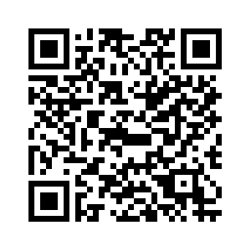
Explore our new charity trustee insights hub which provides guidance specifically tailored for charity trustees, addressing key challenges and developments within the charity sector.
Our hub will provide regular insights to charity trustees, helping to understand responsibilities and take appropriate steps to ensure proper governance, particularly during times of change and financial constraints.
Charity trustee insights hub
Discover our hub

Slide 34
25 Farringdon Street
London
EC4A 4AB
United Kingdom
T +44 (0)20 3201 8000
rsmuk.com
Thank you
The UK group of companies and LLPs trading as RSM is a member of the RSM network. RSM is the trading name used by the members of the RSM network. Each member of the RSM network is an independent accounting and consulting firm each of which practises in its own right. The RSM network is not itself a separate legal entity of any description in any jurisdiction. The RSM network is administered by RSM International Limited, a company registered in England and Wales (company number 4040598) whose registered office is at 50 Cannon Street, London EC4N 6JJ. The brand and trademark RSM and other intellectual property rights used by members of the network are owned by RSM International Association, an association governed by article 60 et seq of the Civil Code of Switzerland whose seat is in Zug.
RSM UK Corporate Finance LLP, RSM UK Legal LLP, RSM UK Restructuring Advisory LLP, RSM UK Risk Assurance Services LLP, RSM UK Tax and Advisory Services LLP, RSM UK Audit LLP, RSM UK Consulting LLP and RSM UK Creditor Solutions LLP are limited liability partnerships registered in England and Wales, with registered numbers OC325347, OC402439, OC325349, OC389499, OC325348, OC325350, OC397475 and OC390886 respectively. RSM UK Employer Services Limited, RSM UK Tax and Accounting Limited and RSM UK Management Limited are registered in England and Wales with numbers 6463594, 6677561 and 3077999 respectively. All limited companies and limited liability partnerships are registered at 6th Floor, 25 Farringdon Street, London, EC4A 4AB. The UK group of companies and LLPs trading as RSM is a member of the RSM network. RSM is the trading name used by the members of the RSM network. Each member of the RSM network is an independent accounting and consulting firm which practises in its own right. The RSM network is not itself a separate legal entity in any jurisdiction.
© 2025 RSM UK Group LLP, all rights reserved

