Slide 1
CTG Tax Conference 2018
15 May 2018
@CharityTaxGroup
#CTG2018

Slide 2
Charity Tax Group business
15 May 2018
@CharityTaxGroup
#CTG2018

Slide 3
CTG Tax Conference 2018
15 May 2018
@CharityTaxGroup
#CTG2018

Slide 4
CTG Tax Conference 2018
Chairman’s welcome – John Hemming
@CharityTaxGroup
#CTG2018

Slide 5

Making Tax Digital
Charity Tax Group Conference
15th May 2018
Oliver Fisher
HMRC

Slide 6
Tax administration is currently inefficient. It…
1
2
3
4
reflects iterative change to tax processes that have their roots in the 19th Century
runs on a range of computer systems that don’t talk to each other
relies on customers/agents to tell us information even if we know it already
without change we will fail to realise technological potential
Making Tax Digital is reshaping tax administration to be more effective, efficient and easy for HMRC’s customers
This will enable customers to transact online with HMRC and get a personalised, secure and up to date service
The goal is for the UK to have a world leading digital tax administration

Slide 7

Why make Tax Digital?
A digital future – over 2 million businesses already keep records digitally, MTD will support the ongoing trend to move to digital services
Better records – Integrating tax into a singe set of business records will make tax easier and more certain; unlocking long-term time savings through simplification
Getting it right first time – It will help business get their tax right. Reducing the amount lost through error by £600m a year
Future proofing – deliver a platform that will unlock future help, such as targeted messages and flagging reliefs and entitlements, which will help businesses grow.

Slide 8
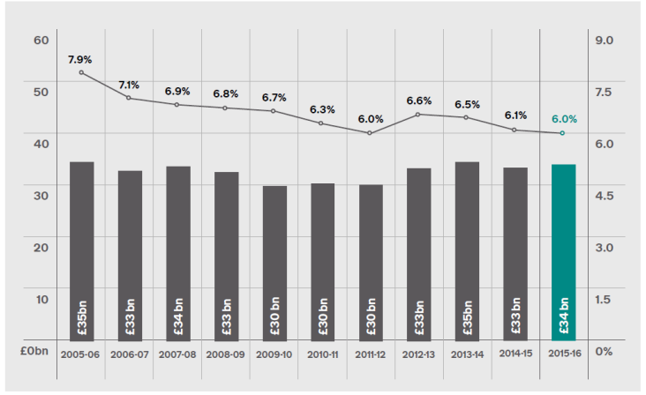
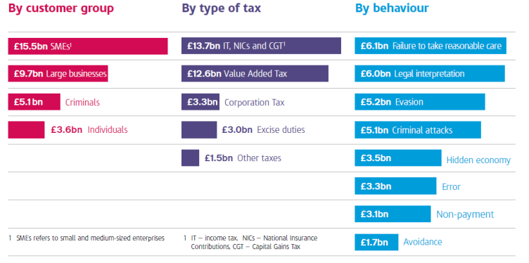
Tackling the Tax Gap
For a number of years the overall level of non-compliance has not changed significantly, but the make-up of the tax gap continues to change.
The UK tax gap is one of the lowest in the world

Slide 9
Story so far….
Ministerial Statement (July 2017)
IT pilot extended (March 2018)
VAT Technical consultation (January 2018)
VAT pilot (April 2018)
Initial consultation (August 2016 – January 2017)

Slide 10
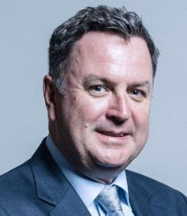
“what I’m very keen to signal to everybody out there… is that we are serious about it [MTD] and it will happen, so there will be no question of any further delay on this, so we all need to make sure that we’re ready for it.”
Rt Hon Mel Stride MP - Financial Secretary to the Treasury

Slide 11




Key concepts

Slide 12

What will MTD mean for Charities?
  Income Tax (IT) -Voluntary;
    For entities paying IT, an exemption exists for trustees of charitable trusts
    The non-trading activities of charities are out of scope but charitable trading subsidiaries are in scope retaining parity with trading competitors.
VAT - Mandated
    VAT rules remain applicable as now. Only charities who are VAT registered and with taxable turnover above the VAT registration threshold will be mandated to use MTD from April 2019.
CT
    No decision on when MTD will be introduced for Corporation Tax or the detailed design.

Slide 13
What is MTD for VAT?
‘Businesses’ with taxable turnover above the VAT registration threshold (currently £85,000) will be mandated from April 2019, to:
    keep VAT business records
    provide their VAT Returns to HMRC through ‘functional compatible software’
Applies to charities registered for VAT in exactly the same way as any other registered entity
Making Tax Digital will be available on a voluntary basis to other VAT registered entities
(MTD will not mandate other taxes before April 2020 at the earliest)

Slide 14
MTD VAT Legislation
Primary powers in VAT Act as amended by Finance (No.2) Act 2017
Consultation on draft VAT Regulations closed on 9 February 2018; Regulations have now been laid. Changes made from consultation draft:
    Businesses leaving MTD can consider alternative methods of preserving their records rather than having to keep them in a specified MTD format.
    A power to vary or relax requirements (for recording information) via directions
  Expect to publish VAT Notice in early summer

Slide 15
MTD Digital links and adjustments in practice (example 1)
Digital records maintained in non-API enabled software
Digital Link
VAT return submitted to HMRC
Agent/Auditor’s API enabled software
API
Adjustment by manual intervention
This could range from correcting mistakes to adjustments required by VAT law. Could take place within the confines of a single software product.
This could be a spreadsheet
Adjustments

Slide 16
MTD Digital links and adjustments in practice (example 2)
Digital records maintained in API-enabled software
VAT return submitted to HMRC
API
Adjustment by manual intervention
This could range from correcting mistakes to adjustments required by VAT law. e.g. capital goods scheme
This could be an API enabled spreadsheet as well
Adjustments

Slide 17
VAT Pilot
Started in April 2018
Agent can act on behalf of their client
Simplest businesses first
More complex businesses join as pilot grows
Must have compatible software to take part
Software development and testing
Publish more information

Slide 18
Next steps…
  Talk to your software provider
  Talk to your accountant
  Talk to your HMRC
  Take part in the pilot

Slide 19

Thank you

Slide 20

Why does irrecoverable VAT on purchases have to be recorded under MTD? In some cases, for heavily exempt charities, changing to this process will increase costs with no perceived benefit (particularly on expense claims etc. where there is high volume and low recoverable VAT value)?
How can business/charities/public sector have confidence in the HMRC software etc. being ready by 1 April 2019 given recent experiences of tax software (e.g. RTI and the Check employment status’/ESI tool), and the fact that Brexit is at almost exactly the same time and no one knows what will happen there yet?
Amanda Darley, Tax Specialist,
British Universities Finance Directors Group

Slide 21
Q&A
@CharityTaxGroup
#CTG2018

Slide 22
CTG Tax Conference 2018
15 May 2018
@CharityTaxGroup
#CTG2018

Slide 23
Giving incentives and the future of Gift Aid
@CharityTaxGroup
#CTG2018

Slide 24


CTG ANNUAL TAX CONFERENCE
Barnaby Brand
Quality and Compliance Manager
WWF-UK

Slide 25
What motivates donors?
Gift Aid is it’s own incentive.
25% extra to the charity “why would you not want to do this?”
The main key consideration is how to explain the benefits for the charity to the donor in a way that makes sense to them.

Slide 26

What puts donors off or makes Gift Aid difficult to understand?
Scary words, Tax, HMRC!
Complex declaration wording is off-putting.
Trust, it seems too good to be true.

Slide 27
What is the future of Gift Aid and is it fit for modern purposes?
The core of Gift Aid is fit for purpose.
The challenge for the future is how to integrate new payment methods and giving platforms.
Technology and innovation move much faster than regulation and guidance.

Slide 28
Giving incentives and the future of Gift Aid
Professor Kim Scharf, University of Birmingham
@CharityTaxGroup
#CTG2018

Slide 29
Evaluating the Effectiveness of Gift Aid
Kimberley Scharf May 15, 2018

Slide 30
The Paper
e More Giving or More Givers? The Effects of Tax Incentives on Charitable Donations in the UK
Disclaimer: This work contains statistical data from HMRC which is Crown Copyright. The research datasets used may not exactly reproduce HMRC aggregates. The use of HMRC statistical data in this work does not imply the endorsement of HMRC in relation to the interpretation or analysis of the information.

Slide 31
UK individual tax incentives for giving: Gift Aid
e General tax relief for charitable contributions introduced in 1990 (called Gift Aid)
e Most people do not fill in tax returns; solution was to use a match-style element as well as a rebate element
e Charities can claim basic rate income tax relief (at 20 per cent) on donations, equivalent to a 25 per cent match on gifts out of net-of-tax income
e Higher-rate taxpayers who fill in self-assessment tax returns, can additionally claim the difference between their marginal rate and the basic rate on the tax return
e System fully equivalent to a deduction

Slide 32
Two questions for the tax administration
e Stated policy objective was to “increase donations”
e Question 1: does Gift Aid do what its supposed to do;
e Question 2: Gift Aid is costly (£1.8 billion in 2015-16) so is deduction the best way of incentivising giving, i.e., is Gift Aid cost-effective
e No UK evidence based on actual tax returns

Slide 33
How to answer
e Estimate price elasticity of giving (incorporates taxpayer responses; has issues but good place to start)

Slide 34
Requirements
e A major policy change that changes the price of giving (1-MTR)
e Data on donations before and after the policy change
e A method for identifying that any changes in behaviour are due to the change in the price of giving and not something else

Slide 35
Policy change
e We exploited a major policy change in 2010 in the UK: Two new tax brackets for higher rate taxpayers – marginal tax rates increased from 40% to 50% (or 60% for a period of time)
e Effect of reform was to lower the price of giving for higher-rate taxpayers who claim the rebate on their self assessment tax returns

Slide 36
UK income tax reform of 2010
1
Price of Giving Relative to Consumption
.8
.6
.4
.2
0
0 50 100 150 200 250
Adjusted Net Income (£'000s)
Price of Giving (2009/10) Price of Giving (2010/11)

Slide 37
Data and change in behaviour
e Full population of HMRC’s Self-Assessment (SA) Income Tax returns for the period 2004/05 through 2012/13
e Approximately 8-9 million returns per year: N = 75 million
e Does not include about 22 million taxpayers who do not file a tax return (Pay As You Earn system)
e Only 11% of taxpayers report positive donations

Slide 38
Graphical Diff-in-diff Analysis
Figure: Normalized Average Donations by Income Group
1.4
Average Donations, Normalized
1.2
1
.8
.6
2004/05 2005/06 2006/07 2007/08 2008/09 2009/10 2010/11 2011/12 2012/13
Fiscal Year
Income < £100k
Income in (£100, £113k)
Income in (£113, £150k) Income > £150k
Note: Calculations derived from HMRC’s administrative data sources

Slide 39
Identification
e Very gnarly problem
e Used a variety of approaches
e Preferred specification – first differenced regressions (read the paper)

Slide 40
Summary of Overall Elasticity Estimates
e Preferred empirical specification:
Intensive-margin price elasticity: ≈ −.25
Extensive-margin price elasticity: ≈ −.1
Total price elasticity: ≈ −.35

Slide 41
Summary of Elasticity Estimates by Income Level
e Bottom 25% of income distribution:
Extensive-margin price elasticity: ≈ −1.6
Intensive-margin price elasticity: ≈ 0
Total price elasticity: ≈ −1.6
e Top 5% of income distribution:
Extensive-margin price elasticity: ≈ −.17
Intensive-margin price elasticity: ≈ −.23
Total price elasticity: ≈ −.4

Slide 42
Did we answer the questions
e Gift Aid does what is intended to do
e Policy objective needs to be more clearly stated (create new donors or more donations from existing donors; what about distribution of donations across charities, which exhibit a lot of heterogeneity in what they do)
e On the surface reliefs maybe not be the best form of instrument for increasing aggregate donations

Slide 43
Optimality?
e Developed new optimal tax expenditures framework that allows for extensive-margin responses and for the government to place a different value on private donations vs direct govt subsidies
e Predicts that our overall elasticity estimates are only consistent with the current subsidy being optimal if the govt values the warm-glow that taxpayers experience when they donate
e Need to understand incentives of Gift Aid for all taxpayers, not just self-assessment. Can obtain this if we combine evidence from Gift Aid Declarations and self-assessment tax returns

Slide 44
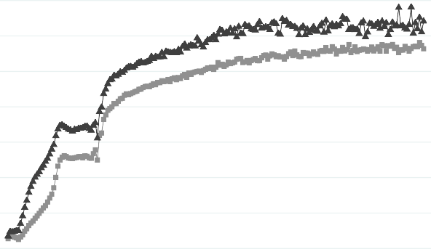
Data descriptives
Figure: Fraction of Donors by Income and Gender
Proportion of donors
.05 .1 .15 .2 .25 .3 .35
0
0
50
100 150
Total Gross Income (£'000s)
200
Men Women
Note: Calculations derived from HMRC’s administrative data sources

Slide 45

Data descriptives
Figure: Share of Income Donated, by Income and Gender
.015
Average Share of Income Donated (%)
.01
.005
0
0
50
100 150
Total Gross Income (£'000s)
200
Men Women
Note: Calculations derived from HMRC’s administrative data sources

Slide 46
Giving incentives and the future of Gift Aid
Matthew Bowcock, Philanthropy Collective
@CharityTaxGroup
#CTG2018

Slide 47
Giving incentives and the future of Gift Aid
David Hook, HMRC
@CharityTaxGroup
#CTG2018

Slide 48
Quadrangle Report
25% of donations did not have Gift Aid added to them where the donor was eligible
Contributing up to £0.56bn to the value of unclaimed Gift Aid.
8% of donations had Gift Aid incorrectly added to them by ineligible donors
Generating a Gift Aid tax gap of up to £0.18bn

Slide 49
HMRC’s Customer Research
Key Findings
The proportion of people donating to charitable causes has stagnated since 2014/15 but the socio-economic profile of donors is shifting towards ABC1s and higher-income households - donors are becoming more generous.
Levels of formal volunteering have stagnated since rising sharply between 2010/11 and 2012/13. With the employment market improving, people may have been less able to commit their time and energy to voluntary activities.
Companies are encouraging their employees to participate in charitable giving and volunteer work, which has been on the rise since 2012/13.
The charity sector has suffered from a recent succession of negative news stories. There were noticeable drops in the proportions of people donating through street and door-to-door collections between July 2014 and June 2016.

Slide 50
How Much Money People Donate
Mean amount of money people donated in the past 3 months, by gender and age, June 2016
"Now thinking specifically about the last 3 months, approximately how much money, in total, have you donated to charities? If you have not donated any money in the last 3 months please enter 0."
Official
4
Base: 1,064 internet users aged 16+ who stated how much money they have donated to charity in the last 3 months
Source: Lightspeed GMI/Mintel

Slide 51
Ways of Donating to Charities
Trends in ways of donating to charities, June 2016 and July 2014
"In which of the following ways, if any, have you donated money to charities in the last 12 months? Please select all that apply."
Base: 2,000 internet users aged 16+
Source: Lightspeed GMI/Mintel
Official
5

Slide 52
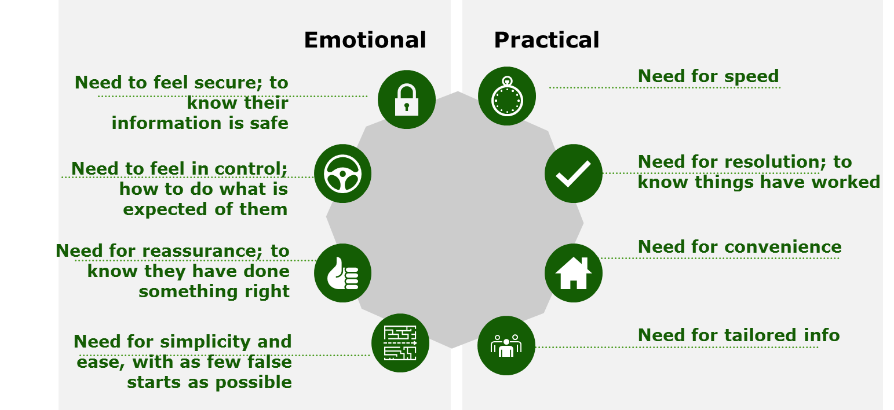
Communications and needs
    Previous research with HMRC customers has found that common needs inform their expectations, thoughts and concerns, especially when engaging with HMRC digitally.
    The following factors should be taken into account to encourage customers to switch to Personal Tax Account.
Source: Digital tax credits
6

Slide 53
SA Customers
Demographics
Donations Declared by Individuals Completing Self Assessment
Customer Intelligence and Behavioural Insights
3% of the total population declared themselves to be gift aid donors
Mean age: 57
Average total income: £43,000
85% filed SA online.
41% in SA with agent.
Employment and pension income were the most significant sources of income for donation.
Those aged 65 and over donated the largest share of total donations by value.
In general, men donated larger amounts than women.
There were a large number of lower value donations declared via the SA system (i.e. up to £500), but these donations comprised only a small proportion of the total value of all donations.
SA customers in general found the pre-populated information helpful. But they had some concerns on privacy, handling of incorrect information and the source of information.
Some behavioural levers can be used to encourage gift aid donors to use their online personal tax accounts and discourage them to contact HMRC by telephone.
7

Slide 54


13
11
Bootle
22 March 2018
I WON’T ASSUME A LEVEL OF KNOWLEDGE
Need to promote and educate
More information on forms
Set up workshops and fairs
Advertise more use YouTube?
GOING FORWARD
Members of Staff spoke face to face with
The lack of knowledge fundraisers had on Gift Aid
Customers
How does it work?
What is it?
How willing customers were to share experiences
How little charities passed onto the public
Customer
Do we need to promote it
What about our Service?
How do you claim?
I
M
S
I
O
M
E
r
n
Customers did not know Gift Aid is a HMRC scheme
Registering
Official
8

Slide 55




Customer Immersion – listening to our customers on 22nd March 2018 – What donors and charity volunteers said ……
Great confusion regarding Gift Aid – some clear & some not depending on personal experience.
Customers are time poor and don’t read guidance and when they do ……
Confused – too complex need to be simpler – Full of jargon
Just giving pages need to be simpler
Lack of info from charities – not sharing info
Donate to Charity

Slide 56



Customer Immersion – listening to our customers on 22nd March 2018 – What donors and charity volunteers said ……
Didn’t know HMRC responsible for administering Gift Aid
Government should use hard hitting factual figures in advertisements – billboards – radio –
Moneybox - how much are charities missing out on?
Not a good idea to ask donors for NINo – most don’t know it.
Don’t know where to go for help – Google first port of call

Slide 57

Customer Immersion –listening to ideas from our customers on 22nd March 2018 - What donors and charity volunteers said ……
Ideas – social media/radio –Moneybox – link to
national campaigns e.g. Children in Need,
Sport Relief – signs in Charity shop – HMRC
will give us a gift if you have paid UK tax.
Publicise on a bill board money lost
to charities
Demographics – what do young people
need to encourage giving?
Education – you tube – have a variety
depending on need
Have notices in charity shops – HMRC
will give 25p for every £1 you give to this
charity (add name). If you are a UK taxpayer
– sign up today.

Slide 58

Staff ideas to take forward following Customer Immersion session
I wont assume a
level of knowledge
Surprised how much
customers didn’t know
Promote and educate
Maybe think about
including more information on letters
/ pay advice notices.
Push for YouTube video
Advertise and reach out to
small charities - local radio
Set up workshops/workfares to
allow customers to talk about
their issues.
Better informed discussions
with charities and ministers

Slide 59
HMRC’s Customer Research
Recommended Next Steps
Simplify customer information on Gov.uk
Consider and use all appropriate mediums to raise awareness of GA rules with donors and small charities.
1. Keep it simple. 2. Tell me what to do. 3. Educate me - to a point

Slide 60
Q&A
@CharityTaxGroup
#CTG2018

Slide 61
CTG Tax Conference 2018
Robert Jenrick MP,
Exchequer Secretary to the Treasury
@CharityTaxGroup
#CTG2018

Slide 62
Lunch
@CharityTaxGroup
#CTG2018

Slide 63
CTG Tax Conference 2018
15 May 2018
@CharityTaxGroup
#CTG2018

Slide 64
VAT reform – review of the OTS report and implications of Brexit
@CharityTaxGroup
#CTG2018

Slide 65
Review of the OTS report
Graham Elliott, CTG Technical Adviser
@CharityTaxGroup
#CTG2018

Slide 66
European Commission review of VAT rates
John Hemming, CTG/Wellcome Trust
@CharityTaxGroup
#CTG2018

Slide 67
European Commission review of VAT rates - recap
April 2016: Commission publishes Action Plan on VAT
Includes proposals for reform of VAT rates
  Extension and regular review of the list of zero and reduced rates
  Abolition of the list of reduced and zero rates
CTG supported Option 2 and greater flexibility for Member States so long as existing charity reliefs were maintained
The voice of charities on Tax

Slide 68
European Commission review of VAT rates - recent developments
January 2018: Commission proposes that Member States can have:
  two separate reduced rates of between 5% and the standard rate chosen by Member State
  one exemption from VAT (or 'zero rate')
  one reduced rate set between 0% and the reduced rates
Current list of goods and services (Annex III) to be abolished and replaced by a negative list (Annex IIIa) to which reduced rates cannot be applied
Requirement for an overall average VAT rate of 12%
The voice of charities on Tax

Slide 69
European Commission review of VAT rates - recent developments
CTG, as member of ECCVAT, made representations to the European Parliament and the Commission. Key asks include:
  Recognising the specific position of charities to ensure they receive the benefit of reduced rates and zero rates
  Allow the deduction of input VAT in cases of non-taxable services and deliveries provided by charities and other public benefit organisations
  Current derogations and reduced rates to be protected and made available to charities and other public benefit organisations across Europe
  Introducing more regular reviews of the list of the excluded items in Annex IIIa
The voice of charities on Tax

Slide 70
European Commission review of VAT rates -
Next steps
May 2018: European Economic and Social Committee (EESC) to publish Opinion
June-October 2018: Amendments and vote on final report of European Parliament
Introduction subject to Council approval with unanimity required
NB Council not bound by European Parliament and EESC’s positions but only by the obligation to consult them
The voice of charities on Tax

Slide 71
Brexit – possible implications for the UK VAT system
Dermot Rafferty, EY
@CharityTaxGroup
#CTG2018

Slide 72
CTG Brexit research project
Brexit could present both threats and opportunities for charities in respect of VAT.
Important we can demonstrate rigorous economic analysis on the value of existing VAT reliefs & the benefit of new/expanded reliefs
New economic research project will help to inform the debate and enable CTG to develop pragmatic costed reform proposals
CTG raising grant funding from interested charity members
Economic consultancies/academics currently tendering proposals
Aim to publish report by early 2019
The voice of charities on Tax

Slide 73
Q&A
@CharityTaxGroup
#CTG2018

Slide 74
CTG Tax Conference 2018
15 May 2018
@CharityTaxGroup
#CTG2018

Slide 75
Business rates
@CharityTaxGroup
#CTG2018

Slide 76
Charity Tax Group Conference
Business Rates Update
Gerry Biddle Deloitte LLP
Property Taxes
Gerry Biddle 15 May 2018
Notes:
#[TitlePage]

Slide 77
Business Rates Current Issues
New Rating List from 1st April 2017 based on 1st April 2015 values
Previous list came into force on 1st April 2010 based on 2008 values
Long gap between revaluations caused unfairness as did not reflect differential changes in value over intervening period
Transitional relief scheme perpetuates this unfairness, increases and reductions on revaluation phased in over a number of years
To deal with this chancellor announced in March Budget statement that next revaluation to be brought forward to 2021 with 2019 valuation date
Thereafter move to 3 year revaluations with valuation date likely to be 1 year before
Scotland had already announced move to 3 year revaluations with valuation date 1 year before, following recommendation of Barclay review
In England proposal to move to self assessment in consultation document has been mothballed

Slide 78
Business Rates Current Issues
In England new appeals system introduced known as check challenge appeal, this system not applied in Scotland and Wales
Causing significant problems, appeals have to be submitted via the government gateway, the software is slow and cumbersome and is causing ratepayers and their agents great difficulties in submitting appeals.
Great deal of dissatisfaction with this system
Government has brought forward legislation to reverse the Supreme Court decision in Mazars v Woolway (VO). This decision caused the VOA to separately assess parts of buildings in the same occupation which had previously been in one assessment. It gave rise to significant increases in assessments and for small occupiers the loss of small business relief. It was dubbed the “Staircase Tax”. Legislation currently on its way through Parliament.
The question of the unit of assessment has been an ongoing issue with the VOA – currently seeking to separately assess 33,000 cash machines and there is ongoing litigation grinding through the courts

Slide 79
Business Rates Current Issues
The government brought in 50% rates retention by Local authorities in 2013 and they have just announced that this will move to 75% in 2020. As a result they are taking much more interest in the rating list entries
Barclay review in Scotland made recommendations, some of which have been accepted by the Minister, too many to set out here, already mentioned more frequent revaluations, reducing tax avoidance by closing off specific tactics. Further consideration of recommendation to remove charity relief from independent schools.
Wales has released a consultation document on “Tackling avoidance of Non-Domestic Rates in Wales” – refers to “dormant or false charities owning or leasing premises that are unsuitable for their needs and benefitting from charitable relief; disingenuous use of the relief provided when a property next in use will be wholly or mainly for charitable purposes.” proposal to publish lists of properties benefiting from mandatory or discretionary relief (Barclay review recommendation)

Slide 80
Business Rates Charitable Relief
Mandatory 80% relief, discretionary relief also available
Ratepayer a charity and property used wholly or mainly for charitable purposes. Registration with Charity Commission is conclusive, no further proof needed. Must be able to demonstrate that the charity is the rateable occupier.
Rate Mitigation Schemes and Charities: vacant property, 3 months void period before empty rates payable, then lease to “charity” to trigger 80% relief. Significant amount of litigation on these schemes. If scheme fails following court action (found to be a “sham”) trustees could be liable for empty rates
Guidance note issued by Charities Commission, Trustees must:
Be assured tenancy is for exclusive benefit of charity, will further its purpose and is in its best interest
Ensure property is genuinely required and fit for purpose
Consider potential rates liability exposure
Safeguard charity’s independence and ensure charity is not being abused for benefit of commercial company
Take professional advice

Slide 81
Business Rates Current Issues
Hughes (VO) v York Museum and Gallery Trust (May 2017) Upper Tribunal decision was not appealed by the VOA
Unit of assessment was an issue – whether parts of site were in occupation of separate trading company that operated cafes and shops or were in the occupation of the trust for their purposes. Also whether an events venue (the Hospitium) was occupied for a different purpose to the Museum and should be separately assessed.
Method of valuation was also contested, traditionally museums and art Galleries have been valued on a Contractors Test basis, using estimated cost of construction with allowances for age and obsolescence. It was contended that a receipts and expenditure (R&E) basis should be used, derived from their accounts but using estimated receipts for those parts that did not charge for entry
Contractors test rejected as “unattractively detached from reality” tribunal said that the fact that the R&E method suggests a nil or nominal value is not a reason for rejecting it and resorting to a Contractors Test basis
The decision referred back to the Court of Appeal decision in Hoare v National Trust (1999) – only likely bidder was NT which would not have paid a rent. RV £1 for two historic houses

Slide 82
Business Rates Current Issues: Hughes (VO) v York Museum and Gallery Trust
York art Gallery (purpose built 1879) did not charge for admission Tribunal estimated receipts if an admission charge levied, added receipts from shop and café (included in main assessment) and carried out a receipts based valuation RV £70,000
Upper tribunal determined £1 RV for the Yorkshire Museum (purpose built 19th Century Museum) which charged for admission but made an operating loss
The Castle museum also charged for admission and the upper Tribunal’s determination included income from café and shop (they were included with main assessment) valuation of £183,000 RV on a receipts based valuation.
Wholly owned non-charitable company ran gift shops and cafes and had no leases or other property rights over them. All profits paid to trust, had same Directors, trust employed all staff but fully recharged operating company. All stock belonged to Opco; separate tills. Trust had free run of whole space

Slide 83
Business Rates Current Issues: : Hughes (VO) v York Museum and Gallery Trust
BUT the Yorkshire Museum shop was deemed to be in the separate occupation of the trading company and a separate assessment was placed on it.
Why was this treated differently? Reasons given:
Space occupied can be readily identified and company in exclusive occupation, the location was fixed and there is no practical possibility of the trust requiring that it be relocated.
It was possible to envisage a separate letting of that area.
Moral of this is that where catering and shops operated by a separate operating company must ensure that the area is fully integrated with charitable occupation so that impossible to envisage separate letting of that area.

Slide 84
Q&A
@CharityTaxGroup
#CTG2018

Slide 85
CTG Tax Conference 2018 – Topical VAT developments
15 May 2018
@CharityTaxGroup
#CTG2018

Slide 86
HMRC grants and contracts guidance
Graham Elliott, CTG VAT Adviser
@CharityTaxGroup @VATDaddy
#CTG2018

Slide 87
HMRC Guidance on VAT and funding from certain bodies
This is also known as ‘grants versus contracts’, or ‘grants versus consideration’
Late January 2018 HMRC published many pages of new guidance
We had been expecting it for around 2 years
We had seen an advanced draft, and made some comments, but CTG did not draft it, or any part of it
The voice of charities on Tax

Slide 88
Why was this done?
HMRC guidance had been very limited and did not appear to endorse any of the usual ‘tools’ that assist us in analysing the position
This omission left HMRC inspectors struggling to draw conclusions or explain their decisions
Charities often lacked confidence in any view they had of the funding, and sought professional advice frequently
Advisers struggled to draw concrete conclusions and were tempted to ‘sit on the fence’
Charities were at risk of applying nuanced principles to a wide range of funding scenarios which were not necessarily sufficiently similar to be treated the same

Slide 89
That was then – This is now…
But has the position changed, or are we in a different kind of fog?
We think there is a meaningful improvement, but not a magic bullet
Benefits:
A charity can refer to a common resource with the inspector
The inspector has to have regard to that resource
It educates inspectors and forces them not to rely on ‘gut feel’
A charity can take a view on a more risk-calibrated basis
Advisers can show a client why they take the view they do
For the most part, HMRC guidance is consistent with professional opinion

Slide 90
Status of Guidance
This is not new law – EU legal principles continue to apply
The guidance is not a decision tree which is binding on HMRC – as with all manual guidance it does not actually bind HMRC, though they tend to acknowledge an obligation
It’s not possible to reduce the subject to black/white principles, so a significant element of grey, nuanced, and ‘on balance’ conclusions will arise – The answer ‘It depends…’ will continue to be a popular one

Slide 91
Layout of Guidance
Consists of ten pages of intro and analysis, and twelve of case commentaries.
Starts with general principles and moves towards more detailed points of interpretation.
Requires the reader to ‘stand back’ and consider all of the issues, so cannot be used as an automated decision tool.
Also tells us what to ignore which might mislead us

Slide 92
Anything missing?
We are concerned by a lack of reference to funding by Foundations (business sponsorship is covered by VATSC09000 and the Notice, but might have been worth including in the same general section)
It is focussed seemingly entirely on public body funding
Despite this, specific policies relating to DfID are not covered and there appears not to be any DfID related material in the manuals, despite there being indications that there is an agreement between DfID and HMRC
Something substantive on Collaborational work between non-profits would have been good (based on university research guidance)
Nothing on ‘conduit funding’ (whether recipient is charging to manage funding or receives a grant)

Slide 93
Some key criteria emerge
What the documentation ‘calls’ a payment (its nomenclature) is not always accurate – you need to look to the underlying facts
It is only consideration where the payment is for a supply to the funder or to parties the funder pays for – not for a general good…
Where a public body makes payment from a fund which is not designated as one from which grants can be paid, it won’t be a grant
Where the payment arises from a formal procurement exercise by a public body, this will usually be for services to the funder
(Note, these last two aspects aren’t simple. How do you know the funding pot, and what if it’s paid from both pots? Is the formal procurement realistically valid as a competitive exercise?)

Slide 94
The confusing page? - VATSC51640 #1
“For a transaction to fall within the scope of VAT there must always be a supply, a consideration and a direct link between the two. A payment is not consideration for a supply if one of these factors is missing.
The following points will help in deciding whether a payment is consideration for a supply for VAT purposes:
Does the grantor receive anything in return for the payment?
Are there any conditions attached to the payment that go beyond merely having to mention it in account statements?” (cont.)

Slide 95
The confusing page? - VATSC51640 #2
“What will the payments be used for?
If the funder does not benefit directly, does any third party receive a benefit?
Is there a contract and what are the terms and conditions?”

Slide 96
Subsidy? #1
“Type 2 – directly linked to the price of a supply
A subsidy forms part of the taxable consideration received by the supplier if it is directly linked to reducing the price to the customer. This is the case when a payment
is paid to the producer, supplier or provider of goods or services;
is paid by a third party to the supplier, and;
constitutes consideration or part of the consideration for a supply of goods or services”
AND

Slide 97
Subsidy? #2
“Indicators that the payment is this type of subsidy are:
the payment must be paid in return for specific goods and/or services
the payment has a direct effect on price or quantity in that the goods or services could not be provided at that price unless there was a subsidy
the funder is specifically seeking to promote the supply of the particular goods or services
there is an arithmetical relationship between a progression of the amount of the payment, the quantity produced and progression of the actual price of the goods or services provided
the price of the goods or services is ascertainable and determined not later than the time of the payment to demonstrate the consumer benefitted from a particular amount being paid”

Slide 98
Indicators of a supply within the scope
“All factors need to be considered, the more there are from each section the greater the evidence for a decision. However, it is not simply a matter of ‘indicators for’ exceeding ‘indicators against’, a balanced view needs to be formed taking all the applicable indicators into account. You must consider the economic reality not just the contractual terms.
The principal factor to consider is if a specific supply is made to the funder or a third party in return for a payment. If so then the payment is consideration for a supply, but if this direct link is not established then the payment can be treated as outside the scope of VAT.”

Slide 99
Indicators – outside scope #1
“the payment was made following a grant application process run by an organisation that regularly provides outside the scope grants, such as central or local government
are the funders the beneficiaries of the project? To be outside the scope of VAT a grant should be freely given. In using the payment, the supplier carries out its own charitable aims and objectives with the assistance of the money which is given with no expectation of direct benefit in return” (cont.)

Slide 100
Indicators – outside scope #2
“the funder will not attempt to control how the money is spent beyond seeing that the funds are properly managed. Any monitoring is no more than simply ensuring the payments are appropriately spent
the supplier will set its own targets as opposed to the funder imposing specific targets
the payments are not treated as trading income or expenditure in the accounts of either party” (cont.)

Slide 101
Indicators – outside scope #3
“if the funding is withdrawn there is no legal redress for the supplier to have the payment reinstated
funding is drawn down by the supplier as a reimbursement of expenditure incurred, rather than an advance payment for services. Alternatively, there may be a ‘deficit funding’ arrangement whereby the funder agrees to plug any funding gaps” (cont.)

Slide 102
Indicators – outside scope #4
“the funding is provided under a statutory provision that empowers the funder to make a grant. This would be mainly relevant if the funder is a Government department or local authority
there is a ‘clawback’ provision within the agreement. Funders use this method to reclaim their funding in circumstances such as where not all the money was spent or if the terms of the agreement were not complied with. In contrast, a contract for a supply should not contain a ‘clawback’ clause as there is no automatic right to reclaim any money. The money is consideration for the supply and the solution for reclaiming the payment in any subsequent breach of contract is to sue for damages”

Slide 103
Indicators – in scope #1
“who initiates the agreement? If the funder is seeking services in return for their payment then this indicates the payment is consideration for supplies made to them if the funder is the direct beneficiary of the supplies. The funder believes they are receiving something in return for the payment.
the supplier undertakes outsourced activities on behalf of the funder where the services provided are ones ordinarily provided by the funder so the supplier is acting as a subcontractor. Examples include the provision of functions ordinarily undertaken by local authorities that they have a statutory duty to perform and would face sanctions if they did not happen” (cont.)

Slide 104
Indicators – in scope #2
“the contract is commercial in nature ie it is a legally binding contract connected to a business activity. This means looking for indicators such as penalty clauses being in place if the supplier does not fulfil their responsibilities and so is in breach of contract
the supplies are undertaken as an economic activity. It is not necessary for the supplier to have a profit motive, but the type of supplies should have the potential to make a profit” (cont.)

Slide 105
Indicators – in scope #3
“the relationship between the funder and supplier will be at ‘arms length’ and there will be an absence of control from the funder in the supplier’s decision making process
the payments made by the funder to the supplier are made specifically for the supplier to provide particular services to its clients. The fact that the funder does not know at the time the service is provided the identity of the client or the even the specific service which is being provided is not relevant
each activity carried out by the funder gives rise to a specific and identifiable payment. This is an agreed sum, either a single payment or a sum per activity ie the more work done, the greater the payment. For this to happen there is probably a detailed recording system for timekeeping, outputs achieved etc” (cont.)

Slide 106
Indicators – in scope #4
“the funder will attempt to control how the money is spent, maybe imposing specific targets in terms of quantity, quality, timeframes etc. Any monitoring is more than simply ensuring the payments are spent properly and is to ensure that specific supplies are made
if the funding is withdrawn there is legal redress for the supplier to have the payment reinstated or claim compensation
the payments are treated as trading income or expenditure in the accounts of either party”

Slide 107
Neutral Factors #1
“the payment is described as a grant in the contract and correspondence. Whilst the wording of a contract is important, what the payment is called does not determine its VAT treatment
the level of detail within the contract/agreement does not point in either direction, ie it is wrong to say that the more detail there is, the more likely there is a contract for a supply the supplier is obliged to provide reports and information to the funder. This is not an indicator either way as a condition in the agreement to report on how the payments are used will be required either to confirm supplies were made or in a grant situation act as good housekeeping to ensure the money is spent for its intended purpose” (cont.)

Slide 108
Neutral Factors #2
“the supplier’s activities and the number of projects undertaken are influenced by the payment ie they would be significantly curtailed in the event of a withdrawal or reduction in funding. Although this could indicate there was a supply made to the funder, you must still look at whether a supply is actually made to them, as a withdrawal of a grant may equally mean a reduction in service provision”

Slide 109
Case law section
Seems almost a random layout – no discernible ‘journey’
Starts with some very old and probably dubious decisions relating to advice to the community – Wolverhampton; Hillingdon – are these still valid
Healthwatch Hampshire excluded. Why?
Not clear how easy some of the very long commentary will be to get to grips with

Slide 110
Summary view
Welcome addition to guidance, but could be made more easy for the charity user by being set out in a Notice
We understand that changes can be made by HMRC if convincing suggestions are made
These may plug the gaps in what appears to be guidance slanted towards public funding issues
Not all of the ‘tests’ appear convincing, but opinions will vary
Lacks an imaginative policy element, but perhaps that’s more than can be expected
Does not change the landscape very much which will reassure many
The proof of the pudding will be in the eating

Slide 111
Advertising
The scope of item 8
The ‘carve out’ of Note 10A
HMRC’s apparent view of the impact of 10A on some electronic advertising
What we can do about it
What to do in the meantime
The voice of charities on Tax

Slide 112
Case discussion
University of Cambridge – investment management fees input tax
Paragon – possible ramifications for printed mail packs
Harley Davidson – possible application to charitable membership schemes
Wakefield College – the last hurrah for non-business transactions?
The voice of charities on Tax

Slide 113
HMRC Policy on input tax following Sveda
Indications that HMRC continues to think charities are not covered by Sveda
The message from the Will Woodlands decision
Iberdrola – and the loose end the CJEU left dangling
The voice of charities on Tax

Slide 114
Q&A
@CharityTaxGroup
#CTG2018

Slide 115
CTG Tax Conference 2018
15 May 2018
@CharityTaxGroup
#CTG2018

